Slide 1
How did the Nazi government try to control young people?
In this lesson, we will:
Describe key features of Nazi youth groups
Assess to what extent they were successful
Starter: Watch this speech to the Hitler Youth in the 1930s. What is the purpose of this rally? Why would Hitler be very popular with the youth?

Slide 2
Nazi ideas on young people
All young Germans should be brought up to be proud Germans.
They should believe in all Nazi policies
They should see Hitler as a father figure
Boys should be brought up to be healthy and fight in the army.
Girls should be brought up to be healthy and have many children.

Slide 3
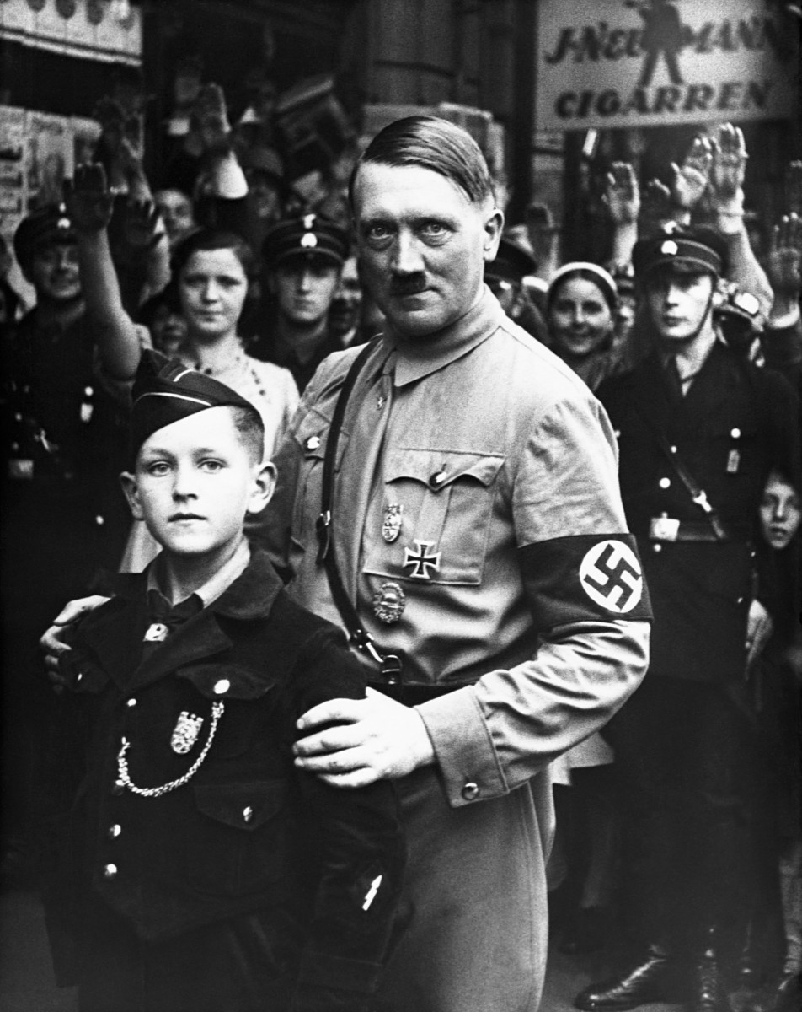
How did the Nazis aim to control young people?
In 1922, Hitler had set up the Hitler Youth for boys and the League of German Maidens for girls.
As Chancellor, Hitler banned all other youth groups in 1933.
In 1939, Hitler made it compulsory for all children over 10 to join one of the Nazi youth groups.
By 1939, over 8 million Germans were part of a Nazi youth group.

Slide 4
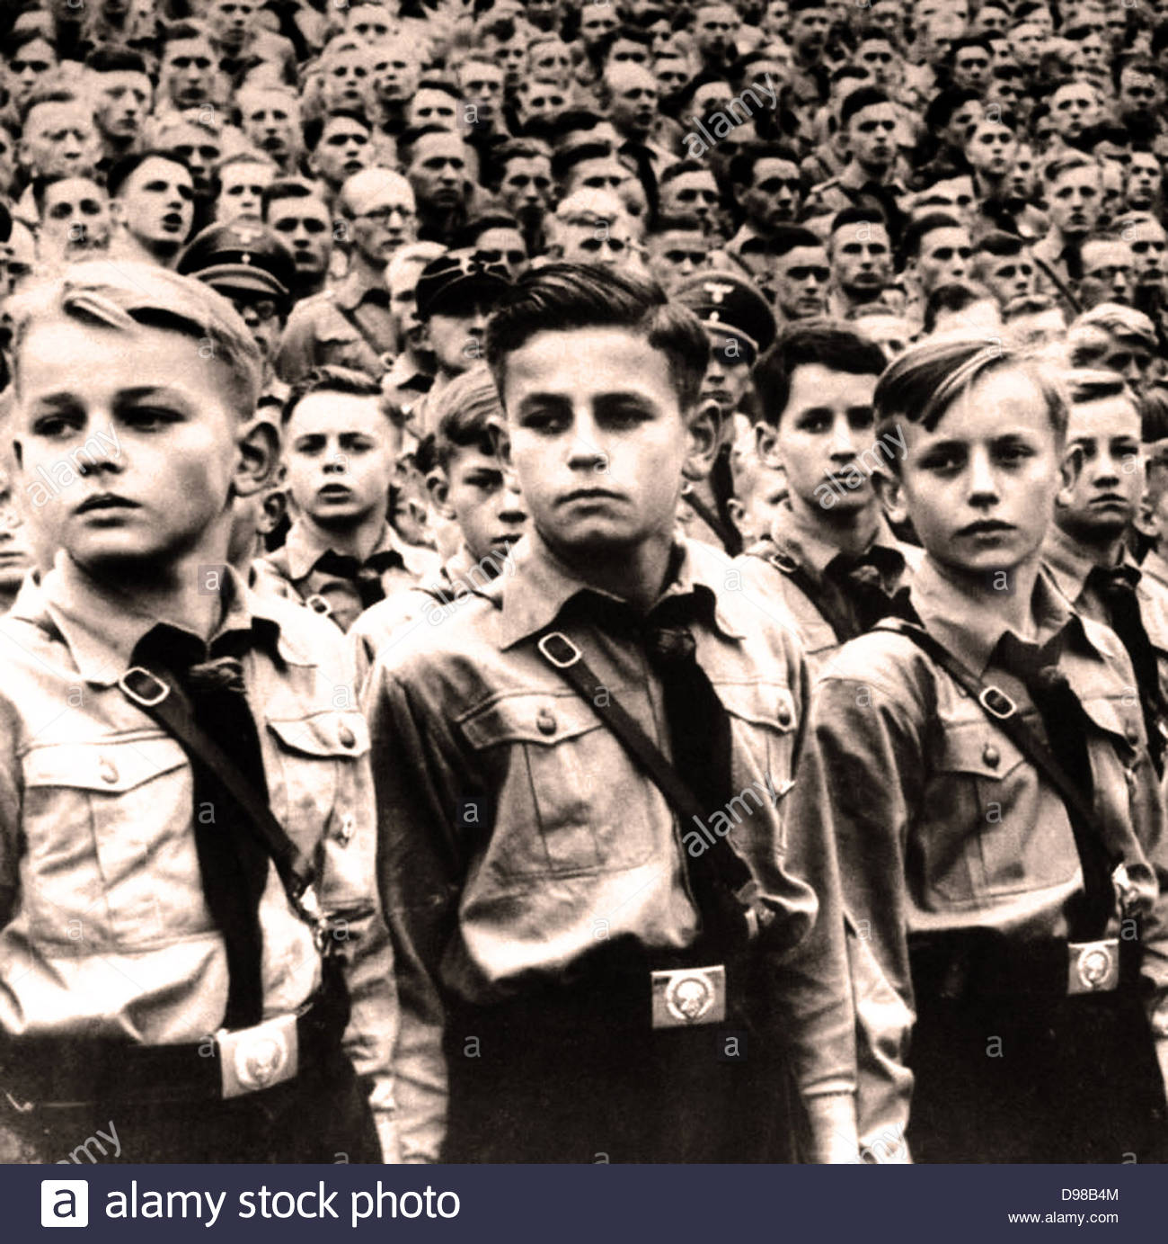
What would the ‘Hitler Youth’ do?
Swear an oath to Hitler.
Learn Nazi ideas
Report anyone who was disloyal to the Nazis (e.g. parents, teachers etc.)
Go camping and hiking
Attend sporting competitions
Learn to march and shoot a rifle
Develop camaraderie and loyalty
Toughen up (e.g. baths of ice water, training in tough weather etc.)

Slide 5
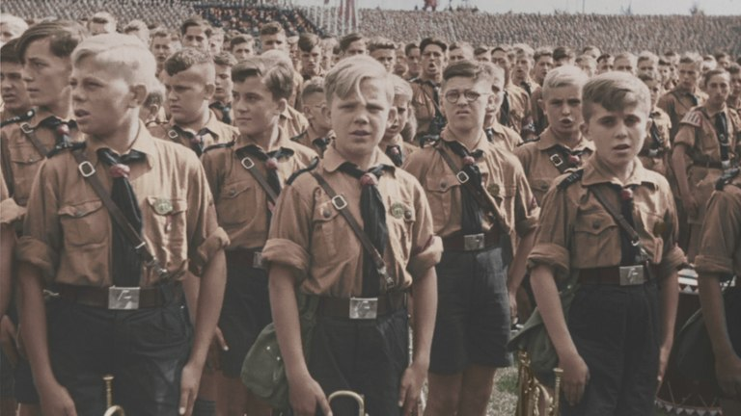

Slide 6
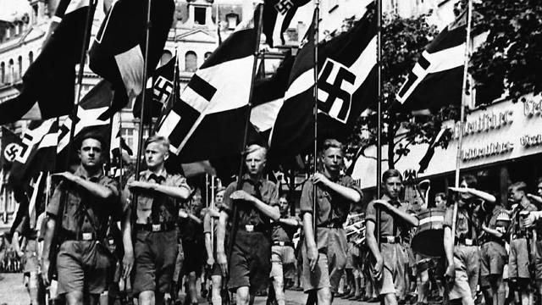

Slide 7
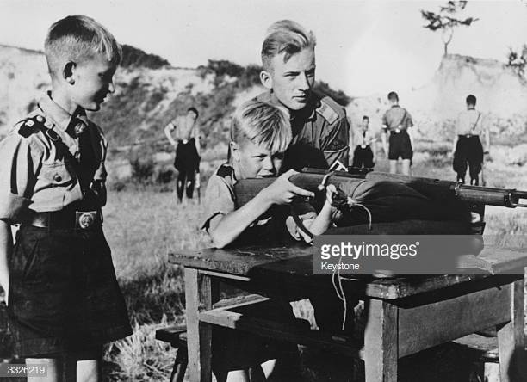

Slide 8
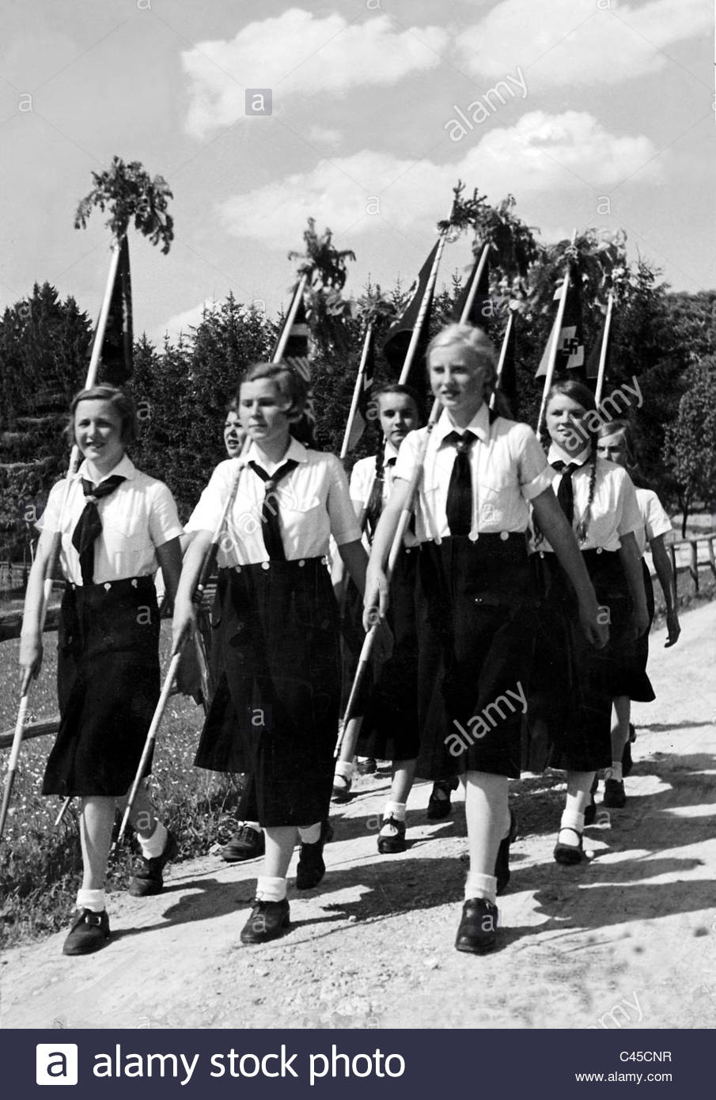
What would the ‘League of German Maidens’ do?
Swear an oath to Hitler.
Learn Nazi ideas
Report anyone who was disloyal to the Nazis (e.g. parents, teachers etc.)
Go camping and hiking
Learn to cook, clean, sew, iron and make beds.
Learn ‘racial hygiene’ – i.e. pure and impure races, how to pick a good husband etc.

Slide 9
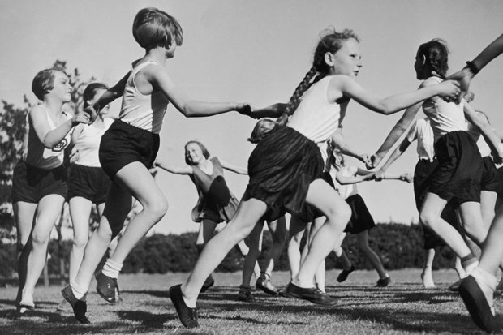

Slide 10
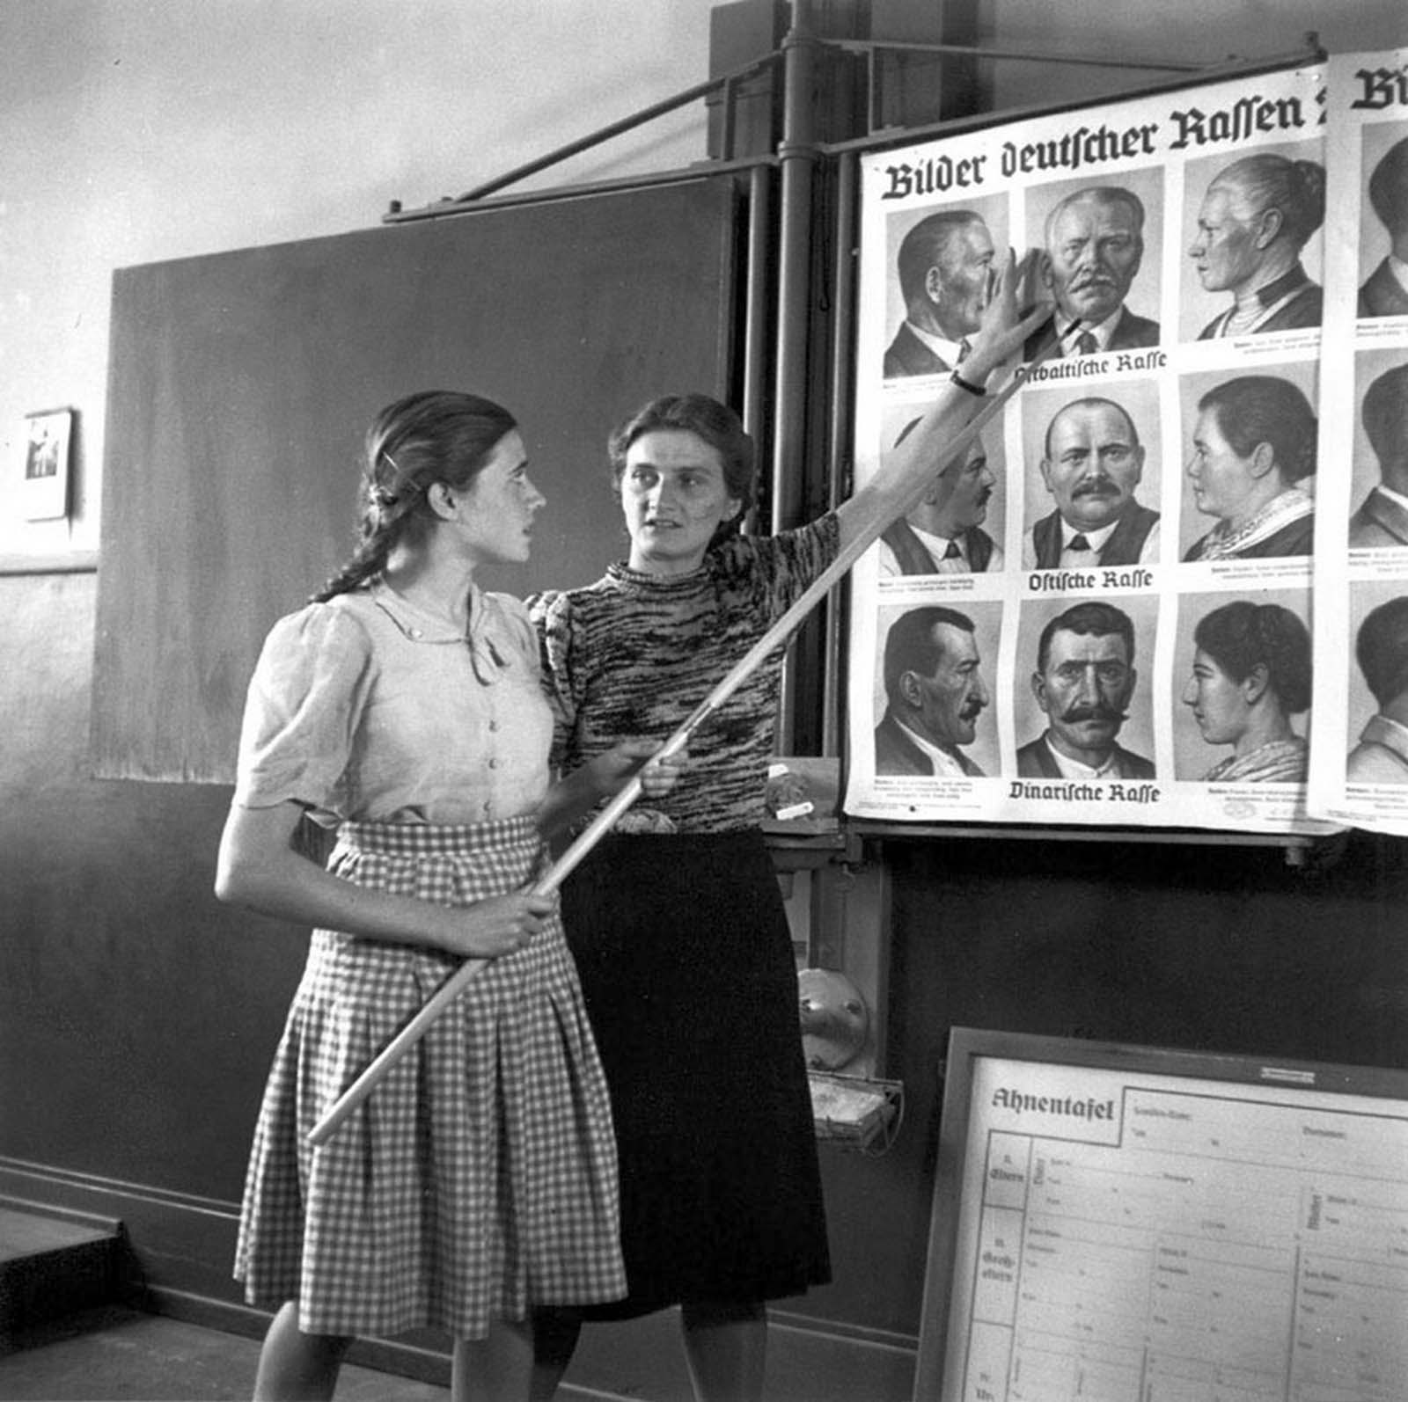

Slide 11
Learning Tasks
Targets 9-7
Read through each extract on the other sheet. For each:
What can you infer from this source about Nazi youth policies? (4)
Identify areas of each source that are useful for historians.
All targets
On your blank venn diagram.
Identify key features of the Hitler Youth
Identify key features of the League of German maidens.
In the middle, explain any similarities
Targets 6 – 4
Read through each extract on the other sheet. For each:
What can you infer from this source about Nazi youth policies? (4)
Targets 3-2
Read through each extract on the other sheet. What is the authors opinion on the Hitler Youth?

Slide 13
Klonne, describing his memories of the Hitler Youth in his book, Youth in the Third Reich, published in 1982.
What I liked about the Hitler Youth was the comradeship. I was full of enthusiasm. What boy isn’t fired by ideals such as comradeship, loyalty and honour and the trips off into the countryside and sport? Later... negative aspects became obvious. The compulsion and obedience were unpleasant. I preferred people to have a will of their own... In our troop, the activity was almost entirely boring military drill.

Slide 14
Henrik Metelmann was a member of the Hitler Youth in the 1930s. He wrote a book in 1980 explaining his experiences in Nazi Germany.
You felt you belonged to a great nation again. I was helping to build a strong Germany. But my father felt differently. He warned, “Henrik, don’t tell them what I am saying to you.” I argued with my father, because I was a great believer in the Hitler regime, which was against his background as a working man.

Slide 15
Paul Briscoe, an English boy was only six-years-old when he first saw the Hitler Youth marching through the streets of Miltenberg
The first Hitler Youth parade I saw electrified me. Seppl (his mother's boyfriend) lifted me onto his shoulders so I could watch it. Behind fluttering banners, rattling side-drums and blaring bugles, row after row of uniformed boys marched past with jutting chins and jaunty caps. I didn't think of them as boys; to me, they looked like gods. When Seppl told me that one day I might be one of them, I could hardly believe him - it seemed too good to be true.

Slide 16
Elsbeth Emmerich was recruited by her school
In High School, I became a member of the Jungmädel (Young Girls). We were all given the entry forms in class to fill in there and then, and told to take it home for our parents' signature.... I enjoyed being in the Jungmädel. We had to attend classes after school and learn about Adolf Hitler and his achievements. We did community work, singing to soldiers in hospitals and making little presents for them like bookmarks, or poems written out neatly. We also went on hikes and collected leaves and herbs for the war effort."

