Slide 1
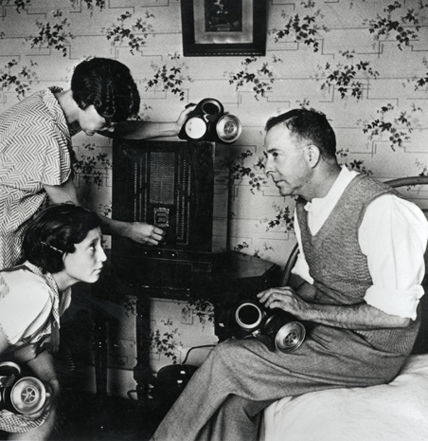
How did the Nazi government influence people at home and abroad?
In this lesson, we will:
Describe how the Nazis used different forms of entertainment to influence people.
Starter:
Under the Nazis, radios were mass produced and the prices lowered. By 1939 the Nazis made sure over 70% of German homes had a radio – but why?

Slide 2
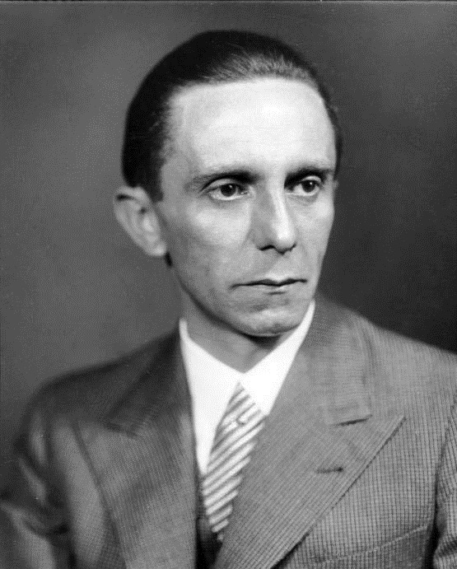
Who was Joseph Goebbels?
Obtained a PHd in Philosophy in 1921, joined the NSDAP in 1924.
Became a Gauleiter for Berlin in 1926.
In Berlin he became interested in the use of propaganda to spread Nazi ideas.
In 1933 he organised a parade of 60,000 men carrying torches to celebrate Hitler becoming Chancellor.
On 14th March 1934 Hitler appointed him to head of ‘Reich Ministry of Public Enlightenment and Propaganda”

Slide 3
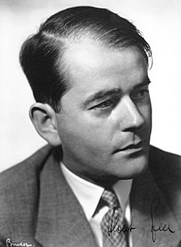
Who was Albert Speer?
Obtained a degree in architecture in 1927.
Joined the NSDAP in 1931.
In 1933 he was asked by Joseph Goebbels to renovate the party’s headquarters in Berlin.
Speer organised the Nuremberg Rally in 1933 which won him the admiration of Hitler.
As a reward Hitler appointed Speer to be “Commissioner for the Artistic and Technical Presentation of Rallies and Demonstrations.

Slide 4
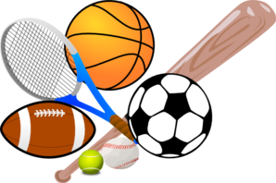
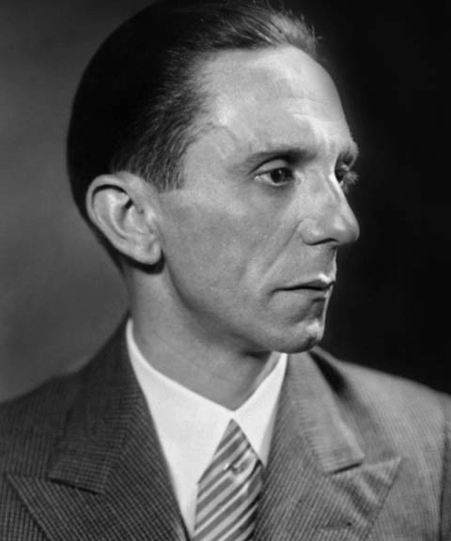
Sporting events
(Olympics and football)
Architecture
(Office buildings and stadiums)
Music
Art
(Paintings and sculptures)
What did Goebbels and Speer use to influence people?
Cinema
(Political recordings, cartoons and movies)

Slide 5
Learning Task One
Targets 9 – 6
Which Cabinet Minister was in charge of this area?
How did they use this to their advantage?
Do you think it would be successful in promoting an image of power to the world?
You will be assigned one of the following areas to research:
Sport
Art
Architecture
Music
Film
Spend 10 minutes reading up on your area, taking notes on the following (right)
Targets 5-4
What did the NSDAP do to control this area of society?
What were they hoping to achieve by doing this? (Think of the impact)
Targets 3-2
How did the Nazis use this? What was their opinion on this?

Slide 6
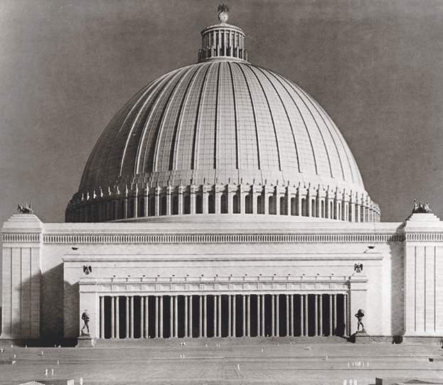
Huge buildings to give impression of power and permanence.
Heavily influenced by Ancient Rome and Ancient Greece.
Used domes, arches, pillars to look grand and historic.
Planned to rebuild all of Berlin and rename it ‘Germania’ At the centre would be the ‘Volkshalle’ – a monumental domed building.
It was to be the largest building in Europe– standing at 950ft tall. Due the to the breath of more than 100,000 people it would cause precipitation to fall back down (it would rain indoors)

Slide 7
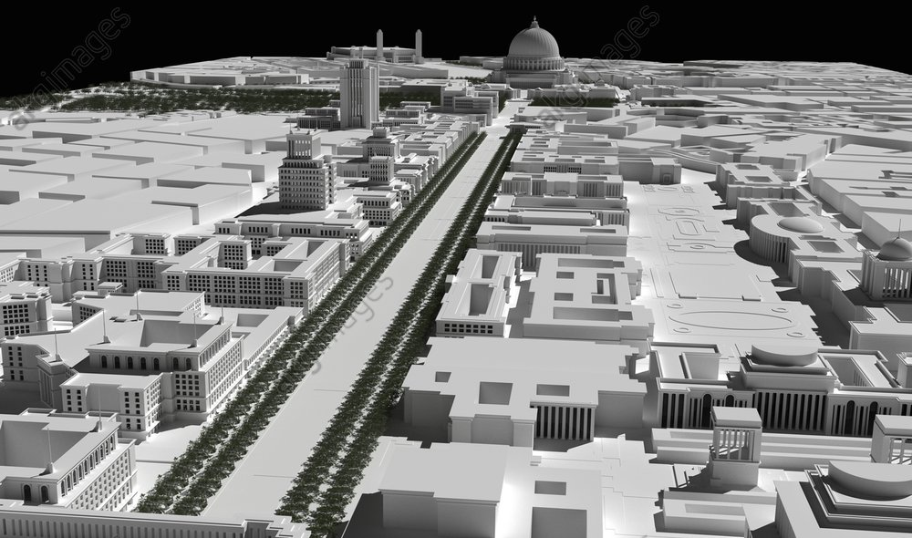

Slide 8
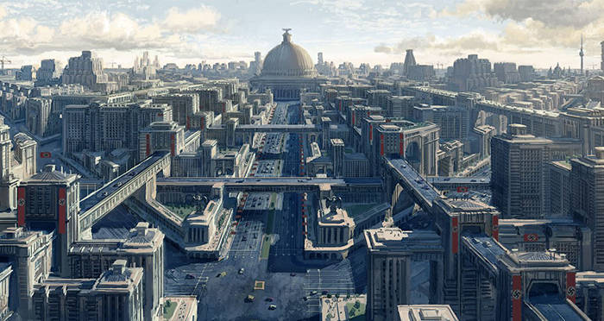

Slide 9
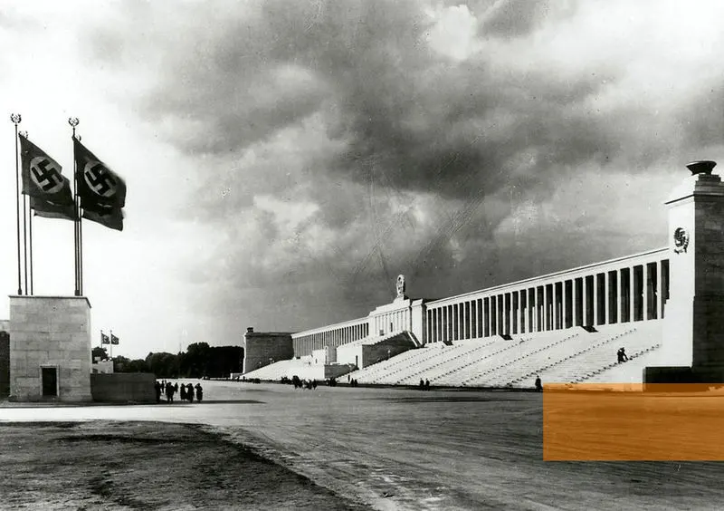
Stadium at Nuremberg, used to hold rallies

Slide 10
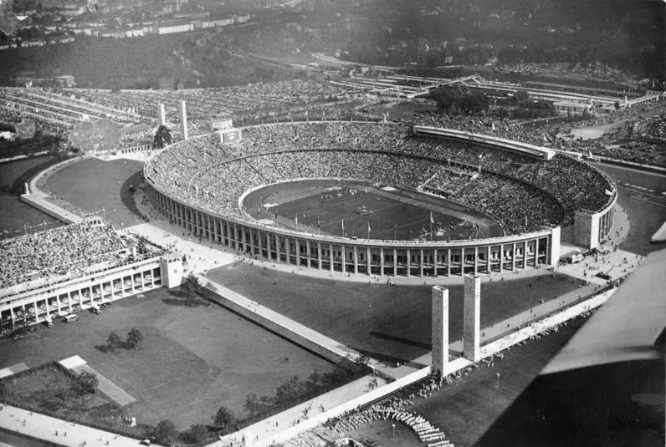
Olympic stadium, built in 1936.

Slide 11
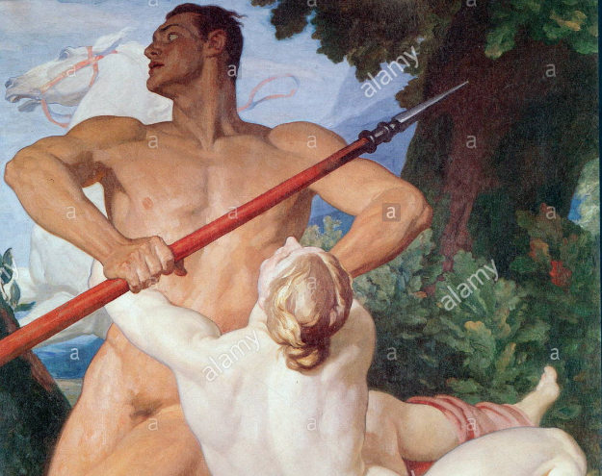
Rejected ‘decadent’ or ‘degenerate’ art of the 1920s.
Promoted art that showed Germany in a way the racial state demanded.
Classical art of the 15th -19th Centuries replaced ‘modern art’
All artists had to apply to be a member of the ‘Reich Chamber of Visual Arts’.
Over 12,000 paintings were removed from galleries.
Artists like Picacco, Cezanne and Van Gough were all banned.
New art was painted to promote an ‘Aryan’ view such as ‘Venus and Adonis’ by Arthur Kampf in 1939.

Slide 12
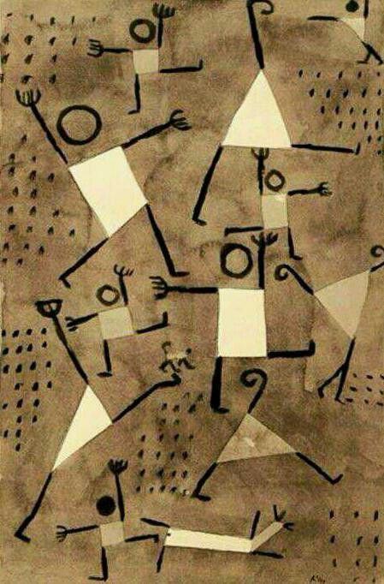
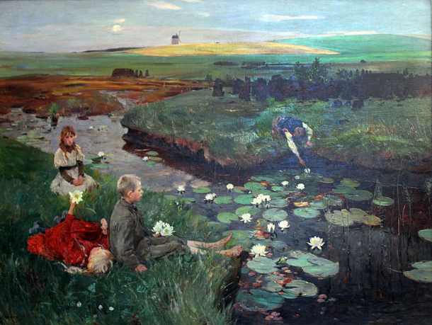
‘Dancing with Fear’, Paul Klee (1938)
‘Waterlillies’, Ludwig Dettman (1897)

Slide 13
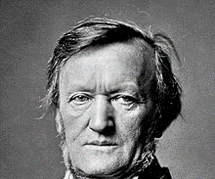
Jazz and blues were linked to African Americans, so was seen as ‘degenerate’
Any composers who were Jewish were seen as inferior.
Classical German composers were heavily promoted.
Hitler’s favourite composer was Richard Wagner.
To the Nazis, classic composers promoted the legends and heroes of Germany’s powerful past.
Other composers who were favoured were Beethoven and Bach.

Slide 14
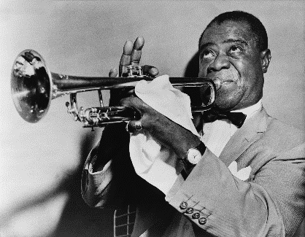
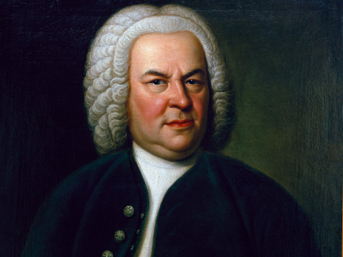
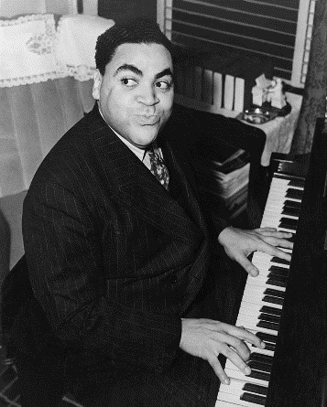
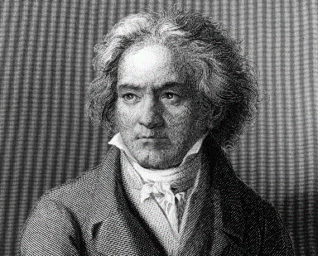

Slide 15
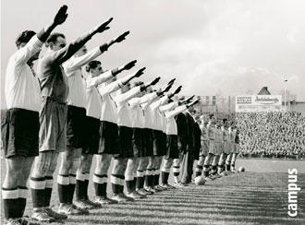
Sporting events could be used to show the world how much Germany had recovered under the Nazis.
It could be used to prove that Aryan athletes were the fittest and strongest which supported Nazi ideology.
Sporting events were always decorated with Nazi swastikas.
All teams visiting Germany had to perform the Nazi salute during the German national anthem.
Victories for German athletes were always linked to victories for the Nazi state.
“German sport has only one task: to strengthen the character of the German people”

Slide 16
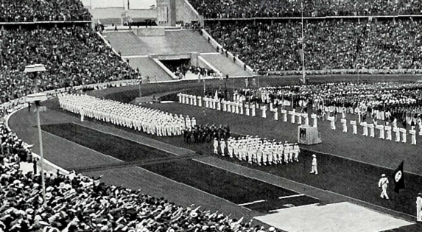
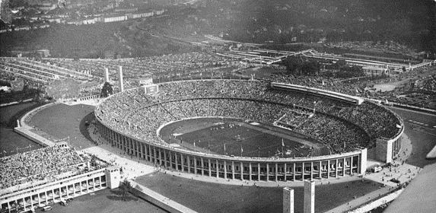
In 1931, Germany won the bid to host the 1936 Summer Olympics in Berlin.
As Chancellor, Hitler funded the building of an Olympic stadium – the largest in the world (over 110,000).
The games were used as propaganda – to show the world how strong the Nazi state was.
Germany won 33 medals, more than any other country. Goebbels hailed this as a success for Nazism.
The Nazis had the full event filmed and released as two propaganda movies.
https://www.youtube.com/watch?v=1dyns367ExE&bpctr=1560502651

Slide 17
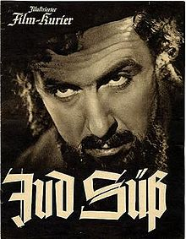
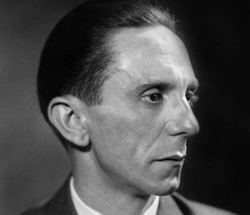
In 1933, cinema had a target audience of over 250 million people across Germany
Goebbels realised that film was a perfect tool to get political messages to the people.
All films in cinema had a 45 minute political message played before.
All directors and writers had to send scripts to Goebbels for approval.
The Nazi Party made over 1,300 films.
All Nazi films had political messages hidden in them.

Slide 18
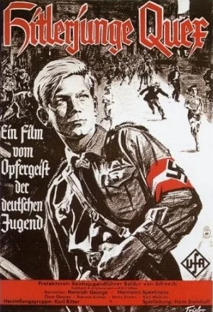
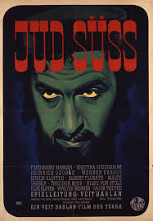
‘Hitlerjunge Quex’ (1933)
Story of a young member of the Nazi Party that is murdered by a Communist.
‘Jud Suss’ (1941)
Story of a Jewish adviser to the Duke of Wurttemberg who loans him money but in return rapes his daughter.

Slide 19
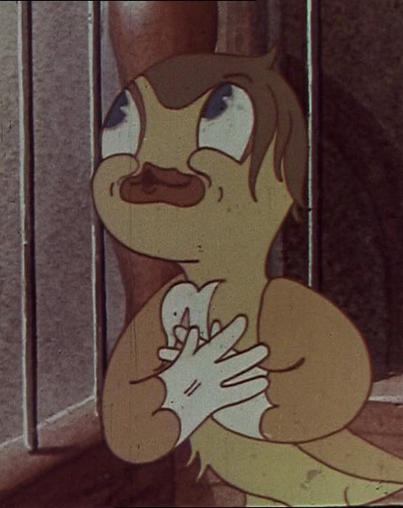
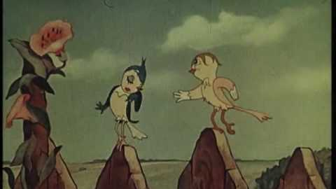
‘Hansi the Canary’ (1933)
Cartoon of a young canary (modelled on Hitler). He is constantly pestered by a very annoying and villainous black crow (modelled on Jews)

