Slide 1
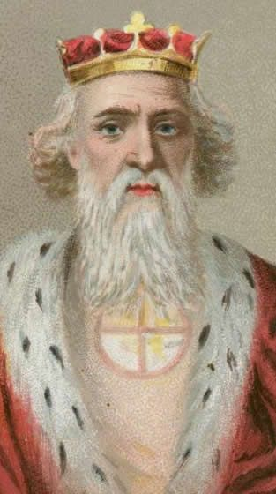
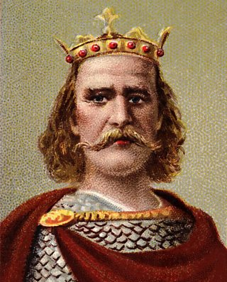
How did the Marcher Earldoms benefit King William?
In this lesson, we will:
Describe the key features of a Marcher earldom.
Explain how establishing these earldoms helped William govern England.
Starter: Edward the Confessor a number of problems facing him as king. Can you identify some of them?

Slide 2
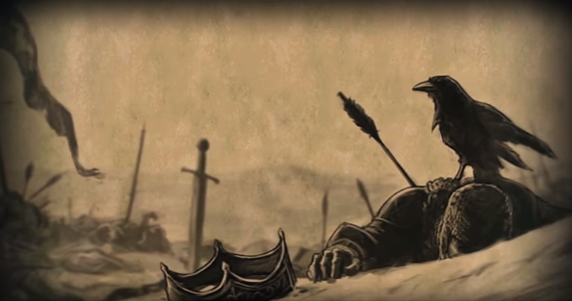
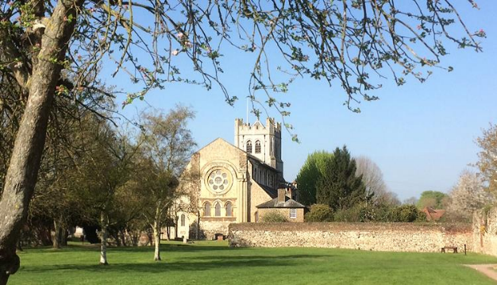
What happened after the Battle of Hastings?
Following his victory at Hastings, William expected the Saxon Witan to offer him the crown – they did not.
Instead, the Witan elected Edgar as their king. Earls Morcar and Edwin pledged their support.
William was so angry, that he refused to allow anyone to collect the Saxon bodies from the fields of Hastings.
William taunted to Harold’s mother: “Harold mounted guard on the coast while he was alive; he may continue his guard now he is dead”
Eventually William allowed Harold’s body to be collected, and buried at Waltham Abbey.

Slide 3
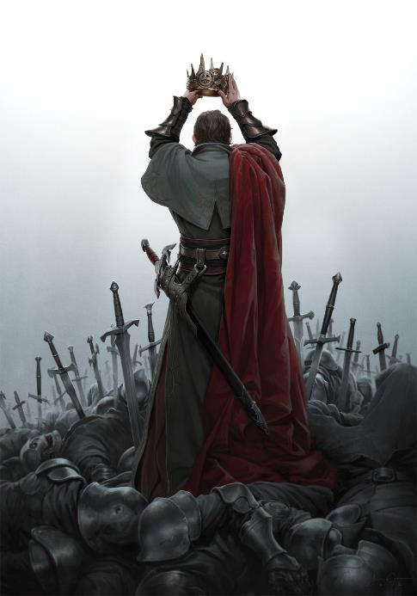
How did William become King?
The fragments of Saxon nobility waited in London and prepared to fight the Norman army.
William made moves to secure the south coast – he marched on Dover but he and his army became very ill from dysentery. They were very vulnerable.
William decided to force the Saxons into submission with a policy of devastation.
As his army marched, they destroyed homes and farms and slaughtered the peasant populations.
At Berkhamstead, he met with Edgar and the Saxon nobles. They surrendered to him, gave him homage and handed over hostages.
On Christmas Day, 1066, William was crowned ‘King William I of England’.

Slide 4
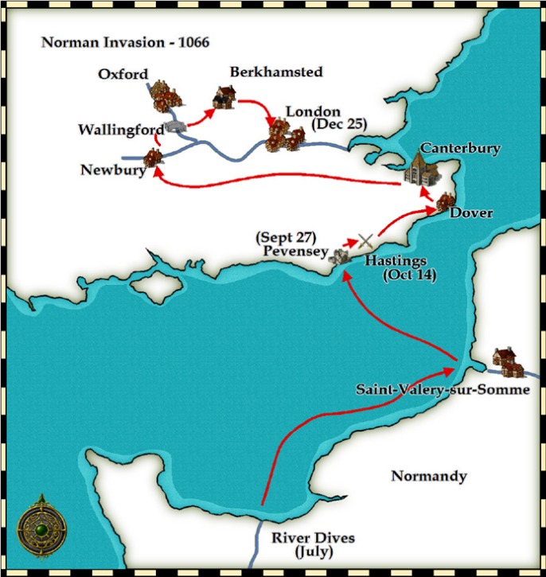
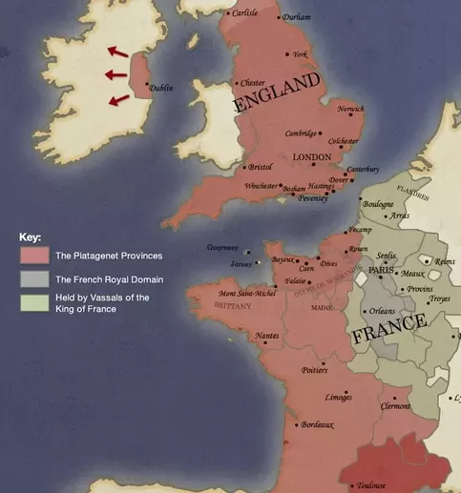

Slide 5
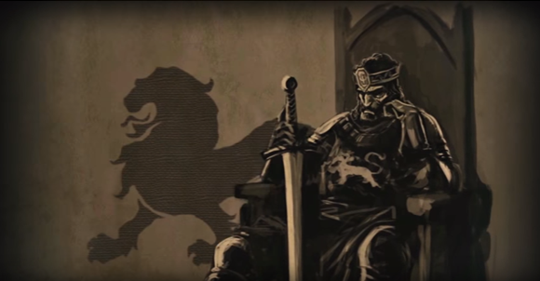
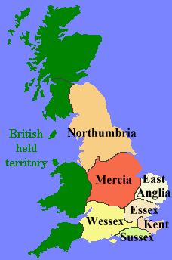
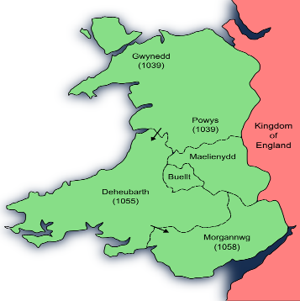
What problems faced William by January 1067?
William had promised many of his supporters land in England for helping him conquer in 1066 (e.g. Bishop Odo, William Fitzobern, Hugh D’Avranches, Roger de Montgomery etc.)
He had promised to reward the Church for blessing his invasion in 1066.
He needed to secure the Anglo-Welsh border, to prevent raids.
He needed to reduce the size and power of Northumbria and Mercia.
He needed to encourage as many Norman lords to migrate to England and settle (specifically on the border)

Slide 6
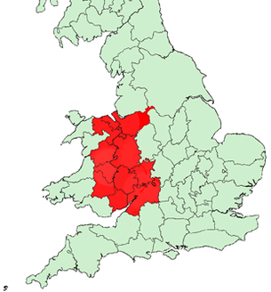
Chester
Hugh D’Avranches made earl because his father gave William 60 ships for the invasion.
Shrewsbury
Roger de Montgomery made Earl because he had governed Normandy whilst William fought at Hastings.
Hereford
William FitzOsbern made earl because he was helped William during the invasion (helped build early Motte & Bailey castles)

Slide 7
Learning Task One
Old Anglo-Saxon Earldoms | Marcher Earldoms (Border Earldoms) | How this benefitted King William
They were usually large areas containing several shires
The King was the only person who could create boroughs, markets and establish Churches
Shire Reeves were the king’s officers.
To build a castle, landholders had to apply to the king.
Earls pay the King taxes on their lands

Slide 8
Anglo-Saxon Earldoms | Marcher Earldoms (Border Earldoms) | Reason for this change
They were usually large areas containing several shires | They were smaller and more compact | Made them easier to control and that Earls were not as powerful as the king.
The King was the only person who could create boroughs, markets and establish Churches | The earls now had the rights that only the king had: to create boroughs and markets, to establish Churches etc. | Helped earls to attract people from Normandy to come and settle the frontier (colonisation) as it gave them more power.
Shire Reeves were the king’s officers. | Sheriff worked with the earls which gave them much more power than Saxon earls. | Gave them more power to ensure loyalty to the crown.
To build a castle, landholders had to apply to the king. | Marcher earls could build castles whenever or wherever they wanted. | Helped control the area and secure the border against the Welsh.
Earls pay the King taxes on their lands | Earls didn’t have to pay tax on these lands. | Reward their loyalty. Encourage the earls to spend their money on defences.

Slide 9
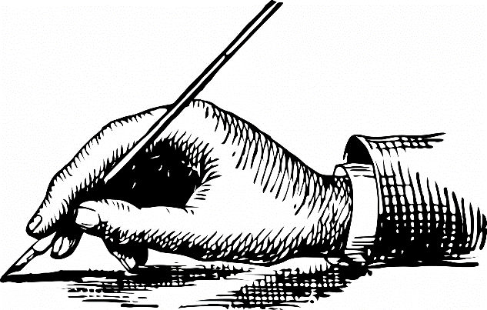
Learning Task Two
For each problem below, write down how the Marcher Earldoms helped solve it!
William had to reward followers.
He needed to secure the Anglo-Welsh border.
He needed to reduce the size and power of Northumbria and Mercia.
He needed to encourage as many Norman lords to migrate to England and settle.

