Slide 1
How did the forest laws benefit King William?
In this lesson, we will:
Explain the impact of the Forest Laws on King William and English peasants.
Starter: Thunk of the day. If King William was an animal; what animal would he be? Justify your answer!

Slide 2
What do we mean by ‘forests’?
Much like other noblemen of that period, King William loved to hunt. In England, William was free to hunt on the demesne (the king’s land).
Between 1066 and 1088, William extended the size of official crown land (demsene increased to 18% of all England)
He turned new areas of land into ‘forests’ – areas of land used only for hunting.
Many Anglo-Saxons, Normans and the Church lost land to make ways for these new ‘forests’.
Whole areas, like New Forest, were converted into forests causing thousands to lose their land and homes.

Slide 3
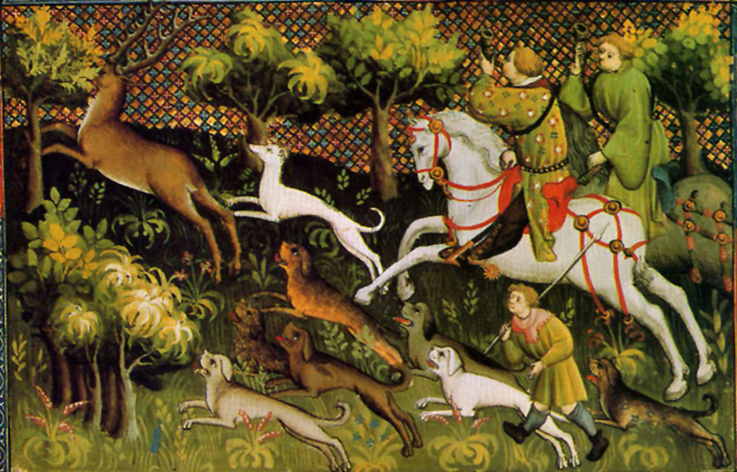
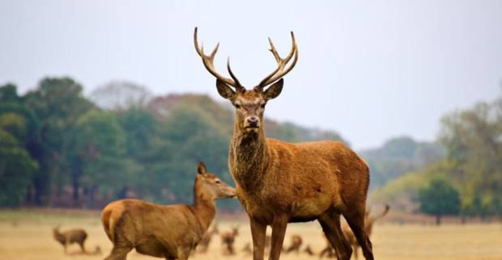
What was so different about Forest Laws?
Laws protected animals that were best to hunt (deer and wild boar). Vegetation was also protected.
Poaching was a criminal offence.
Hunting weapons, hunting dogs, cutting wood, clearing land and building were all banned.
Anyone caught breaking these laws would be fined.
Anyone who wanted to hunt on this land had to pay the crown.
A small amount of people were blinded for breaking these laws.

Slide 4
How did these new laws make William more powerful?
It was symbolic of William’s power being above everything else.
Increased the amount of land he controlled.
Showed that he had the power to simply steal land from anyone he wanted.
The harsh punishments used showed his subjects how powerful he was.
Forest areas became another source of income for the crown (fines and rights to hunt being sold)

Slide 5
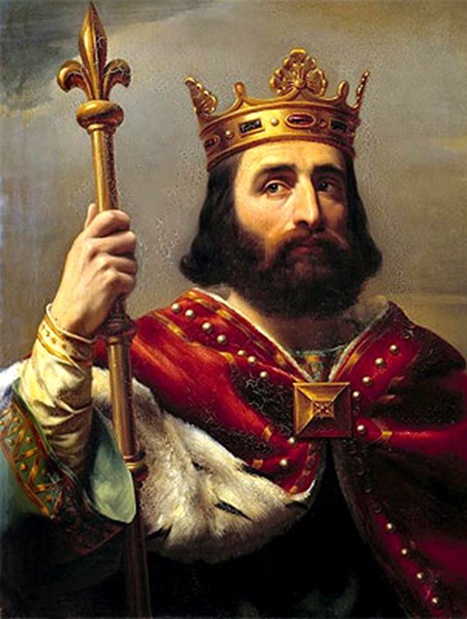
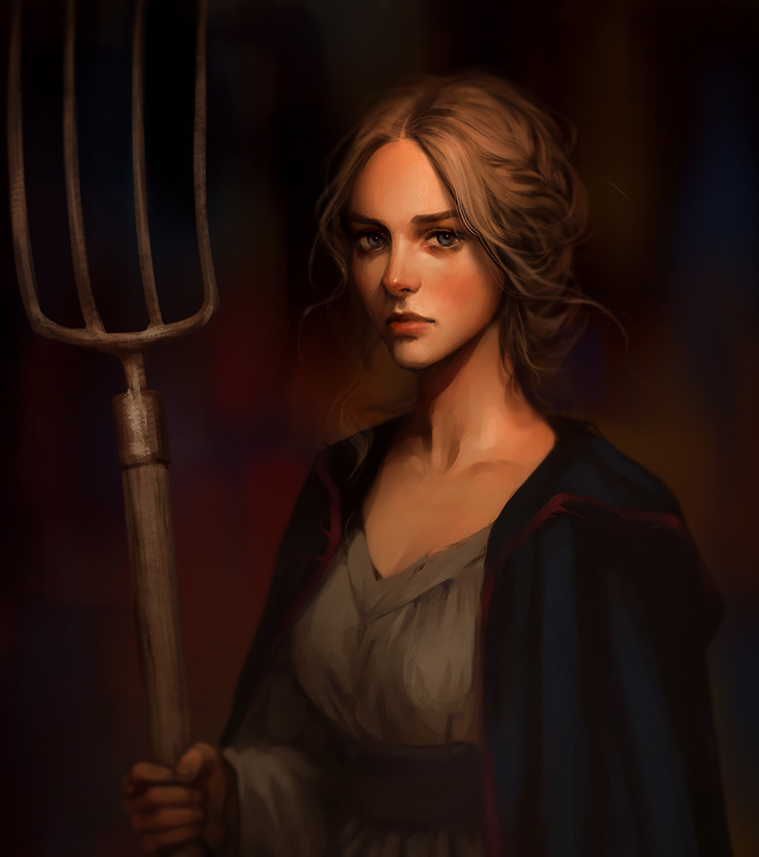
Learning Task One
Read the information on p.87.
Cut out each picture and glue it into your book.
How would the Forest Laws impact King William?
How would they impact a peasant farmer?

Slide 6
King William
Gave him more land to hunt boar and stag.
Protected his land from destruction so animals could would be healthier.
Allowed him to control more land which enforced his rule of England.
Strict laws for poaching reinforced his images as a strict leader.
Would get richer through the fines imposed on breaking Forest Laws.
Peasants
As it was an offence to carry hunting weapons into forests it prevented families from eating.
Prevented clearing woods and building in the forests so people had less of a choice where they could live
Families were evicted from their homes if it was on royal forest
land.

