Slide 1
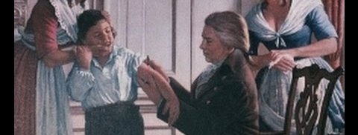
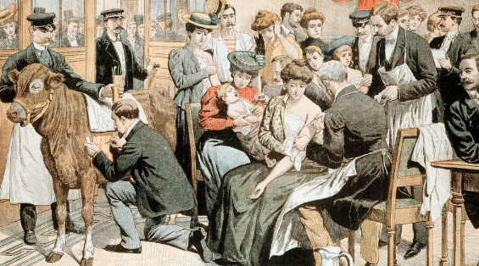
How did the First World War affect the health of British soldiers?
In this lesson, we will:
Describe how bad injuries were on the Western Front.
Starter: Can you explain why public health began to slowly improve by the 19th Century?

Slide 2
Explain why public health began to slowly improve by the 19th Century.
Role of individual – Edward Jenner – in developing smallpox vaccinations.
However, at first society rejected his work as they did not trust it. So other factors need to be at work.
Influence of government e.g. 1807 they asked Royal College of Physicians to organise nationwide vaccination. In 1852 they funded compulsory vaccinations. In 1867, compulsory vaccinations were enforced. Public Health Act aimed to clean up cities to improve public health.
Changing attitudes towards disease – Pasteur and Koch’s work began to influence how society viewed public health. Hospitals began to become more focussed on preventing infection and improving conditions.

Slide 3
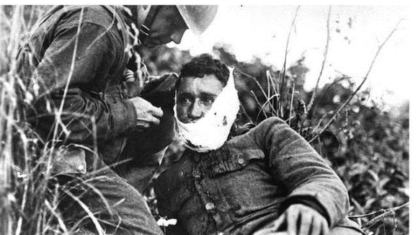
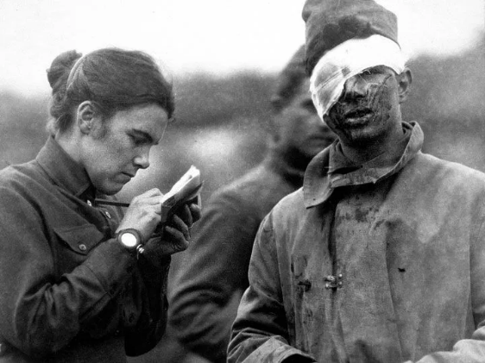
How bad were injuries during the war?
31% of those who served in the army were wounded,
Over 41,000 men had their limbs amputated during the war – of these 69 per cent lost one leg, 28 per cent lost one arm, and nearly 3 per cent lost both legs or arms.
272,000 suffered injuries in the arms or legs,
60,500 were wounded in the head or eyes.
89,000 sustained other serious damage to their bodies.
This was caused by the variety of new weapons used during the war.

Slide 4
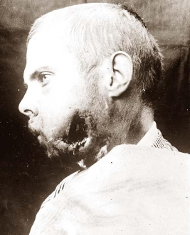
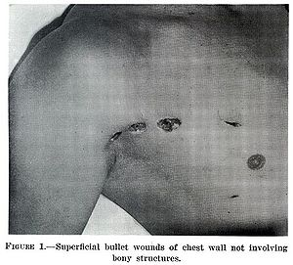
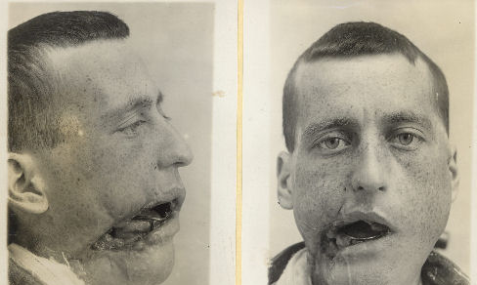
How did bullets cause problems for soldiers?
Out of 200,000 men wounded in one case study – 58% of wounds were caused by shrapnel (60% of these shrapnel wounds were on the arms and legs).
A further 39% were caused by bullets. Machine guns could fire 450 rounds a minute and the bullets could fracture bones. Rifles could fire accurately at 500m but lacked the speed.
To reduce the risk of head shots, the British Army introduce steel helmets in 1915. It was estimated that it reduced fatal head wounds by 80%.

Slide 5
Learning Task One – Can you describe how bad injuries were on the Western Front?
For each number below, write down what it is referring to!
58%
31%
41,000
80%

Slide 6
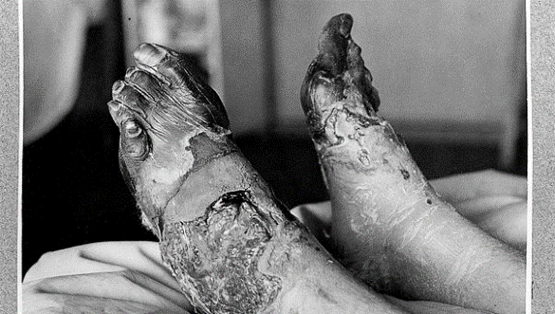
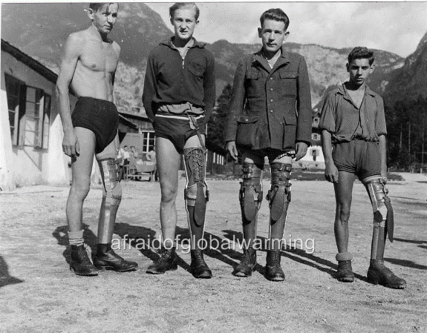
How did infection cause problems?
When men were wounded, the bullet or shrapnel would pull some of their uniform into the wound.
The soil was farmland so was very heavily fertilized so was crawling with bacteria to cause gangrene.
When wounds were exposed to the soil, they would very quickly develop infection and gangrene.
There was also the threat of developing trench foot – an infection caused by dirty water entering open wounds on the foot.

Slide 7
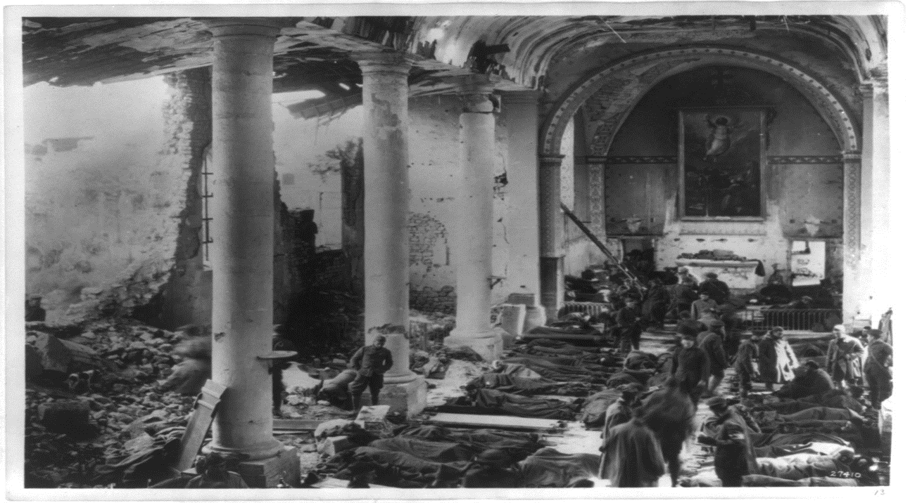

Slide 8
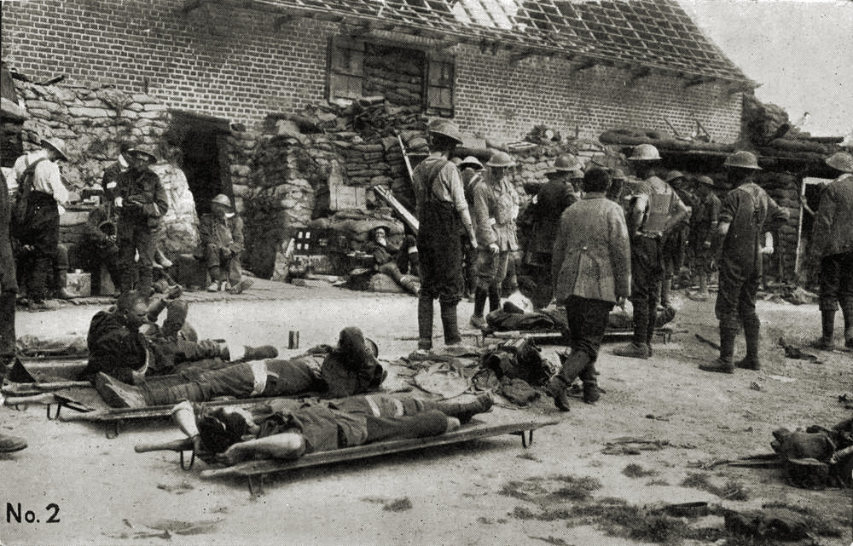

Slide 9
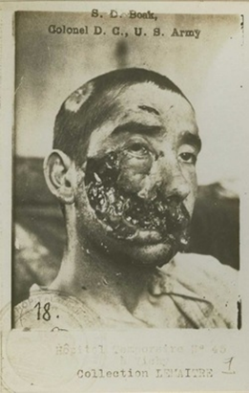
How did gas cause problems?
There were three types of gas: chlorine, phosgene and mustard.
Chlorine – the lungs would fill with fluid and the victim would drown/suffocate.
Phosgene – same as chlorine but would kill you within two days.
Mustard – had no smell, caused blistering of the skin and internal organs.
Army reacted at first by soaking cotton pads in urine and holding it to the face to stop the gas.
Eventually gas hoods and gas masks developed to combat it.

Slide 10
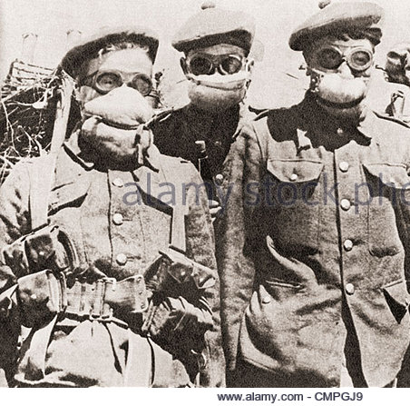
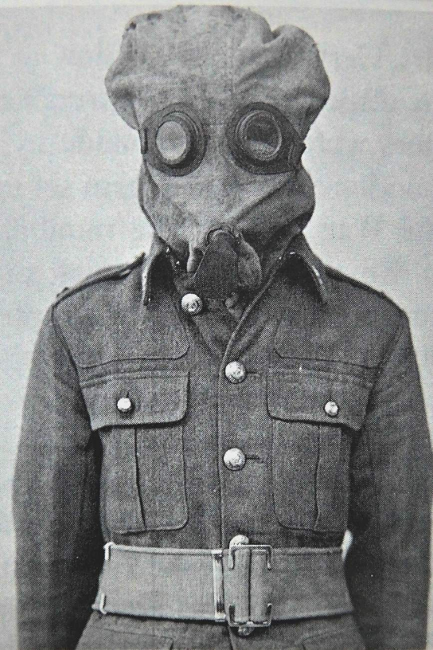

Slide 11
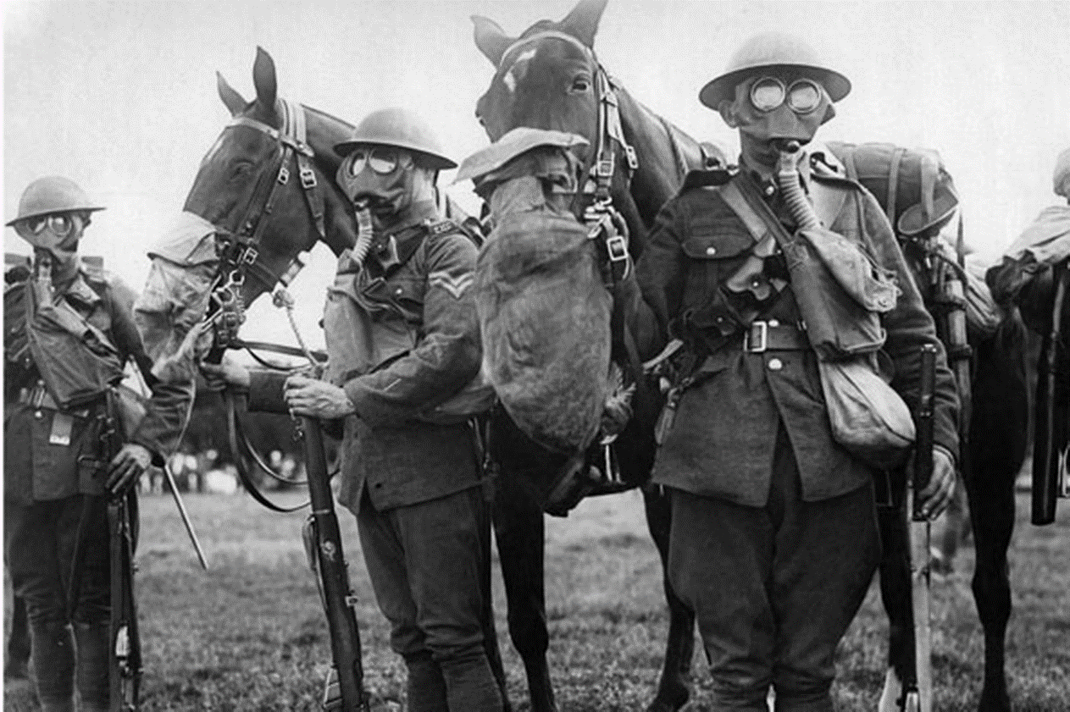

Slide 12
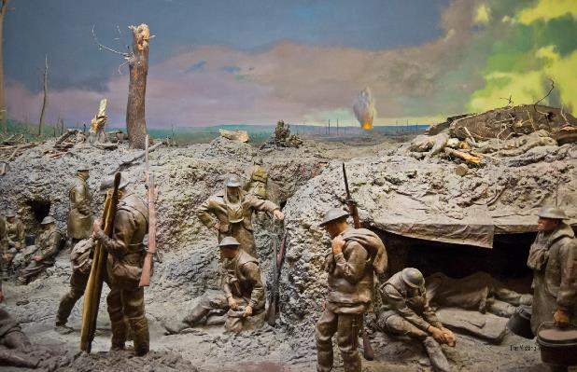
Learning Task Two
Collect the diagram of a typical Western Front battlefield. There are several clues to injuries and dangers facing British soldiers.
Circle each danger.
Using precise contextual knowledge, explain each danger shown in the diagram.

Slide 13
Shells were fired at trenches in the hope of weakening them before an offensive.
They often contained shrapnel balls, which would kill and wound soldiers.
Constant shelling caused ‘shell shock’ symptoms included ticks, shakes, giggling, incontinence and facial spasms (much like PTSD)
Three types of poison gas used: chlorine, phosgene and mustard.
Phosgene and chlorine needed to be inhaled to be deadly. Soldiers would either be blinded, or suffocate.
Mustard gas blistered the skin.
There was no cure, soldiers had to wait 2-3 weeks to let it pass through the system.
At start of war, cotton pads were held over the mouth.
Within 6 months, PH helmets were issued which went over the head.
Eventually respirators were developed by 1916 which would protect soldiers.
All of the trenches were dug on French farm land, so was crawling with bacteria.
Open wounds often got infected, which could cause huge problems for soldiers.
Gas gangrene was the most common infection on the Western Front.
Trench food was a huge problem for soldiers due to flooded trenches.
Only cure was amputation
Preventions included whale oil and changing socks 2-3 times per day.

