Slide 1
How did Lanfranc and the Church help William keep England in 1075?
In this lesson, we will:
Explain why Normans and Saxons wanted to rebel in 1075.
Explain how Lanfranc and the Church helped crush the rebellion
Starter: Thunk of the day! If England was a colour in 1070, what colour would it be? Explain your answer!

Slide 2
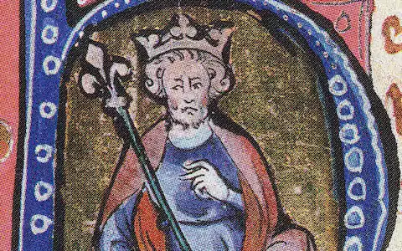
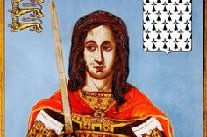
Who was involved in 1075?
In 1075, two Norman lords and one Saxon lord planned a rebellion against King William.
It was led by Ralph de Gael, Earl of East Anglia. Ralph plotted with Rodger de Bretuil (Earl of Hereford) and Waltheof (Earl of Northumbria).
They planned to raise an armies in Hereford and East Anglia, unite and march to London.
They would seize power and divide the kingdom up into three parts.
The Danes led by Prince Cnut sent an invasion fleet to help them overthrow William.
Hoël II, Duke of Brittany and King Henry I of France also sent ships and men to help them.

Slide 3
“The king is unworthy – all men hate him and his death would cause great rejoicing.”
Orderic Vitallis, vol II

Slide 4
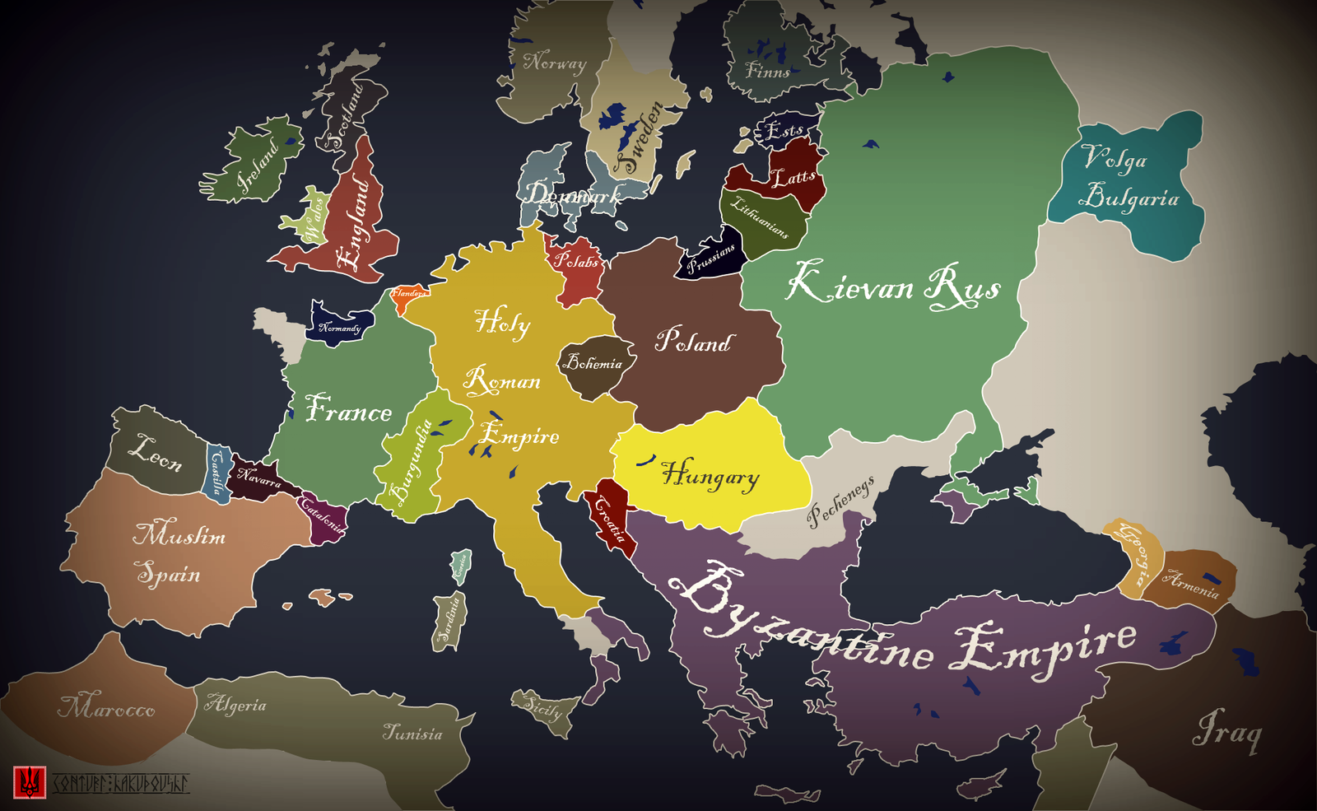

Slide 5
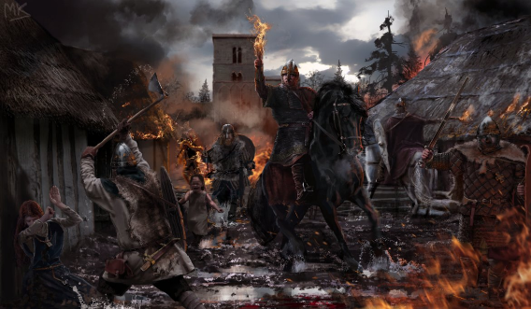
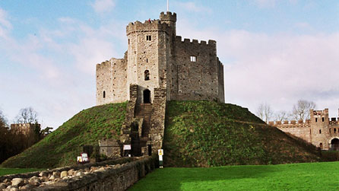
Why would they rebel?
Loss of land – Earl Roger de Bretuil was angry that his Earldom was much smaller than that of his father.
Loss of privileges – de Bretuil also hated that William had introduced sheriffs into the marcher earldoms so that took some of his power away.
Loss of power – William was making all the earldoms smaller and even stopped Ralph de Gael from marrying Rodger de Breteuil’s sister.
Resentment against William – castles, forest laws, reliefs, land changes, sheriffs, harrying of the north.
William’s absence – England was under the control of the regent Archbishop Lanfranc. It was the perfect opportunity.

Slide 6
Learning Task One
For each man, explain three reasons why they would have chosen to rebel against King William in 1075.

Slide 7
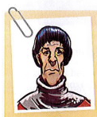
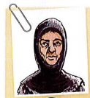
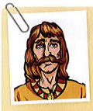
Ralph de Gael
Roger de Breteuil
Waltheof
1) He was banned from marrying the sister of Roger de Bretueil.
2) His earldom had been made smaller under King William.
He had lost power in his earldom e.g. introduction of sheriffs.
1) Marcher earldoms lost power e.g. had to pay tax, introduction of sheriffs.
2)His land was made much smaller than under his father.
3) He resented having to pay a relief to inherit his father’s land.
1) He hated that King William had destroyed his earldom
2) He had strong connections to the Saxons and the Danish.
3)William was in Normandy, so he would have felt really confident.

Slide 8
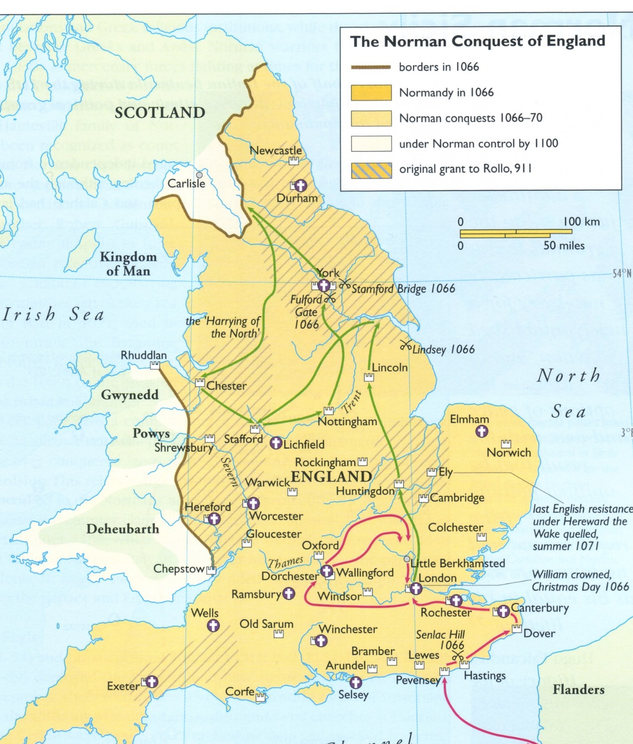
How did Lanfranc help?
Waltheof informed Lanfranc of the plan. He instantly sent men to spy in Hereford and East Anglia and gather intelligence on castle building and troop build up.
He then wrote letters to Roger and tried to convince him to stop what he was doing. He reminded him of loyal his father had been to William in 1066.
He excommunicated Roger and Ralph – this would have prevented some from joining their cause.
He ordered Bishop Wulfstan to raise an army and stop Roger from crossing the Severn River. He ordered the same to be done in East Anglia. This stopped the two armies uniting.
This bought time for William to arrive from France. When the Danes heard of William’s return, they fled.

Slide 9
Learning Task - Two
“It was primarily because of Archbishop Lanfranc that the 1075 rebellion failed”
Evidence to support the statement | Evidence to suggest it wasn’t just Lanfranc.

Slide 10
Evidence to support the statement | Evidence to suggest it wasn’t just Lanfranc.
He instantly sent men to spy in Hereford and East Anglia and gather intelligence on castle building and troop build up. He then wrote letters to Roger and tried to convince him to stop what he was doing. He reminded him of loyal his father had been to William in 1066. He excommunicated Roger and Ralph – this would have prevented some from joining their cause. He ordered Bishop Wulfstan to raise an army and stop Roger from crossing the Severn River. He ordered the same to be done in East Anglia. This stopped the two armies uniting. This bought time for William to arrive from France. When the Danes heard of William’s return, they fled | Without Waltheof confessing, Lanfranc would not have been able to act as he did. William’s reputation as fearsome warrior is what scared the Danes away and prevented them joining the cause.

