Slide 1
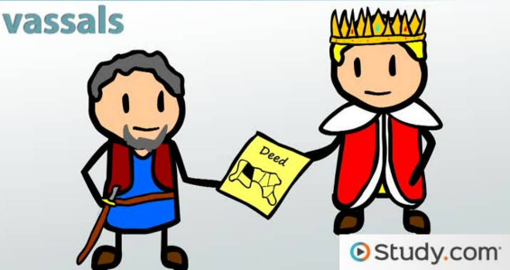
How did King William ‘Normanise’ England after 1070?
In this lesson, we will:
Describe the key features of Norman knights and barons.
Explain how Archbishop Lanfranc helped King William control England after 1070.
Starter: Using your knowledge from last lesson, define what is meant by a ‘vassal’

Slide 2
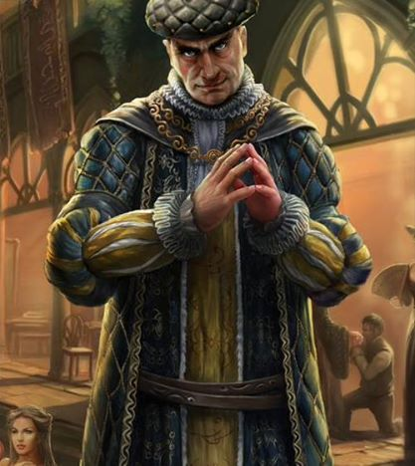
What was a tenant-in-chief?
They were expected to fight with the king.
Lead their own band of knights, defend their own land.
Provide knights for the king.
Had to run the courts of their land, judge cases and keep the king’s peace.
Had to pay the king a share of all tax raised in their land.
Would serve on William’s witan.
Had to provide food and accommodation for William and his court when he travelled the land.
Largely replaced the Anglo-Saxon Earls.

Slide 3
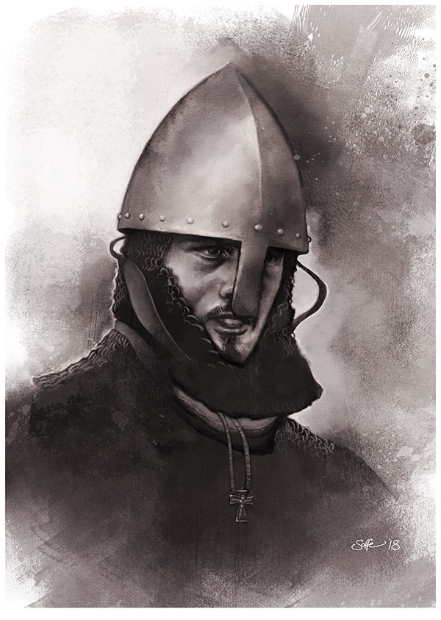
What was a Norman knight?
Were granted land (sometimes very small) from their tenant-in-chief. This land was called a fief.
Some were very powerful and nobles wanted their sons trained as a knight from a young age.
Roughly 6,000 of them in England.
Had to guard their lord’s property and fight for the king for 40 days.
Were superior to any other soldier e.g. could lead cavalry charges (couched lances)
Castles would be places where knights would organise attacks and defence.
Mostly replaced thegns.

Slide 4
Learning Task Two
Green groups + orange groups
What role did they play in Norman England?
How different were they from their Saxon counterparts (e.g. earl and thegn)
Cut out and glue down your pictures of a Norman baron and Norman Knight!
Blue groups
Describe key features of both a knight and a baron

Slide 5
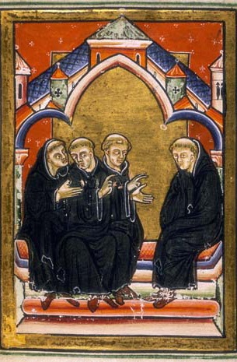
Why was the church so important to King William?
Advised the king
Helped create laws
Wrote up writs
Controlled the royal seal
Archbishops acted as King’s representative in negotiations
At first William kept Anglo-Saxons in the Church (e.g. Ealdred, Archbishop of York crowned him) but after the rebellions they were all replaced by Normans.

Slide 6
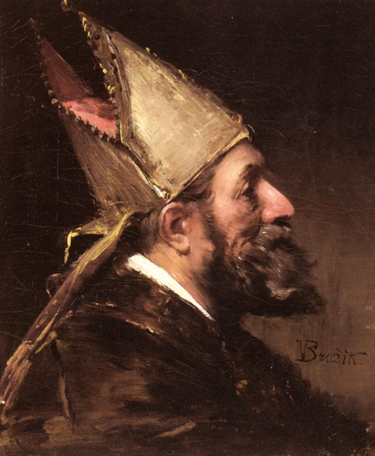
Who was Lanfranc of Pavia?
Following the wave of rebellions between 1068 and 1070, William appointed Lanfranc as Archbishop of Canterbury on 29th August 1070.
Lanfranc was an Italian monk who had helped William gain papal support from Pope Alexander II in 1066.
Lanfranc soon began to reorganise and reform the Church in England.
Under Stigand, the Church in England was far from perfect.
Lanfranc wanted to make the Church into a strong force that was more in line with Rome and that could help King William govern England efficiently.

Slide 7
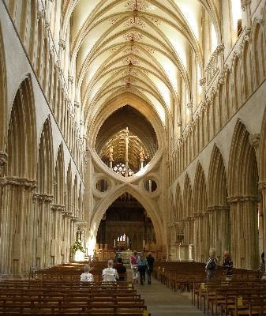
How Lanfranc “Normanise” the the Church
Lanfranc’s reforms to church brought very rural churches under Church control.
In 50 years, every Anglo-Saxon churches knocked down and replaced with Norman architecture.
Workers in church remained, but all important positions replaced by Normans.
Bishops preached how God favoured the King.
25% of land went to Church, so loyal Norman bishops were given it to hold.
Church leaders should be appointed by the Church, not Earls.

Slide 8
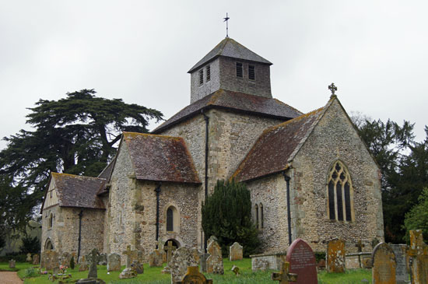
St Mary’s Parish Church, Breamore, Hampshire – Anglo Saxon

Slide 9
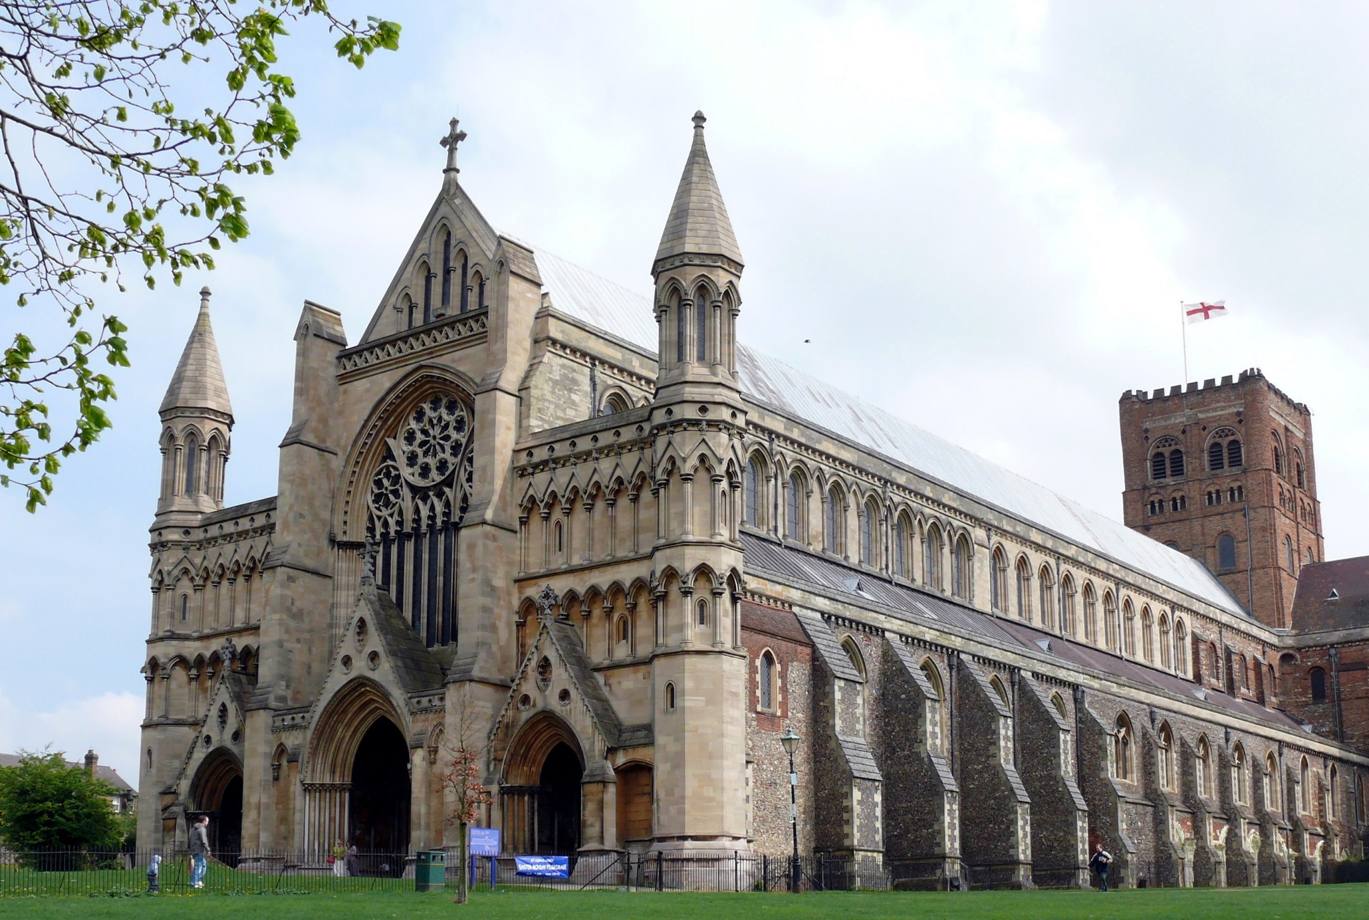
St Albans Cathedral, Hertfordshire - Norman

Slide 10
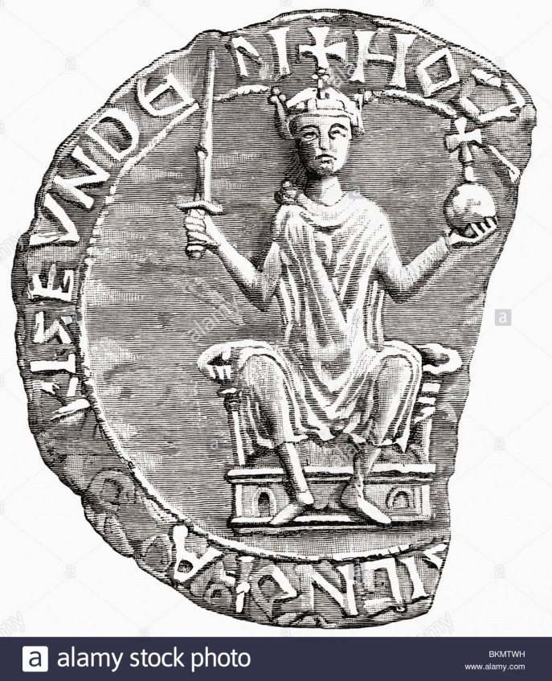
Key decisions were approved by William.
All new bishops did homage to William.
Church leaders would lose land if they failed their duties to the King.
The Church paid William taxes for the land he gave them.
William appointed new bishops.

Slide 11
Learning Task Two
Green groups + orange groups
Explain how Lanfranc helped King William stay in power after his appointment to Archbishop of Cantebury in 1070.
Cut out and glue down your pictures Archbishop Lanfranc
Blue groups
Describe the changes that Lanfranc made to the Church in England after 1070.

