Slide 1
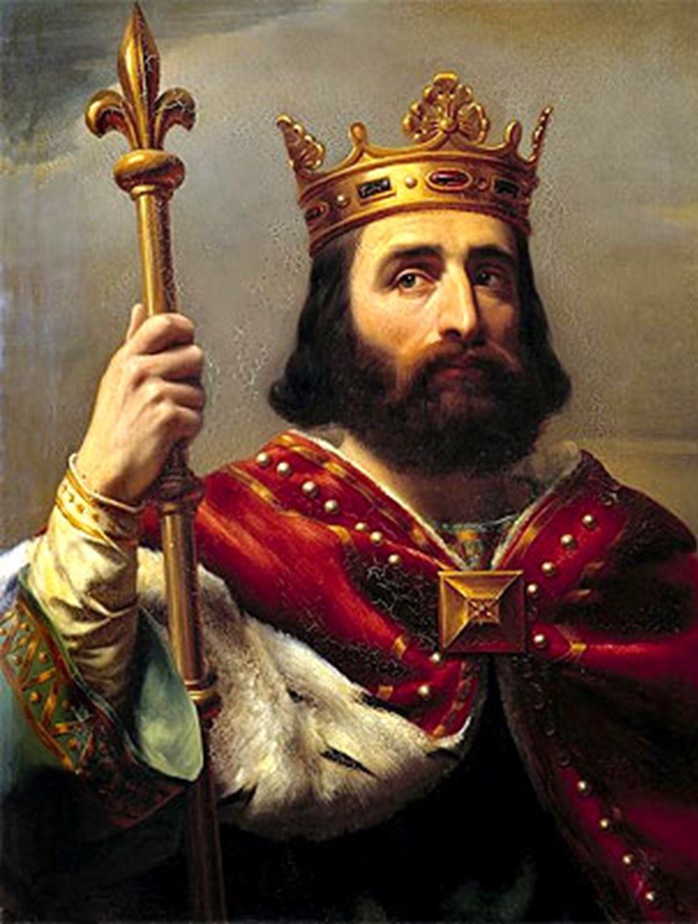
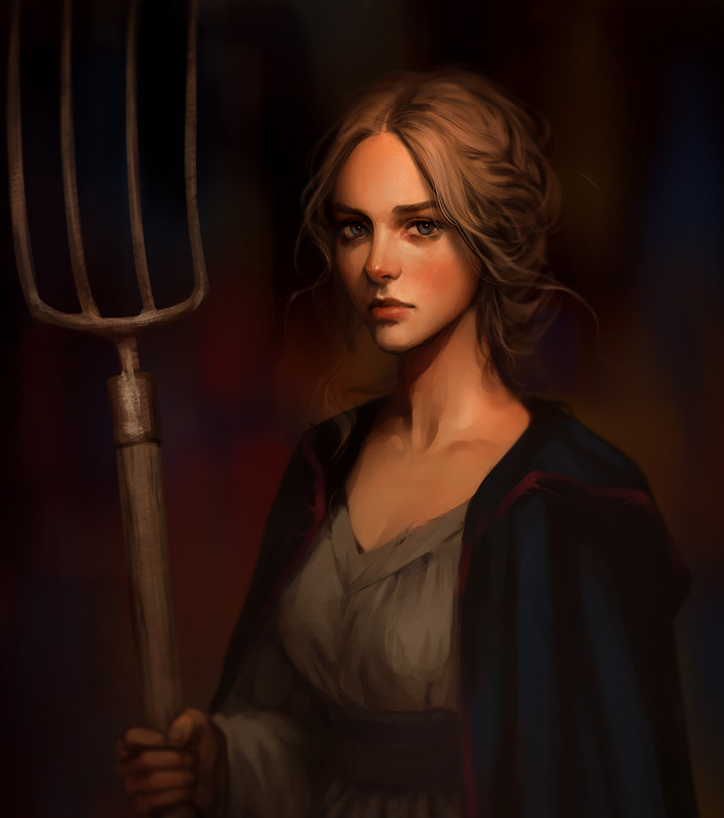
How much did King William reform English government?
In this lesson, we will:
Describe change and continuity of English government under King William.
Explain why Norman Sheriffs are often portrayed as villains.
Starter: Go back and explain the impact of the Forest Laws on King William and English peasants.

Slide 2
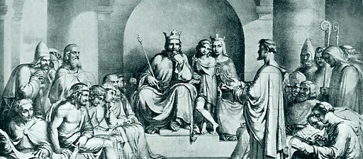
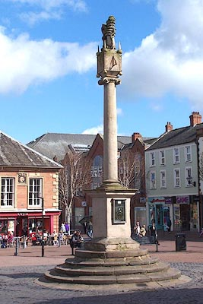
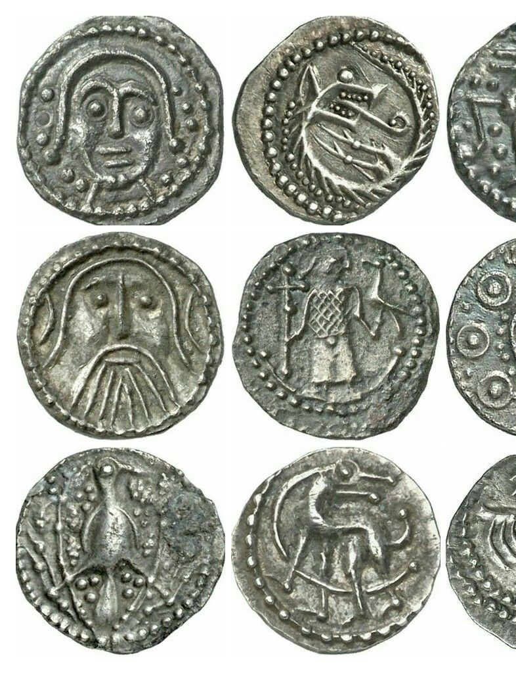
What did William not change in England’s government?
When William took England in 1066, he inherited a country that was far more advanced than his Duchy of Normandy. So much stayed the same.
He continued to use the hide for working out tax. Trading continued to take place within shires so goods could be taxed.
The Witan stayed the same. In 1085 William gathered all the important landholders together much like a large-scale Witan.
Silver pennies continued to be used.
The Royal Treasury stayed at Winchester, but William kept a closer control over who could mint coins.

Slide 3
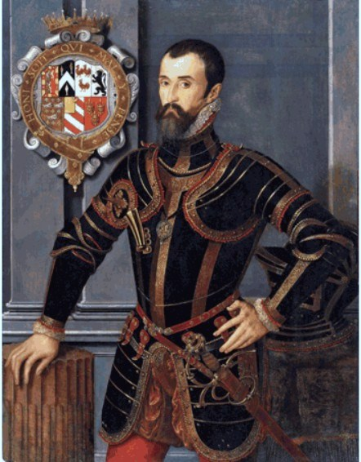
What did William change in England’s government?
William reduced the power and number of earls.
By 1088, every Anglo-Saxon earldom had been replaced by smaller fiefs.
Marcher Earls had their powers vastly reduced.
Earls became ‘tenants-in-chief’ so merely leased land from the king.
Regents were introduced to run the kingdom whilst William was in France.
In 1067, Bishop Odo and William FitzOsbern (Earl of Hereford) acted as regent.
After 1075, Archbishop Lanfranc acted as regent.

Slide 4
Learning Task One
Quickly draw a small table in your book.
Identify two things that changed in Norman government.
Identify two things that stayed the same in Norman government.
Stretch challenge:
Briefly explain why William didn’t change much in English government.

Slide 5
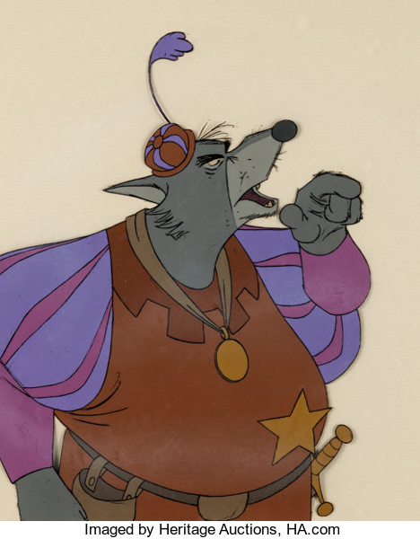
What did Norman Sheriffs do?
The sheriff was appointed by the king, with greater power than an Saxon sheriff. They led the shire, and took orders from no one but the king.
Norman sheriffs ran the courts, and were expected to punish anyone who rebelled against King William.
They had to organise the defence of the shire and gather an army (running alongside knight service)
They became very rich due to collecting tax.
Sheriffs had to pay a set sum to the king, but everything after that they kept. This made them very rich which made them extremely unpopular.
Sheriffs were at the front of Norman landgrabs – no one could complain about them because they had the ultimate power in the shire.

Slide 6
Learning Task Two
Watch this clip from the Disney movie ‘Robin Hood’ showing the Sheriff of Nottingham.
Cut out the picture, glue it into your book.
Underneath, explain how the cartoon has chosen to portray this Sheriff.
Using knowledge from p.86, back up Disney’s interpretation.
https://www.youtube.com/watch?v=afvKzAQ-QJY

