Slide 1
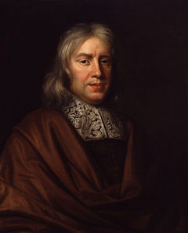
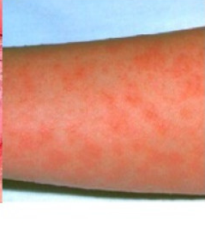
How did hospitals begin to change during the industrial period?
In this lesson, we will:
Identify key features of hospitals in the Medieval, Renaissance and Industrial periods.
Explain the impact that Lister, Simpson and Nightingale had on hospitals by 1900.
Starter: The man to the right is Thomas Sydenham, a very famous doctor. You have until the register is completed to find two reasons why he is important.

Slide 2
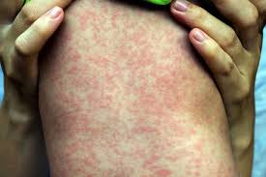
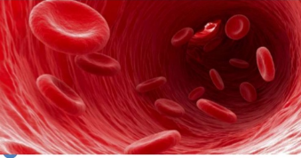
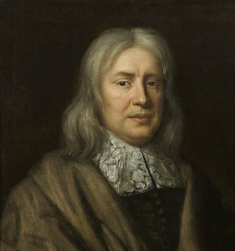
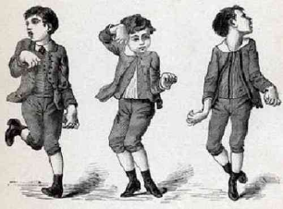
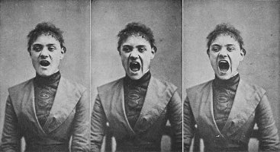
He was the first to prove scarlet fever and measles are two different diseases.
He was the first to use iron in treating anaemia.
He was the first to explain the symptoms of ‘Sydenham's chorea’
He was the first to explain the symptoms of ‘hysteria’

Slide 3
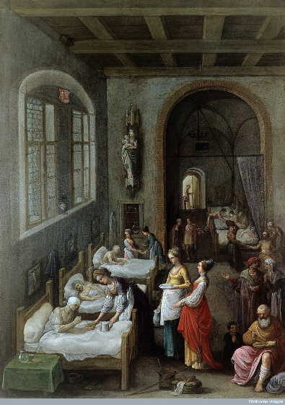
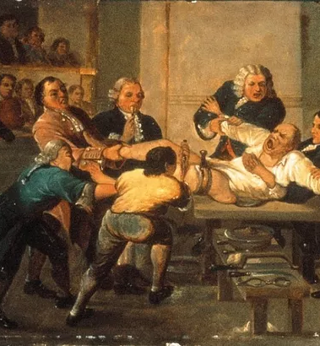
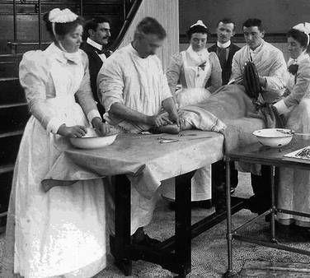
1900 – late industrial period.
1800 – early industrial period
1600 – Renaissance period

Slide 4
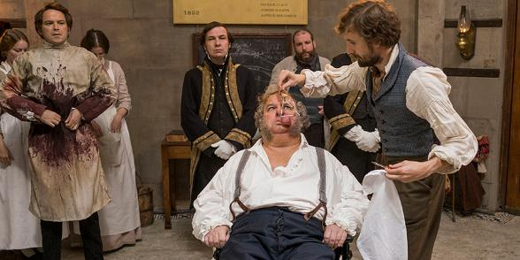
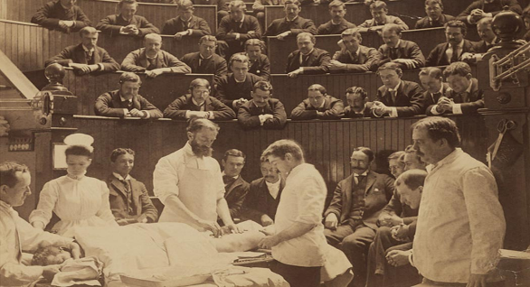
Were 18th Century hospitals pleasant?
Hospitals in early 1700s had changed a lot since the 1500s.
They were no longer operated by the Church (instead founded by rich people)
Doctors would focus on treating the patients. However, the treatment was often poor quality or quack.
Nurses were untrained and undervalued.
Doctors and surgeons would go from one patient to another without washing.
Infection was a huge problem. Around 45% of all surgical patients would die of infection.

Slide 5
Learning Task One
Green groups
Identify 5 -6 key features of a Medieval hospital.
Explain one differences in hospitals in the 1500s and 1700s. (4 marks – GCSE question)
As a class, read the hospital information for the 1500s and 1700s on the sheet your teacher has given you.
Orange groups
Identify 5 -6 key features of a Medieval hospital.
Had hospitals changed much by the 1700s?
Blue groups
In your ‘Medieval’ section, write down as many key features of a medieval hospital as you can remember from Y10.
Once you have done this, pick out one difference and one similarity.

Slide 6
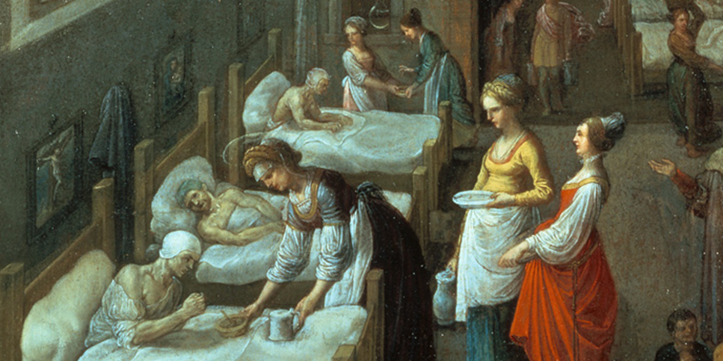
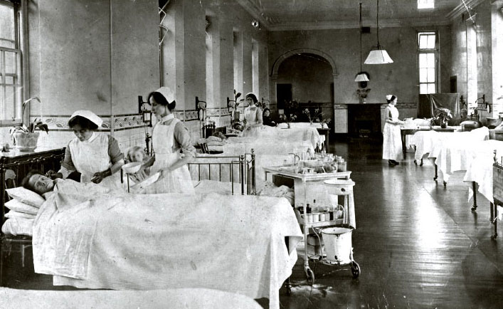
Why did surgical hospitals begin to change?
By the turn of the 20th Century, hospitals had completely transformed.
The focus was on treatment and preventing infection through aseptic conditions.
The way they were built reflected this change – they were large, well ventilated buildings which had separate wards for infectious diseases.
They were no longer controlled by the Church, however it still cost money to use them.
Surgery was much safer and cleaner – pain was no longer felt.
Three people helped change this – Nightingale, Simpson and Lister.

Slide 7
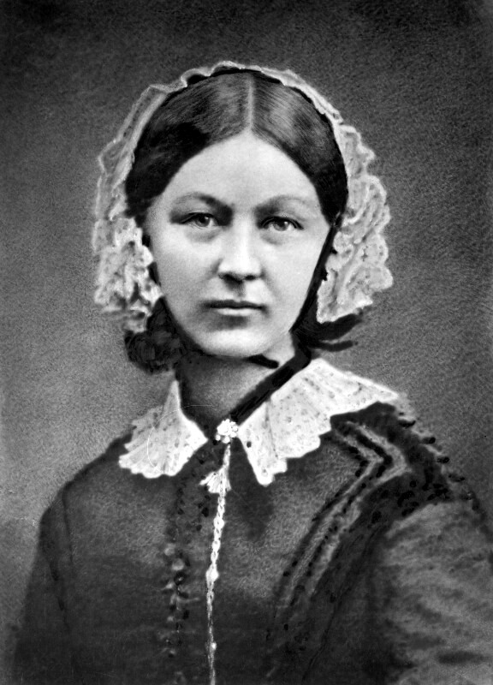
The work of Florence Nightingale
Born into a wealthy family in 1820; she had a “religious vision” at age 17 that told her to serve mankind. She trained as a nurse in Germany and then France. In 1853 she became superintendent of nurses at King’s College Hospital in London.
In 1854, Britain went to war with Russia in Crimea. The media published stories that hospitals were not fit for soldiers to be treated in – it was a media scandal.
Due to her reputation as a successful nurse, Nightingale convinced the British government to send her to improve hospitals in Crimea with 38 other nurses.
Her team demanded 300 scrubbing brushes to clean dirt near patients. She organised her time into smaller teams to treat nearly 2,000 wounded soldiers. She also provided all men with clean bedding and good food.
Overall the impact was a vast reduction in infection rate – mortality fell from 40% to 2% in six months. This helped support Pasteur and Koch’s work on germs causing infection.

Slide 8
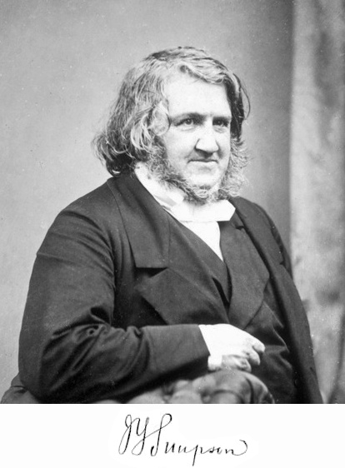
The work of James Simpson
A surgeon who trained and worked in Edinburgh, Scotland.
Was convinced that there were better anaesthetics than laughing gas to be discovered.
In 1847, Simpson and many of his colleagues began hosting events at his home to inhale various vapours to find the best anaesthetic. One such chemical was chloroform which knocked them all out for hours.
Chloroform began to be used widely in surgery to knock the patient unconscious so surgery could be more accurate. It reached new levels of popularity in 1853 when Queen Victoria used it during the birth of her son.
Because of Simpson’s work, surgeons could take their time and perform more complex surgery. However it did nothing to solve bleeding and infection.
https://www.youtube.com/watch?v=6hBfFeuOuHE

Slide 9
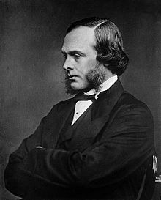
The work of Joseph Lister
An English surgeon who was obsessed with finding the cause of infection in his patients. Inspired by Pasteur’s work on microbes causing decay in beer and wine, Lister believed they also caused decay in flesh.
He began to look for chemicals that could ‘kill’ these microbes before infection set in. In 1834, carbolic acid began to be used to treat sewage.
In 1865 Lister operated on a patient with a broken leg at Glasgow Infirmary. He wrapped the leg in a bandage soaked in carbolic spray. The wound healed cleanly within 6 weeks.
His work was published in The Lancet in a series of 6 articles between March and July 1867. Lister instructed surgeons to wear clean gloves and wash their hands before and after operations using a 5% carbolic acid solution. He also championed the use of a carbolic spray in the air during surgery.

Slide 10
Learning Task Two
Green groups
Hospitals had changed by 1900. How far do you agree?
Paragraphs or table arguing for and against.
Precise examples (A01)
Explain how this shows change, or not change (A02)
For each of the people below, use one piece of paper to identify:
What did they do?
What positive impact did it have?
Was there any opposition to their work?
Nightingale
Simpson
Lister
Orange groups
Blue groups

Slide 11
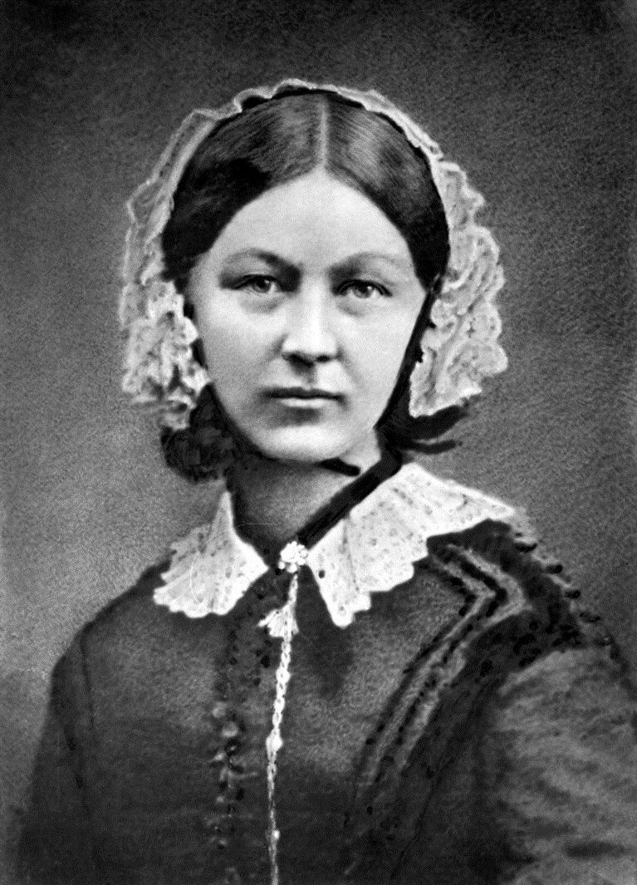
Successes:
Cleaned hospitals, reduced infection rate to 2%
Influenced the way hospitals were built and designed in Britain. Hospitals were build with improved ventilation, more windows and larger rooms. Isolation wards set up to prevent disease spreading.
Nursing school established which transformed nursing into a respected profession. Encouraged more women to join.
Limitations:
Successes:
Championed use of chloroform in surgery which allowed surgeons to perform complicated surgery without the patient feeling pain.
Limitations:
Chloroform had many dangerous side-effects e.g. overdose and heart attacks.
Surgery remained dangerous due to blood loss and infection. Death rate actually increased.
People didn’t tryst the new drug or know how to use it so there was a lot of opposition.
Many didn’t use it as they though the patient was more lkely to die in surgery as they couldn’t scream.
Successes:
Carbolic spray allowed surgery to become more ‘aseptic’. His work vastly reduced infection rate.
It was used quite widely across Britain; from London to Aberdeen.
The death rate in surgery fell dramatically; from 45.7% in 1866 to 15% in 1870
Limitations:
By 1875, Lancet was reporting that many surgeons stopped using carbolic spray as it dried the skin and smelled bad. Many hated using it.
He never proved using science that his spray worked.
Surgeons did not accept germs caused infection. Many refused to accept that they were responsible for killing their patients.

Slide 12
Checkpoint: Can you explain the impact that Lister, Simpson and Nightingale had on hospitals by 1900?
Complete the ‘1900’ section of your worksheet to show the key features of a hospital in the late industrial period!

Slide 13
How would we answer this????
Plenary
There was little progress in understanding the cause of disease in the years c1250–c1700.’ How far do you agree? Explain your answer.
You may use the following in your answer:
The Great Plague in London, 1665
Thomas Sydenham
You must also use information of your own.

Slide 14
Evidence that things stayed the same… | Evidence that things changed…
Belief in religious causes of illness were still popular by 1700s e.g. fasting and praying during the plague in 1665. Miasma was still being used by 1700s, e.g. barrels of tar being burned in streets and sweet smells being used in 1665. The idea of imbalance of humours was still popular e.g. bleeding and purging was still being used by 1700. Discoveries made by Harvey and Vesalius during Renaissance had not impact on ideas about disease so were largely ignored. | A new idea about the cause of disease is suggested by the killing of dogs and cats in London during plague in 1665. Thomas Sydenham suggested ways to group different diseases and showed the difference between scarlet fever and measles. Medical training was getting better because the Church was not as powerful.

