Slide 1
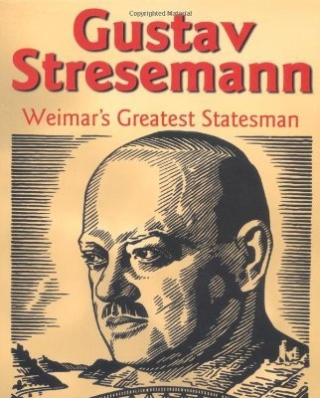
How did Gustav Stresemann improve Germany after 1923?
In this lesson, we will:
Describe strategies used by Stresemann to improve the German economy.
Assess how successful they were
Starter: Write down in your homework diary: “Explain two consequences of the Pacific Railroad Act”
Due: 07/02/2019

Slide 2
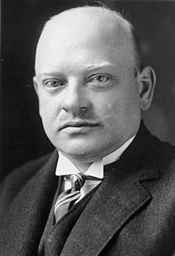
Who was Gustav Streseman?
Appointed Chancellor and Foreign Secretary by President Ebert in 1923.
Only served one year as Chancellor, and seven years as Foreign Secretary.
His main aim was to stabilise the German economy.
He hoped to unite most of Germany behind moderate parties (like the SPD)
He wanted to stop people from turning to far right parties like the DAP.

Slide 3
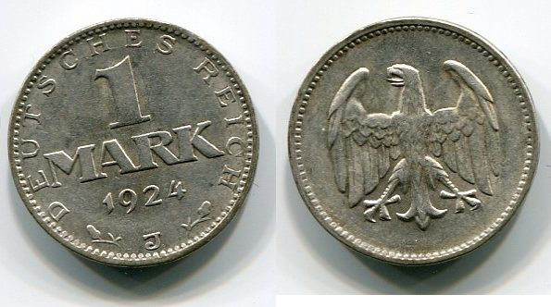
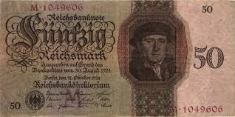
Solution 1: New Currency
In November 1923, he established a new bank called the Rentenbank.
A new currency was established – the Rentenmark.
Paper money was very limited and was always tied to the price of gold.
In August 1924, the Reichmark replaced the Rentenmark.
This put an end to hyperinflation.

Slide 4
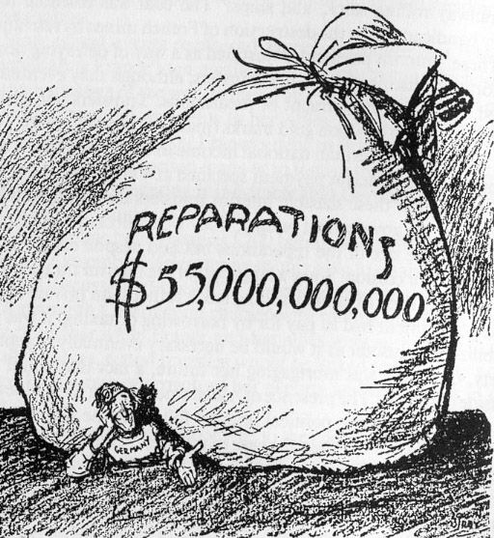
Solution 2: Agree loans for Germany
In April 1924, Stresemann made a deal with American banker Charles G. Dawes.
Reparations repayments were reduced to £50 million per year.
US banks agreed to loan Germany over $25 billion to help pay these reparations.
French soldiers agreed to leave the Ruhr and hand it back to German workers. Employment increased and industrial output increased.
However, it was all propped up by US loans.

Slide 5
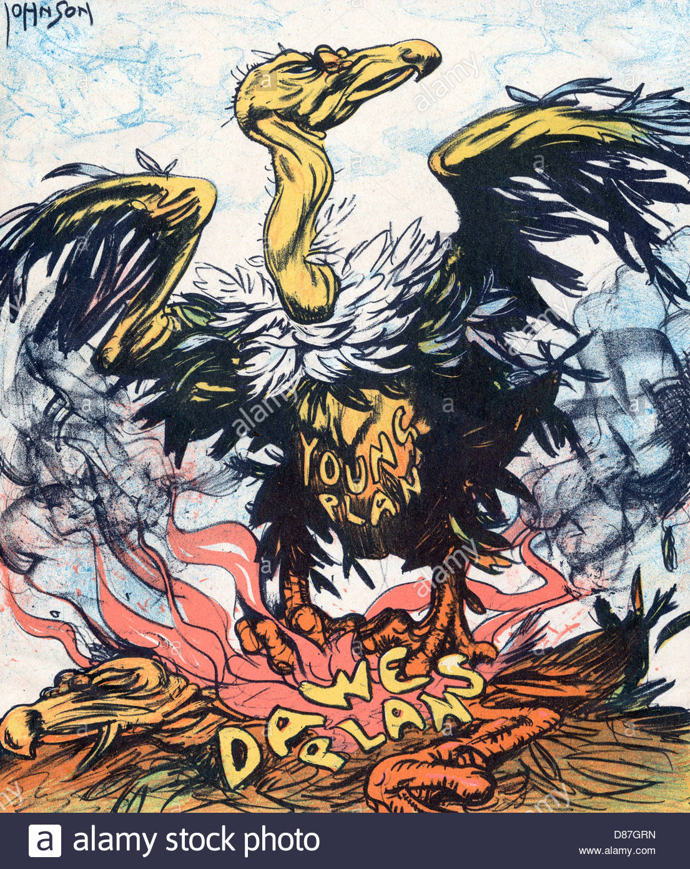
Solution 3: Reduce Versailles Reparations
In August 1929, Stresseman signed the Young Plan with the Allies.
This reduced the total reparations from £6.6 billion to £2 billion.
It extended the time period to 59 years (1988)
Repayments were still fixed at £50 million per year.
It was often attacked and mocked by the far-right.

Slide 6
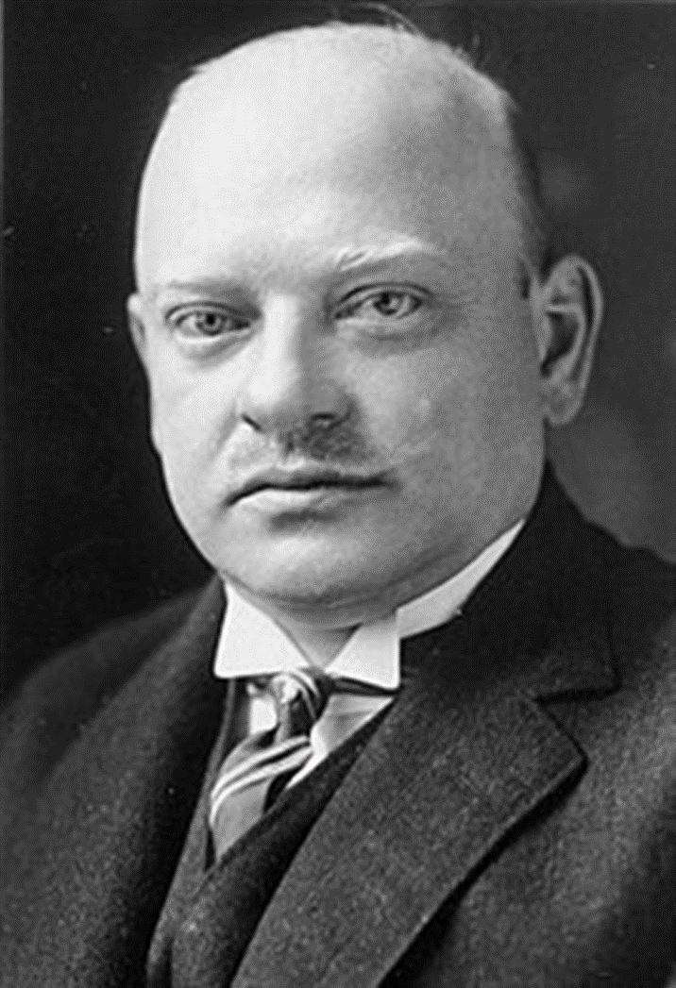
Set repayments at £55 million per year.
Ended hyperinflation
Restored confidence in the German currency
Lowered reparations by £4.6 billion
Convinced the French to pull out of Ruhr
Set up loans to help German economy

Slide 7
Learning Task One
Stretch:
What is the message of this cartoon?
For each policy below, explain:
How it helped Germany
How it did not help Germany
Rentenmark (1923)
Dawes Plan (1924)
Young Plan (1929)

Slide 8
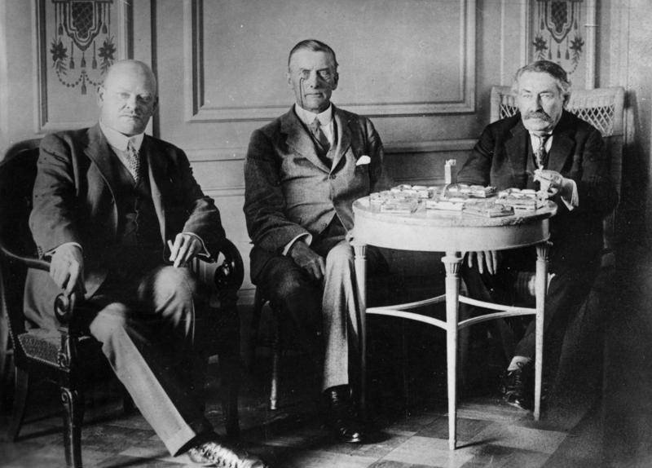
Solution 4: Renegotiate Versailles
In December 1925, Stresemann signed the Locarno Pact with Britain, France, Italy and Belgium.
It allowed Germany a say in peace negotiations.
Germany agreed to accept a new border with France.
France promised peace with Germany.
Everyone agreed the Rhineland would be free of troops.

Slide 9
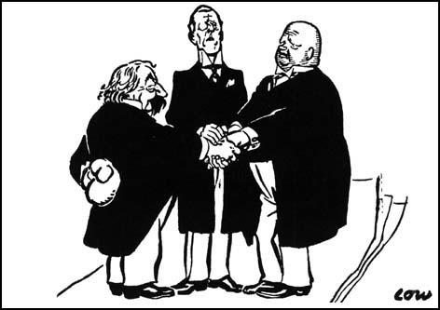

Slide 10
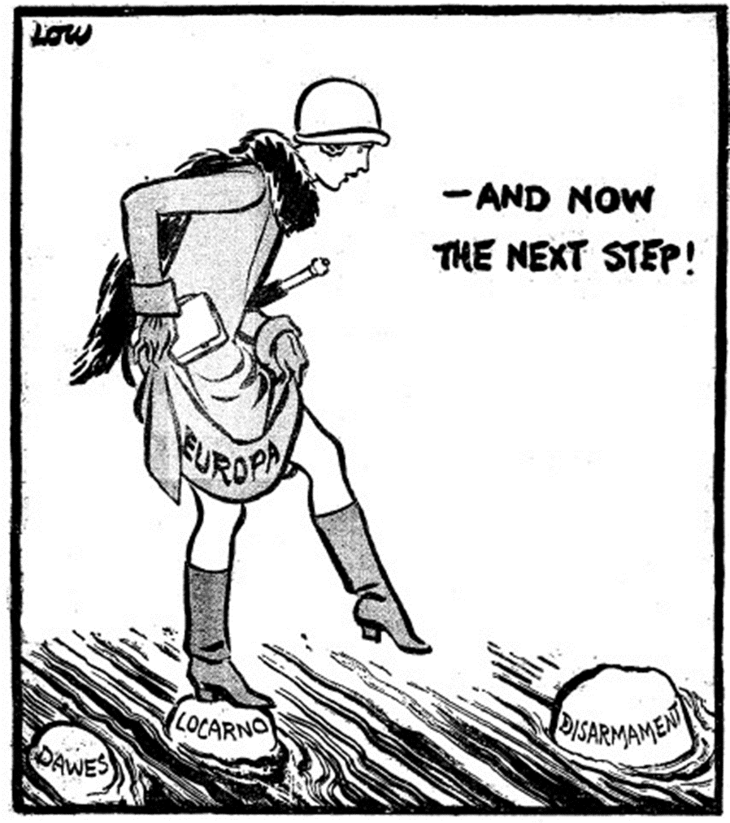

Slide 11
Solution 5: Get Germany into the League of Nations.
After the First World Ear, the Allied countries set up the League of Nations.
It was an organisation that discussed ways of solving problems rather than war.
In 1919, Germany had been banned for joining.
However, in 1929 Stresemann convinced the other countries to accept Germany as a member.
Not all political parties in Germany accepted this

Slide 12
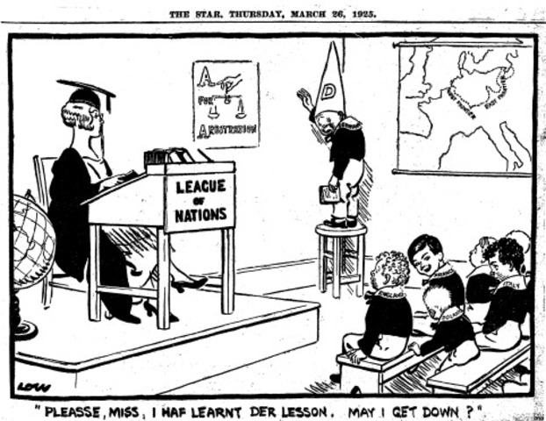

Slide 13
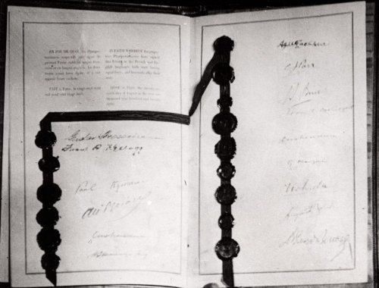
Solution 6: Show the world Germany wanted peace
In August 1928, Germany and 61 other countries signed the Kellog-Briand Pact.
It promised that all countries would not use war to achieve their aims.
It showed that Germany was not included in the world’s most powerful countries.
It showed that the Weimar Republic was now a respected world state.

Slide 14
Learning Task Two
For each policy below, explain:
How it helped Germany
How it did not help Germany
Locarno Pact
League of Nations
Kellog-Briand Pact

