Slide 1
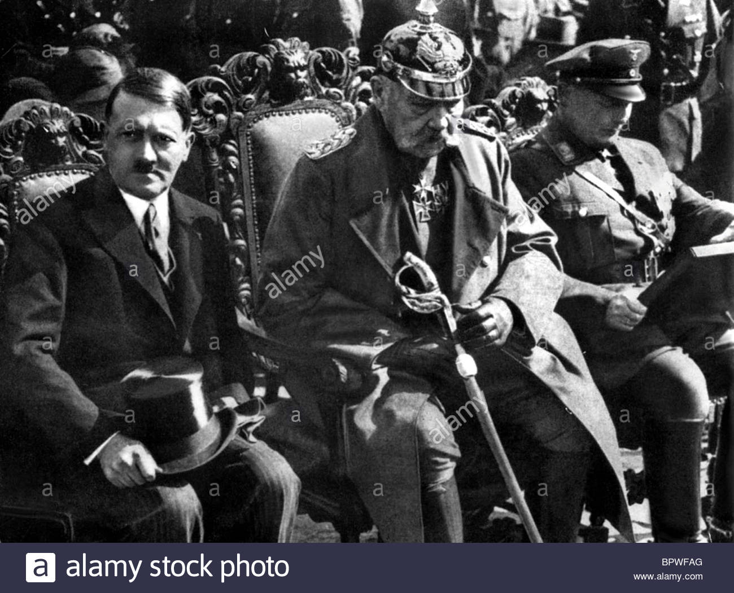
How did Adolf Hitler create a totalitarian state in Germany by 1934?
Starter: Why was President Hindenburg forced to make Hitler chancellor in 1933?
In this lesson, we will:
Describe the steps taken to change Germany from a democracy to a dictatorship.
Assess the legality of Hitler’s decisions.

Slide 2
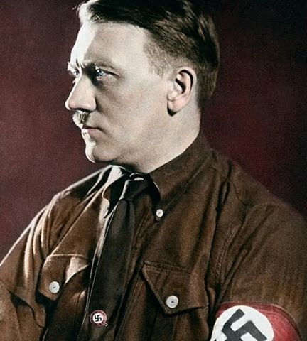
How strong was Hitler by 1933?
The Weimar constitution controlled he could do.
Hindenburg retained all the powers of the President.
Hitler’s cabinet had 12 members – but only two were NSDAP members (Wilhelm Frick and Hermann Goering).
NSDAP members numbered only about one-third of the Reichstag.
The New York Times observed that ‘the composition of the Cabinet leaves Herr Hitler no scope for his dictatorial ambition’.

Slide 3
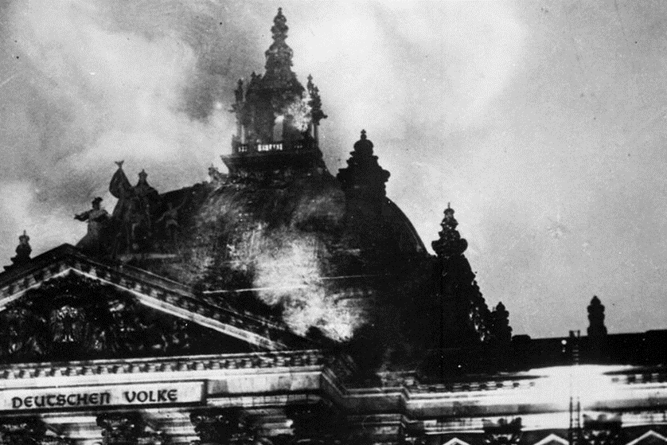
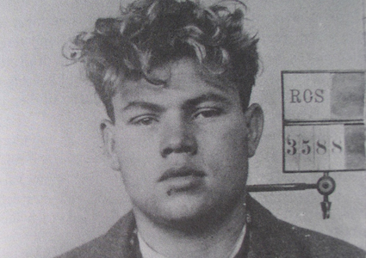
What changed in February 1933?
On the evening of 27 February 1933, the Reichstag building was destroyed by a massive fire.
A young Dutchman, a communist supporter named Marinus van der Lubbe, was caught on the site with matches and firelighters.
The other four were found not guilty and released; van der Lubbe was found guilty and executed.
Hitler and Hermann Goering, the new chief of police, claimed that van der Lubbe was part of a communist conspiracy against the government.
They decided to use the Reichstag Fire as an opportunity to attack the communists.

Slide 4
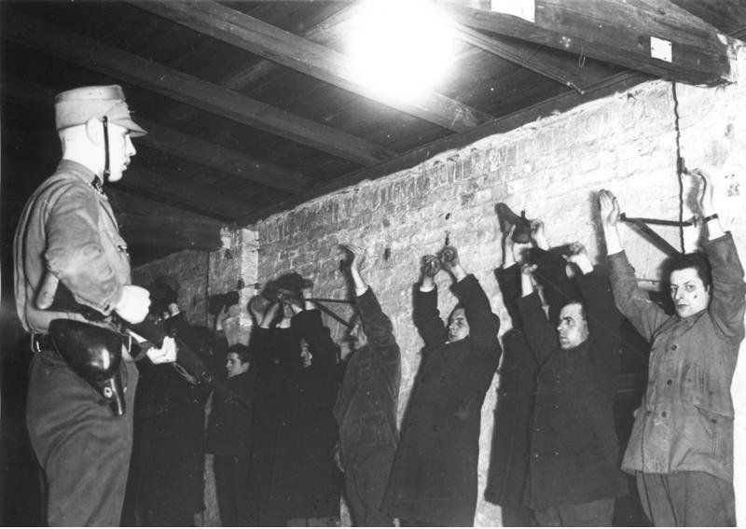
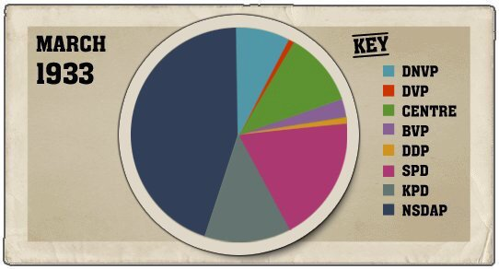
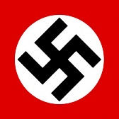
28th February 1933
Chancellor Hitler orders the arrest of 4,000 Communists.
He pressures President Hindenburg to declare a state of emergency and call an election.
1st March 1933
Hitler uses the emergency powers to pass a law giving him the power to imprison political opponents and ban communist newspapers.
At the election, the Nazis win 288 seats.
Hitler bans the Communist Party from taking their 81 seats.
This gives the NSDAP two-thirds of the Reichstag.

Slide 5
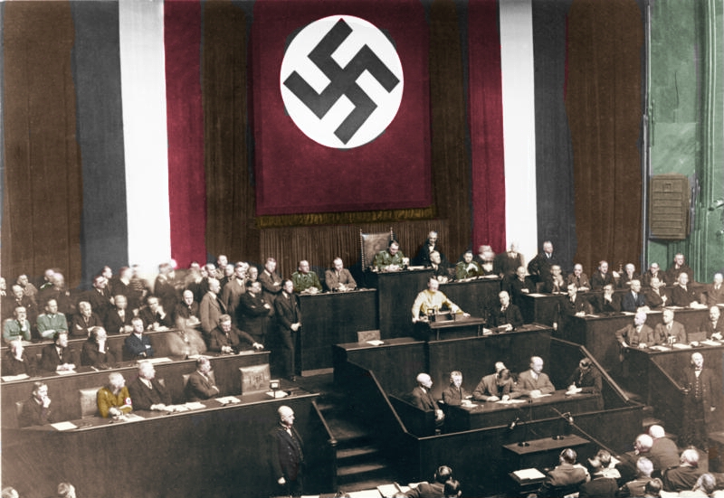
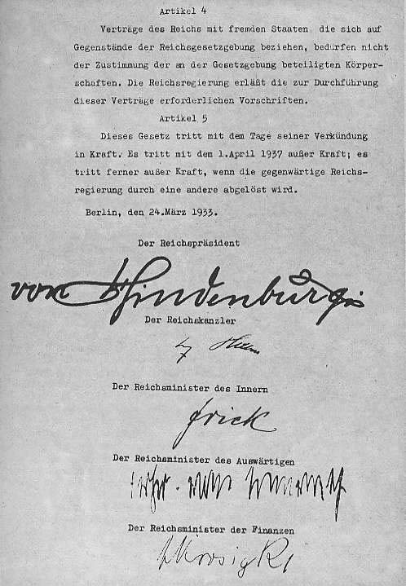
22nd March 1933
Hitler proposes the ‘Enabling Act’ to the Reichstag.
It would give the Chancellor the power to pass laws without the Reichstag for four years.
Hitler uses the SA and SS to intimidate other politicians into voting for it.
24 March 1933
The Enabling Act is passed by 44 votes to 94.
In this sense, it was legal – even though Reichstag members were intimidated during the vote.

Slide 6
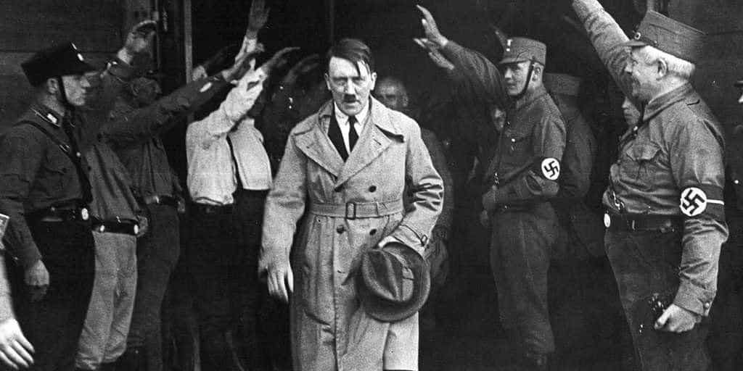
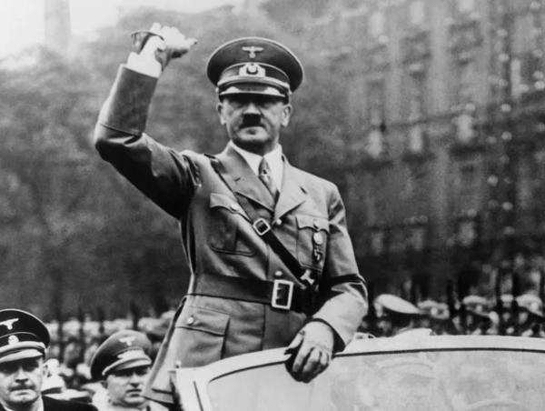
May 1933
SA and SS break into the offices of the SDP and the Communist Party.
Their newspapers are destroyed and their funds confiscated.
July 1933
Hitler makes a law that banned all political parties except for the NSDAP.
Germany is now a one-party state.

Slide 7
Learning Task One
28th February 1933
1st March 1933
22nd March 1933
24th March 1933
May 1933
July 1933
Using the information you have read as a class, create a timeline to show how Hitler destroyed German democracy. It should include:
27th February 1933 – Reichstag fire
July 1933 – All other political parties banned by Hitler.

Slide 8
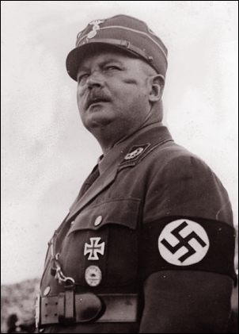
How was Rohm a threat?
By the start of 1934, Hitler had complete control of Germany but the SA were a massive threat.
Rohm had increased the SA to 3 million and were growing in discontent with Hitler (60% of them were unemployed)
Rohm himself was a threat – he criticised Hitler’s links to rich industrialists and was more powerful to the army.
People like Himmler resented him and thought by destroying the SA he could raise the profile of SS.

Slide 9
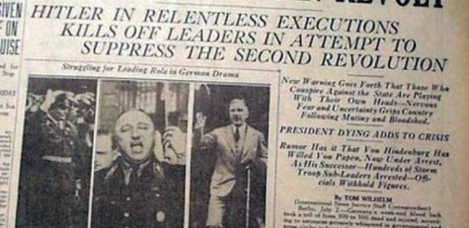
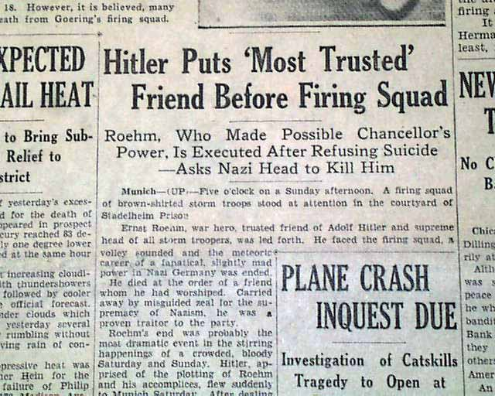
What was the ‘Night of Long Knives’?
As a result of all this, Hitler arranged to remove the threat of Röhm and the SA.
He arranged a meeting with Röhm and 100 other SA leaders at a hotel in the Bavarian town of Bad Wiessee on 30 June 1934.
When they arrived, Röhm and the other senior officers of the SA were arrested, imprisoned.
The next day, as Hitler celebrated becoming Chancellor, executions began.
The SA began shooting all enemies of Hitler and the NSDAP.
Between 700 and 1,000 people were killed including Rohm and von Kahr.

Slide 10
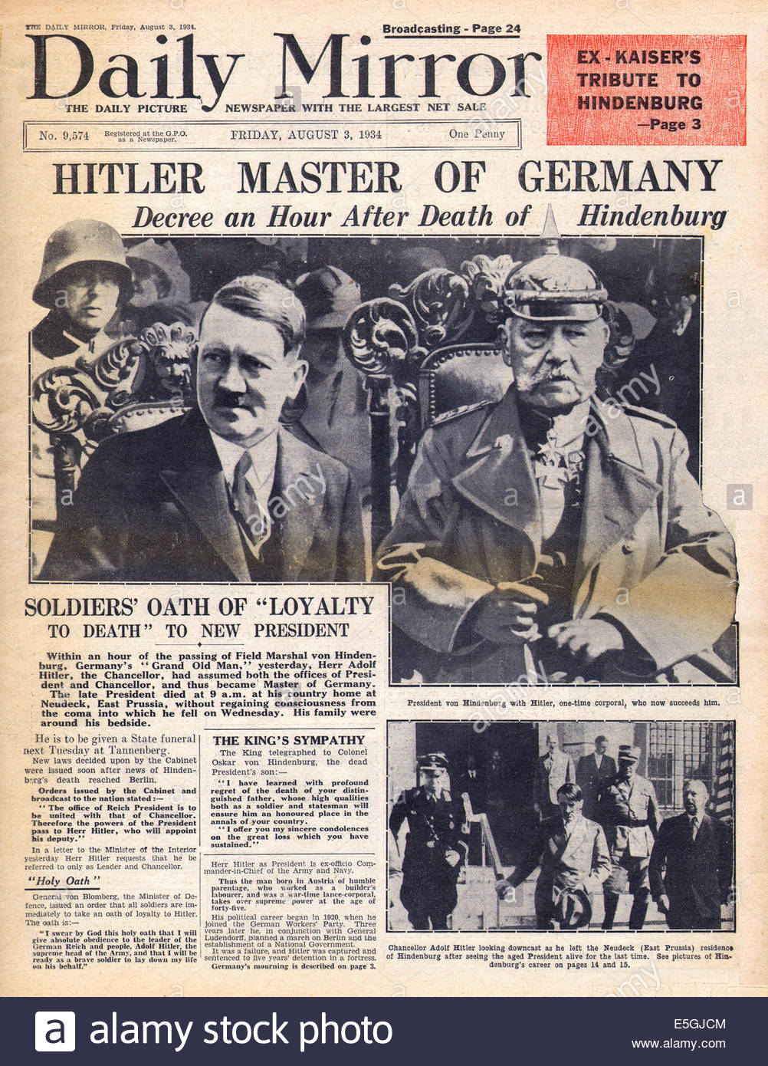
The death of Hindenburg and the Weimar Government
On 2 August 1934, President Hindenburg died, aged 87.
Hitler combined the offices of both Chancellor and President. He was now known as ‘Fuhrer’.
He forced every soldier in the army to swear an oath to him.
He held a vote in Germany on whether he should be Fuhrer. 90% voted yes.
The Weimar Republic was now dead.

Slide 11
Learning Task Two
By August 1934, was Hitler’s political power based on legal or illegal means?
Provide evidence of legal and illegal ways he gained power and control over Germany.
Make sure that you explain and justify your answer.

