Slide 1
How did dealing with the black change between 1200 and 1700?
In this lesson, we will:
Describe treatments, preventions and ideas about the plague in both the Medieval and Renaissance periods
Assess to what extent medical ideas had changes during this 500 year period.
Starter: Can you explain why the Johnson County War was important for law and order in the west?
Tip: what did it show about the legal system? What did it show about order in the western territories?

Slide 2
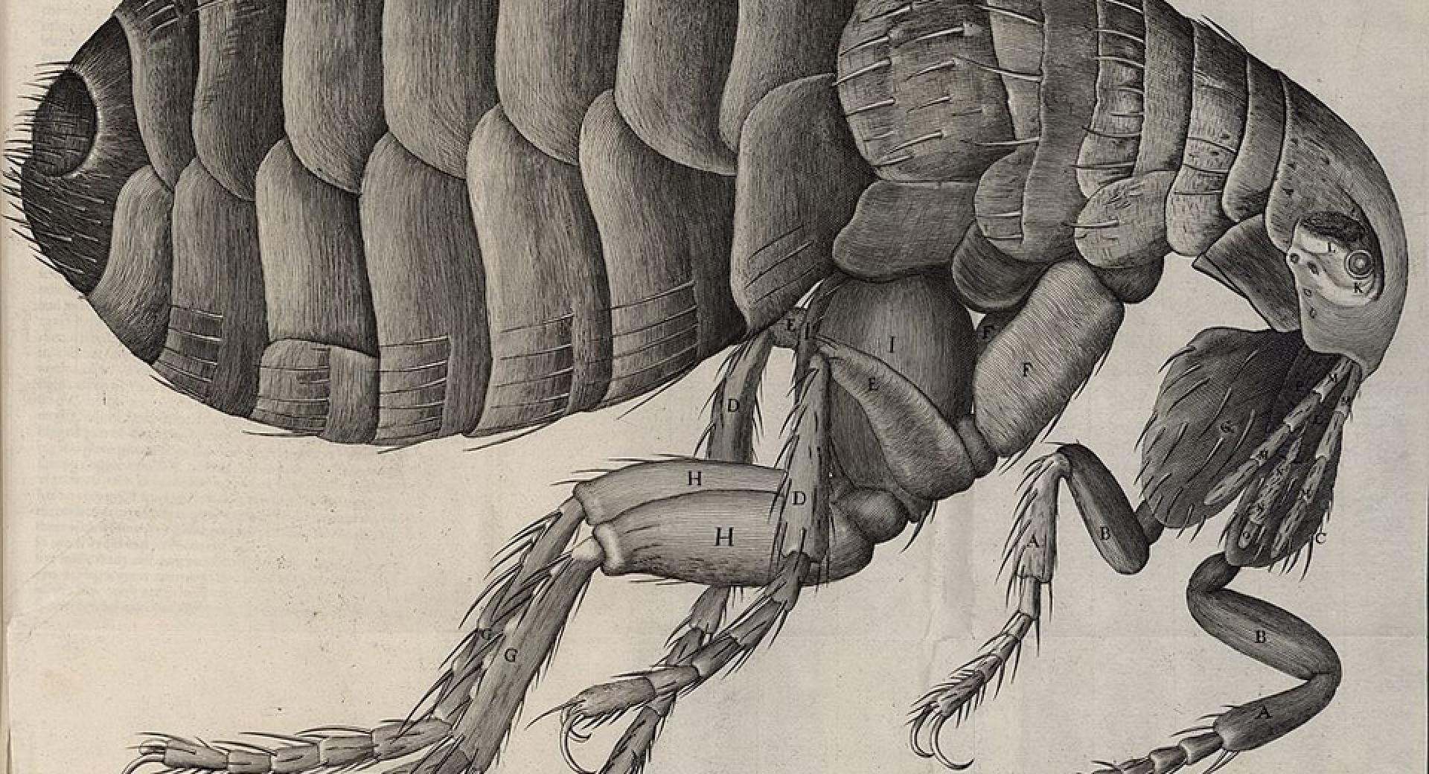
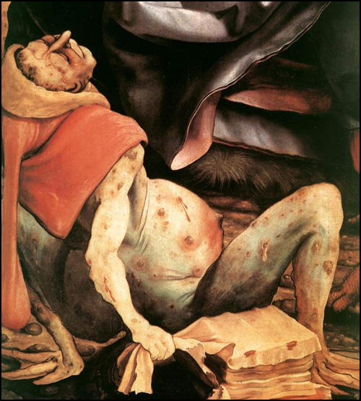
Outbreaks of the Black Death
First hit England in 1348, originating from the Far East and following trade routes via shipping.
Within months it had killed thousands in England. It effected everyone – rich and poor, religious and non-religious.
It was carried by fleas on the back of rats. Once caught, it would kill its victims in 3-5 days.
At it’s height in 1348, it was killing 200 people every day.
It hit England again in 1665, and this time was called The Great Plague. Lasted from June – November.
At it’s height, it was killing 1,000 people every day. In total, 100,000 people in London were killed.

Slide 3
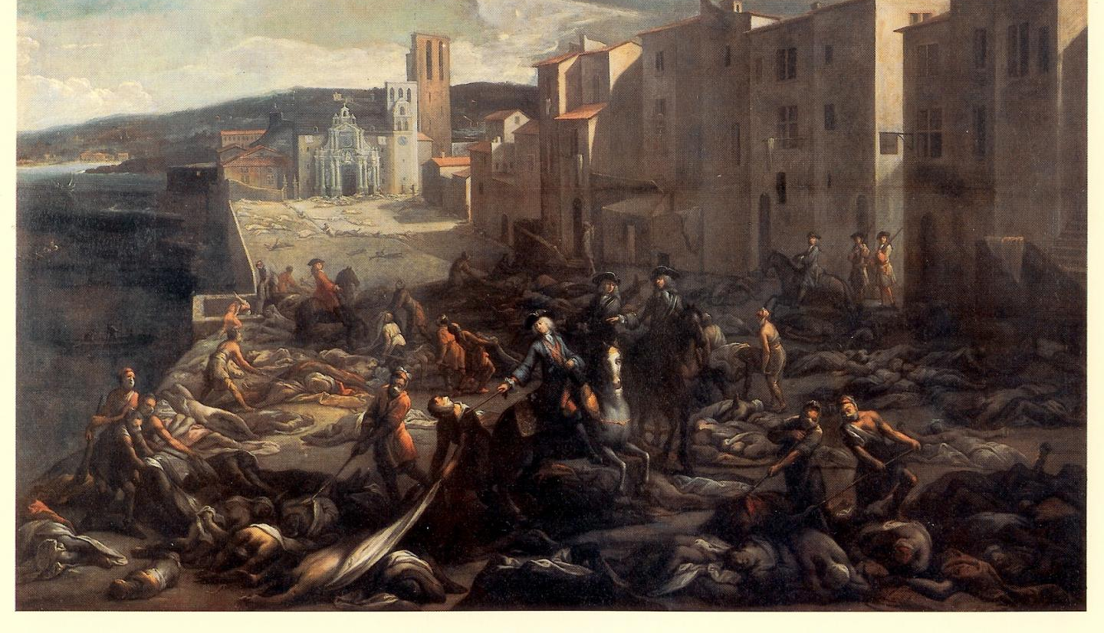

Slide 4
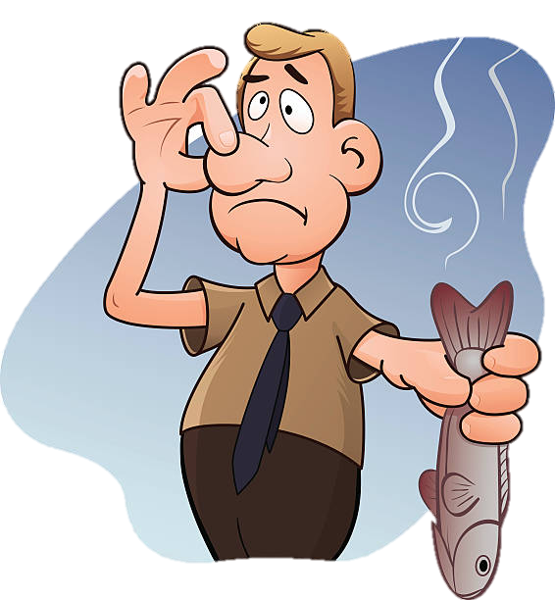
Beliefs about the cause of the disease
Many believed that it was the result of God punishing man kind for their sin in the world. Others said it was Judgement Day, as written in the Bible.
Exact same as 14th Century, it was the result of man’s wickedness. The 300 years since the last outbreak had seen various wars in the world
No change
In 1345 there was an unusual positioning of the planets (Mars, Jupiter and Saturn). Some said this was a sign from God or terrible things about to happen.
Same as 14th Century, people said it was because of the strange alignment of Saturn and Jupiter. Also a comet had been spotted, which was usually a bad sign.
No change
Most people believed it was caused by miasma. The bad smells were created by stinking rubbish an dunghills. When the weather was warm, the smell would increase which made sense as the plague hit in the summer.
A very small amount of people argued that bad air (miasma) caused the disease. This bad air may have originated from an earthquake or volcanic eruption in Europe.
Slight change

Slide 5
Ways of treating the disease
No change
Confess to God your sins and ask for forgiveness. Give money to the Church.
Lots of evidence to suggest people continued to rely on prayer and self-flagellation to show God they were sorry.
Bleeding and purging was used, but didn’t work. Herbs like aloe and myrrh were used because of their cleanliness. Lighting fires to drive off the bar air. Lancing the buboes to drain the puss.
Physicians used something called transference (see previous lesson).
Wrapping the patient up in cloth and lay them by the fire to sweat it out.
Herbal remedies continued to be used (e.g. poultices, tobacco, mint, nutmeg, sugar)
Slight change

Slide 6
Way of preventing the disease
No change
Pray to God
Pray to God
Fast
Go on pilgrimage
Self-flagellation
Carry a pomander around containing perfume
Diets of garlic and sage.
Doctors to wear special masks and outfit to avoid catching disease
Catch syphilis (STI)
Advice from government (Charles II advising fasting)
Escape the disease (leave the city and head to the countryside)
Carry flowers or scented herbs and hold to the nose.
Avoid washing, as hot water would open the pores.
Slight change
Local councils did more e.g. banning festivals, meetings, large funerals etc.
Cats and dogs killed to stop disease spreading (240,000)
Council sent round inspectors to check houses. Anyone infected were taken to a pest house or locked up for 40 days. Red cross painted on door.
Run away to country side
Local councils set up quarantine laws to stop people moving.
Streets stopped being cleaned, rotting bodies and rubbish would drive away miasma.
Slight change

Slide 7
Learning Task One – Exam Practice
Explain one way in which treatment for the plague was similar in the 1300s and 1600s. [4 marks]
Explain one way in which treatment for the plague was different in the 1300s and 1600s. [4 marks]
Explain one way in which preventions for the plague were different in the 1300s and 1600s. [4 marks]
Explain one way in which ideas about the cause of the plague were different in the 1300s and 1600s. [4 marks]

