Slide 1
How did Adolf Hitler change the Nazi Party during the ‘lean years’ of 1924 - 1928?
Source J: A confidential report on the Nazi Party by the Interior Ministry, July 1927.
Starter: Give two things you can infer from Source A about the NSDAP in the 1920s. (4 marks)
Hint: What does it suggest? Back up with a quote.
A numerically insignificant…radical-revolutionary splinter group incapable of exerting any noticeable influence on the great mass of people and the course of political events.
In this lesson, we will:
Describe how Hitler tackled the problems in the Nazi Party in the 1920s.
Assess to what extent he was successful by 1928

Slide 2
Suggests in the context of wider Germany, the party were small and not worthy of paying attention to.
Source J: A confidential report on the Nazi Party by the Interior Ministry, July 1927.
A numerically insignificant…radical-revolutionary splinter group incapable of exerting any noticeable influence on the great mass of people and the course of political events.
Suggests the people of Germany are not really paying attention to what the Nazis are doing
Suggests that they hold quite extreme ideas.

Slide 3
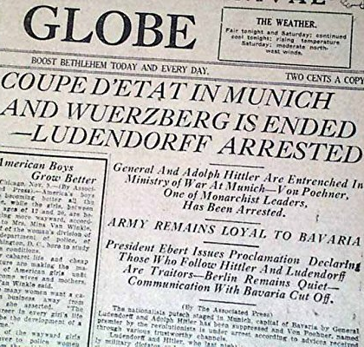
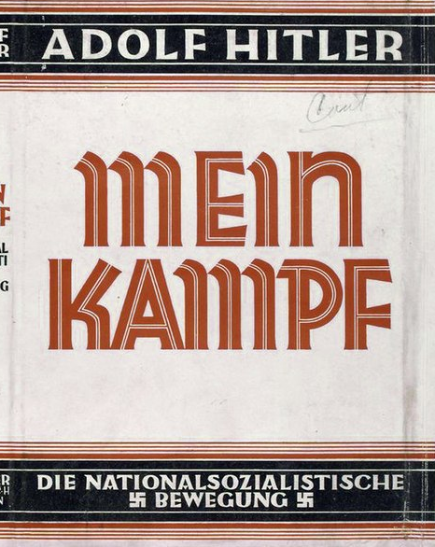
How was this failure important for Hitler?
Firstly, he learnt that the only way to get power was to stand in elections and once in power, destroy the system from within. Although he hated it; democracy was his only option.
Hitler used his trial to get national publicity for his views – the courts were extremely sympathetic to the right wing.
The court rooms were packed full of journalists who publicised his words.

Slide 4
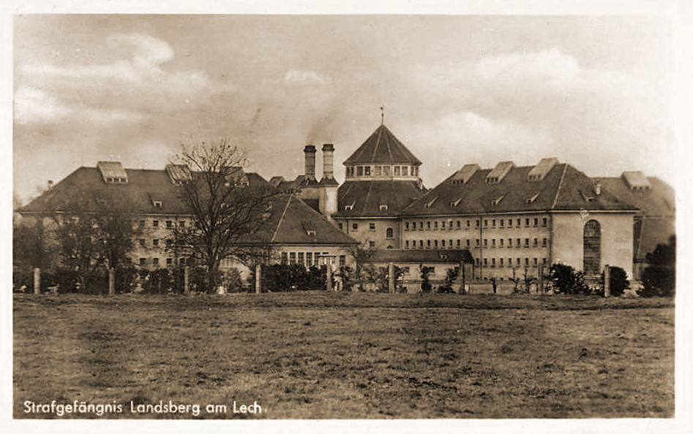

Slide 5
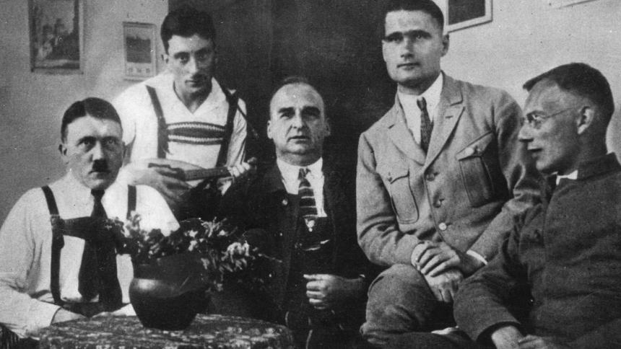

Slide 6
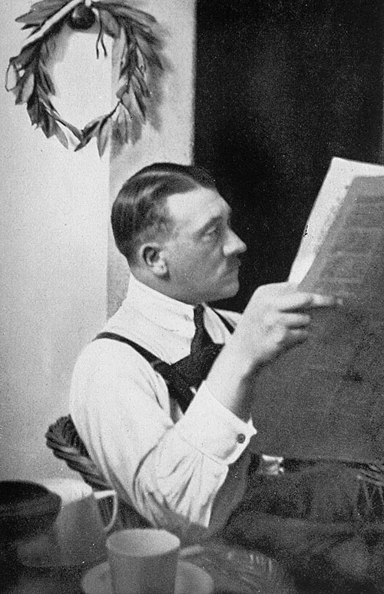
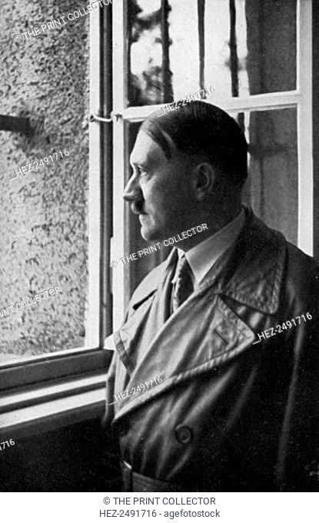

Slide 7
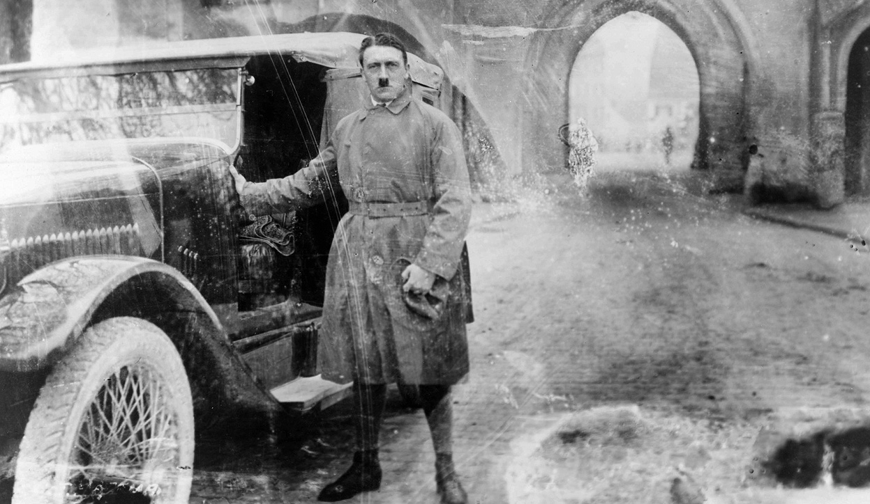

Slide 8
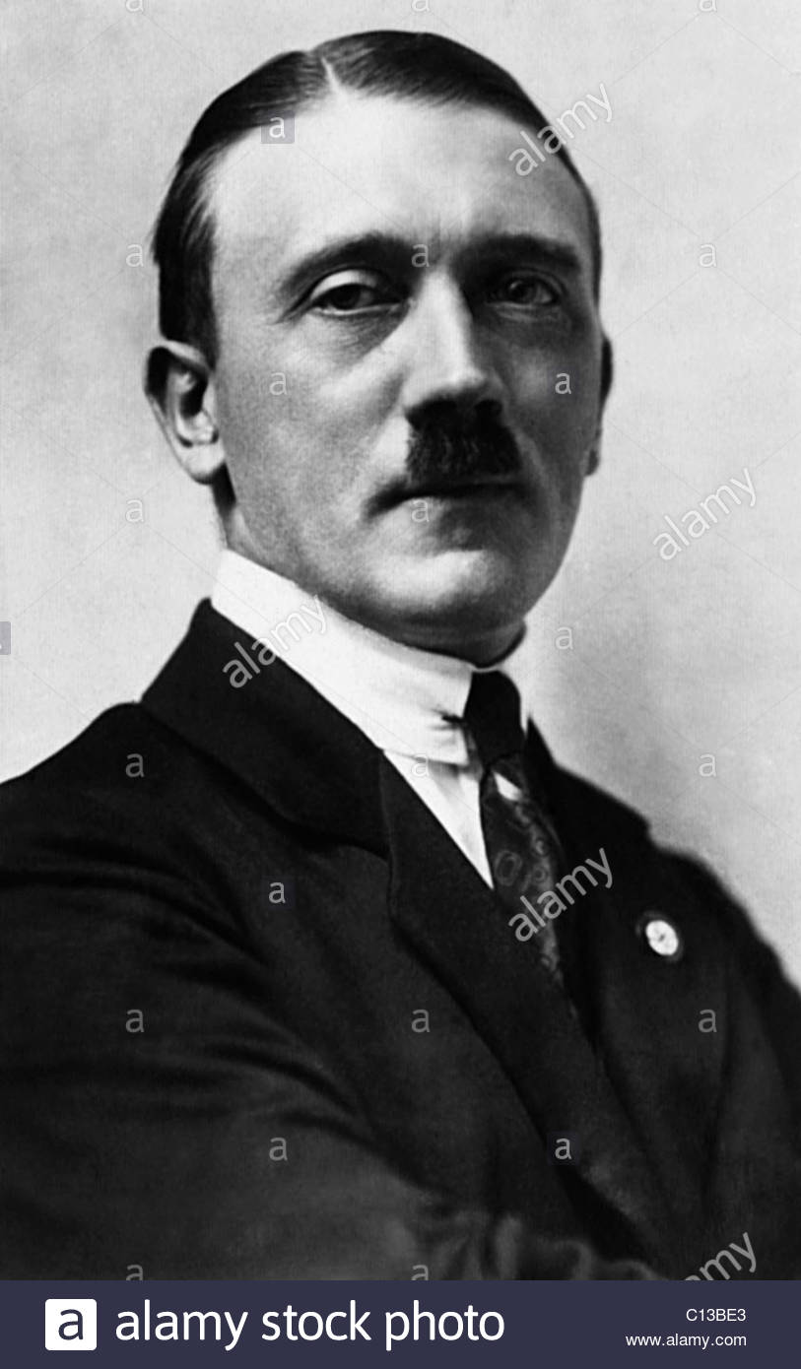
Problems with the Nazi Party, 1924
Although they had a 25 point programme, the party did not have a proper ideology.
They had no proper structure.
They were virtually unknown outside Munich.
The SA were a potential threat to Hitler, as they were difficult to control.
They were split between nationalists and socialists within the party.

Slide 9
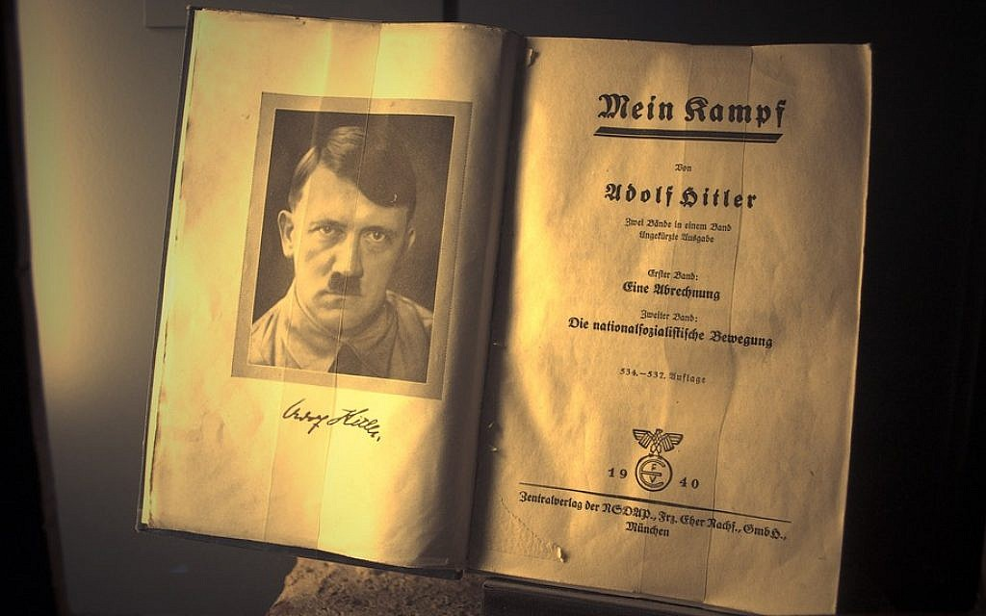
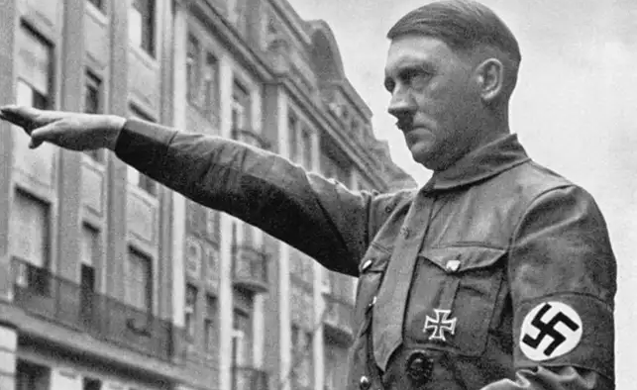
The introduction of an ideology.
Whilst in prison for 9 months, Hitler had time to read widely. He used his time to write down his ideas in a book known as “Mein Kamp This book would be used to give the Nazi Party an ideology after 1924:
The German race (called the Aryan race) were destined to rule the world.
There was a Jewish conspiracy to weaken the Aryan race by intermarriage and take over German industry.
Germany could be made strong by reversing the Versailles Treaty.
Germany should invade Russia and land to the east to create “lebensraum” (living space” for the German people).
The wealth of industry should be used to help German workers, not rich people.
Democracy should be scrapped and replaced by a totalitarian government (only one leader)
Traditional German values (strong family, clear male and female roles, Christian, old-fashioned German art, music and theatre)

Slide 10
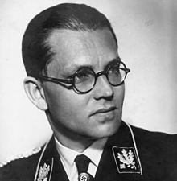
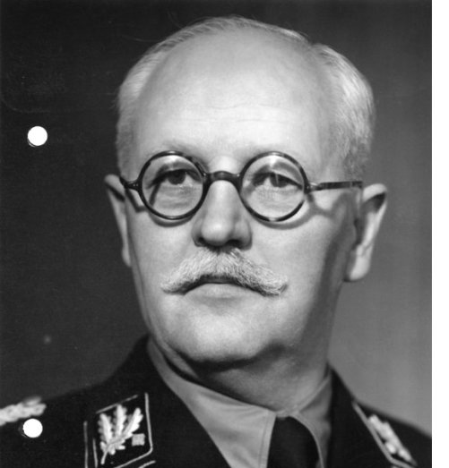
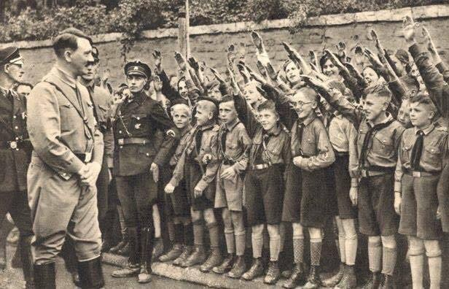
Bringing structure to the party
Philipp Bouler was made secretary and Franz Schwarz made treasurer, this brought organisation and finances.
All aspects of government were given their own departments e.g. finance, foreign affairs, industry, agriculture and education.
The German Women’s Order and National Socialist German Students League were set up to represent women and students within the party.
The Hitler Youth was set up to cater for 14 to 18 year olds.

Slide 11
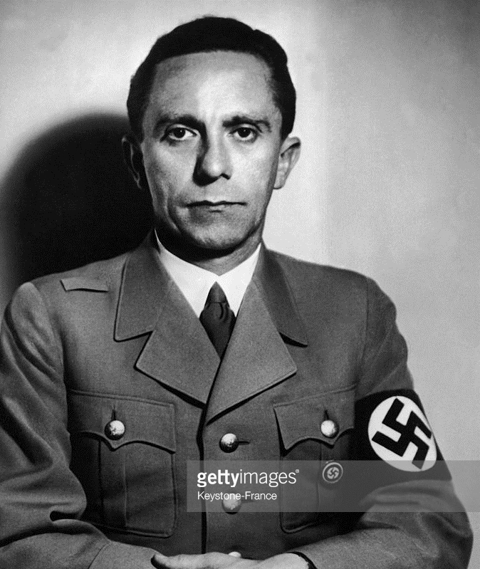
Taking the Nazi Party outside Munich
The rest of Germany was split up into 35 regions. The Nazis appointed one Gauleiter to lead a local Nazi organisation in each. They were not appointed, Hitler relied on them forcing their way to the top much like he did in the DAP.
Gregor Strasser was a powerful Gauleiter in the north and Joseph Goebbels (right) in the Rhineland.
To pay for this expansion, Hitler raised money from wealthy industrialists who shared his views and thought he could control the trade unions. They even got loans form big companies, including Bosch.

Slide 12
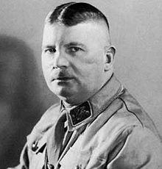
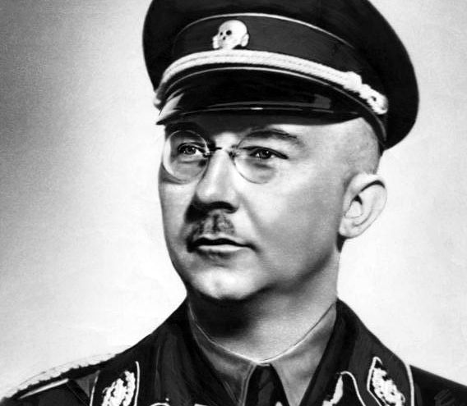
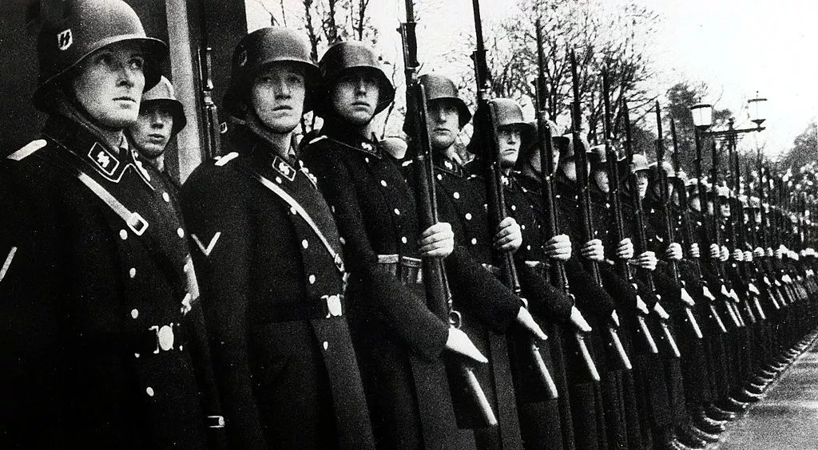
Controlling the violent SA
In 1925, Hitler replaced Rohm as leader of the SA. He was forced to find work abroad until 1930.
The Schutzstaffel (“Protection Squad” or SS) were set up. It was smaller, with members specially chosen by Hitler so they could be trusted.
SS were eventually run by Heinrich Himmler, a senior member of the party. Himmler expanded the SS to 3,000 members by 1930.
Famous and feared for their black uniforms. These were introduced in 1932 and were supplied by Hugo Boss (a member of the Nazi Party since 1931)

Slide 13
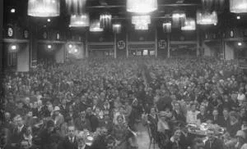
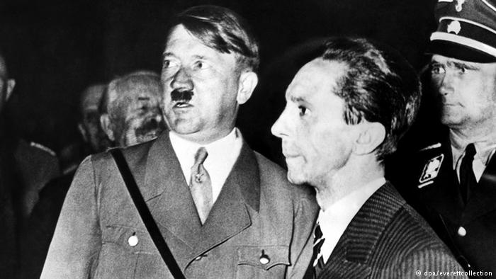
Solving the divisions within the party
Some members, like Goebbels, were based in the northern areas, so emphasised socialism. They stressed benefits for workers. But others, like Hitler, were in the south so emphasised nationalism.
Hitler called a conference of the party in Bamberg, Bavaria. It was mostly made up of southern party members.
Northern leaders were allowed to put forward their views. However Hitler spoke for five hours and attacked the socialists; calling them communists and enemies of the party.
Seeing his potential, Hitler persuaded Goebbels to take his side. In disgust, Goebbels was labelled “a scheming dwarf” by socialist Gregor Strasser.
The socialist principles of the party were weakened.

Slide 14
Learning Task
Targets 7-9
Identify 4 ways Hitler tackled the problem.
Explain how this would have benefitted himself and the wider Nazi Party.
All targets
Your teacher will provide you with a table with the five problems in the Nazi Party in 1924. You should cut this out and glue it into your book.
Targets 4-6
Identify 3 ways Hitler tackled the problem.
For each; what would the impact be? Identify any good and bad things about this (from Hitler’s perspective)
Targets 1-3
For each problem, write down some ways that Hitler tried to change it.

