Slide 1
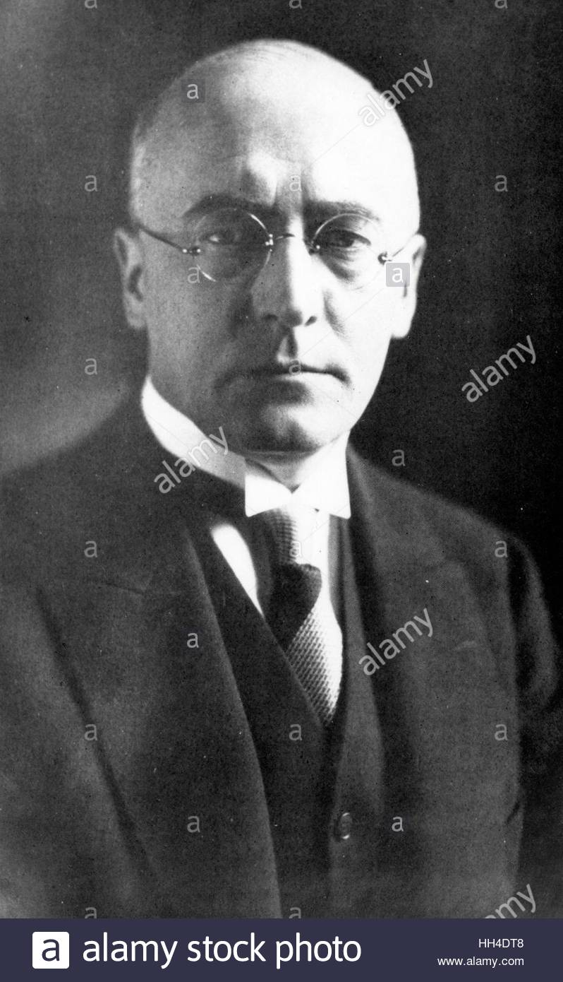
How did Adolf Hitler become Chancellor of Germany in 1933?
In this lesson, we will:
Describe the process that led to Adolf Hitler becoming Chancellor in 1933.
Assess how strong Hitler was by 1933.
Starter: Chancellor Bruning was forced to resign from office in 1932. Can you remember why the Reichstag did not support him?

Slide 2
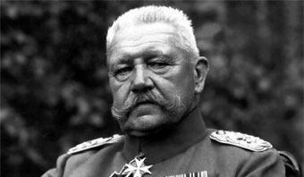
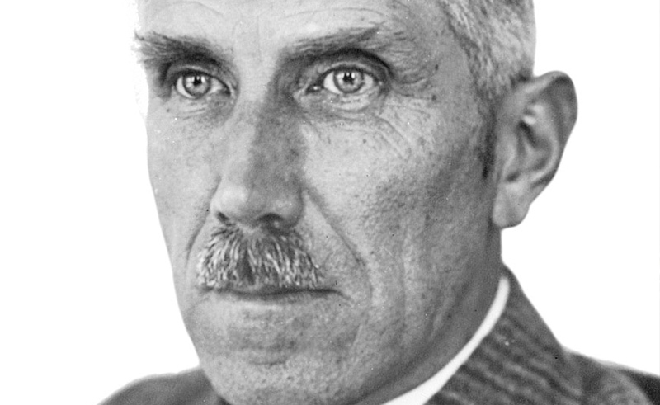
March 1932
At age 84, President Hindenburg calls elections for President. He won 49%, Adolf Hitler won 30%.
April 1932
As no one got over 50%, another Presidential Election is held. Hitler wins 36%, Hindenburg wins 53%
May 1932
Chancellor Bruning resigns as Chancellor, a Reichstag don’t support his policy for dealing with Wall Street Crash.
President Hindenburg appoints Franz Von Papen as the new Chancellor. Hitler and NSDAP agree to support the new government in the Reichstag.

Slide 3
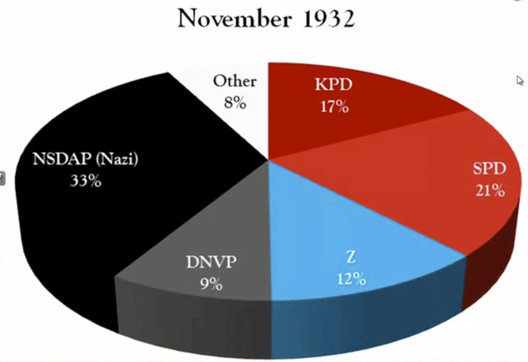
July 1932
Reichstag election are held, it is a massive victory for the Nazi Party. They gain 230 seats and become the largest party in the Reichstag. Hitler demands that Papen be sacked, and he become Chancellor.
August 1932
Hindenburg refuses to appoint Hitler Chancellor – he detests him and finds him vulgar. Von Papen stays as Chancellor.
November 1932
To try and weaken the Nazis in the Reichstag, Chancellor von Papen call another election. Although the Nazis lost eats to 193, they were still the largest party in the Reichstag.

Slide 4
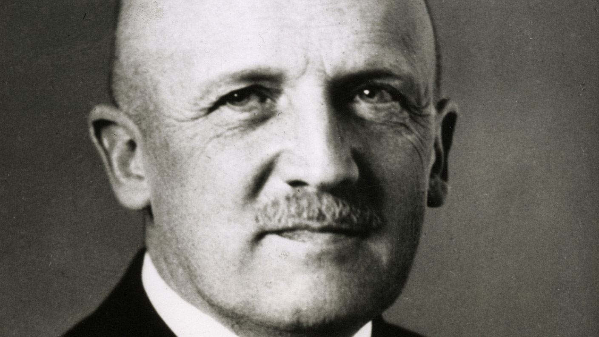
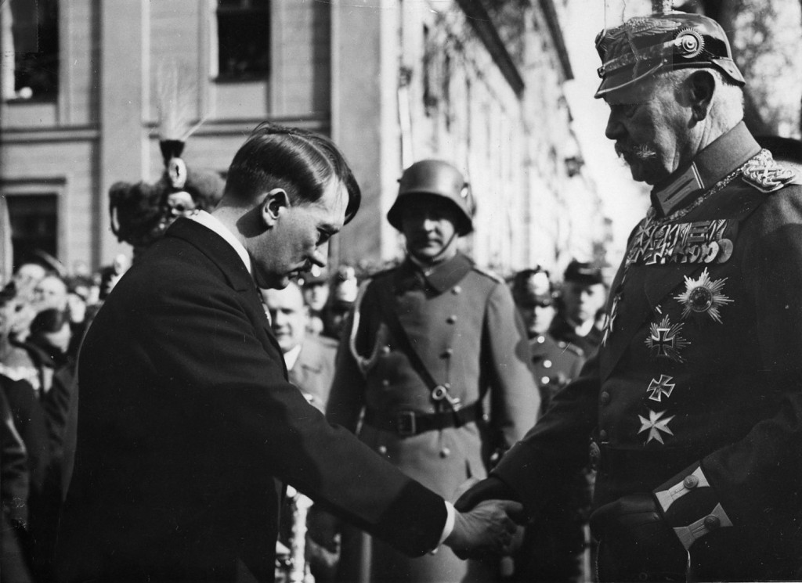
December 1932
Hindenburg is told that if he does not sack von Papen, then Germany could fall into Civil War. Reluctantly, von Papen is dismissed from office. Rather than appoint Hitler Chancellor, Hindenburg makes Kurt von Schliecher, an army general, Chancellor.
January 1933
With no support in the Reichstag, von Schliecher asks Hindenburg to allow him to create a military dictatorship of Germany. To stop this, von Papen suggests that Hindenburg make Hitler Chancellor and himself Vice Chancellor.
Reluctantly, Hindenburg appoints Adolf Hitler Chancellor of Germany.

Slide 5
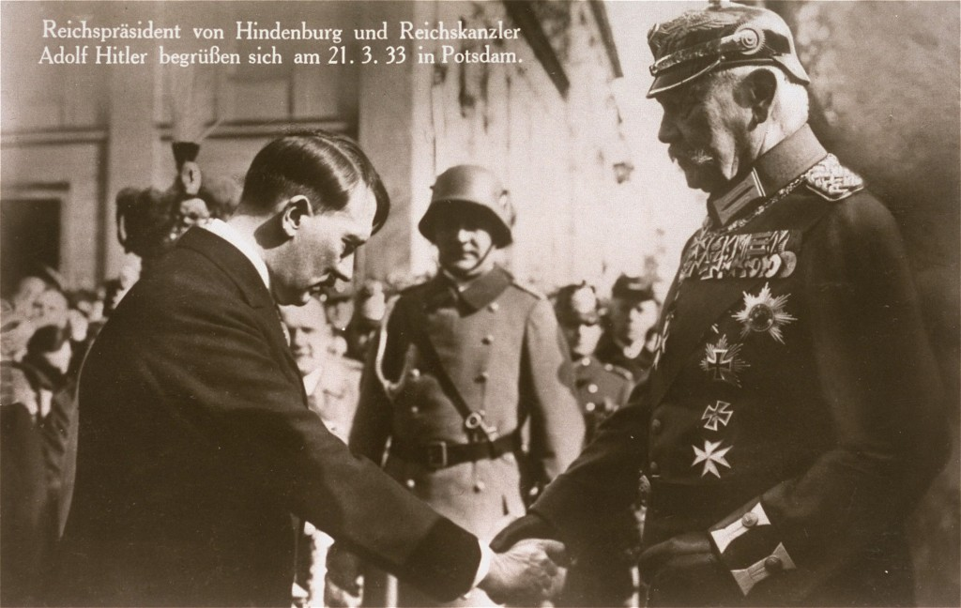
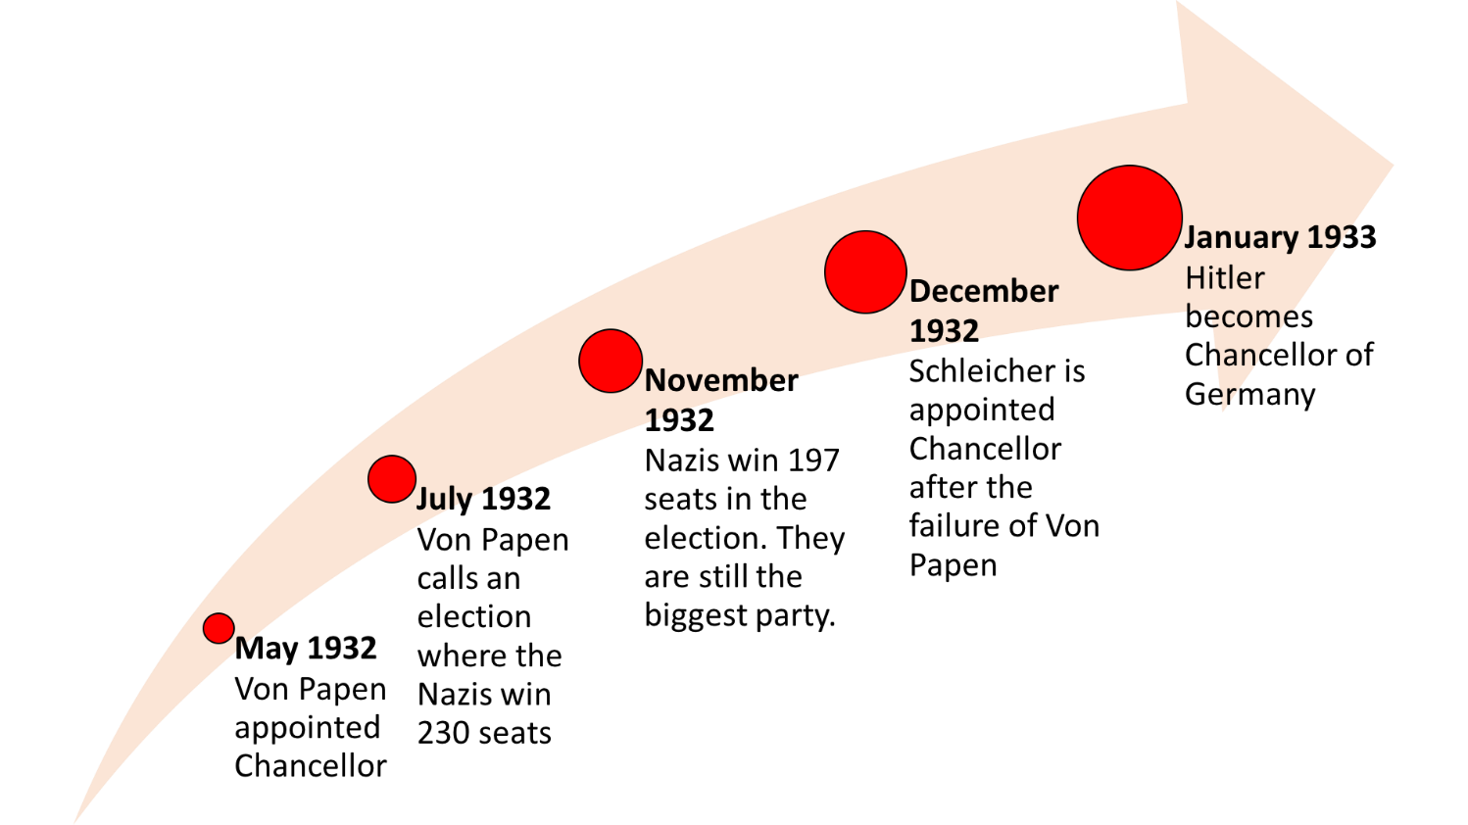
Learning Task One
Cut out each card and match it up to the correct year.
Glue it down in your book to create a timeline!
Go through, and highlight key words and phrases.
Challenge:
How can von Papen and von Schliecer be blamed for Adolf Hitler becoming Chancellor?

Slide 6
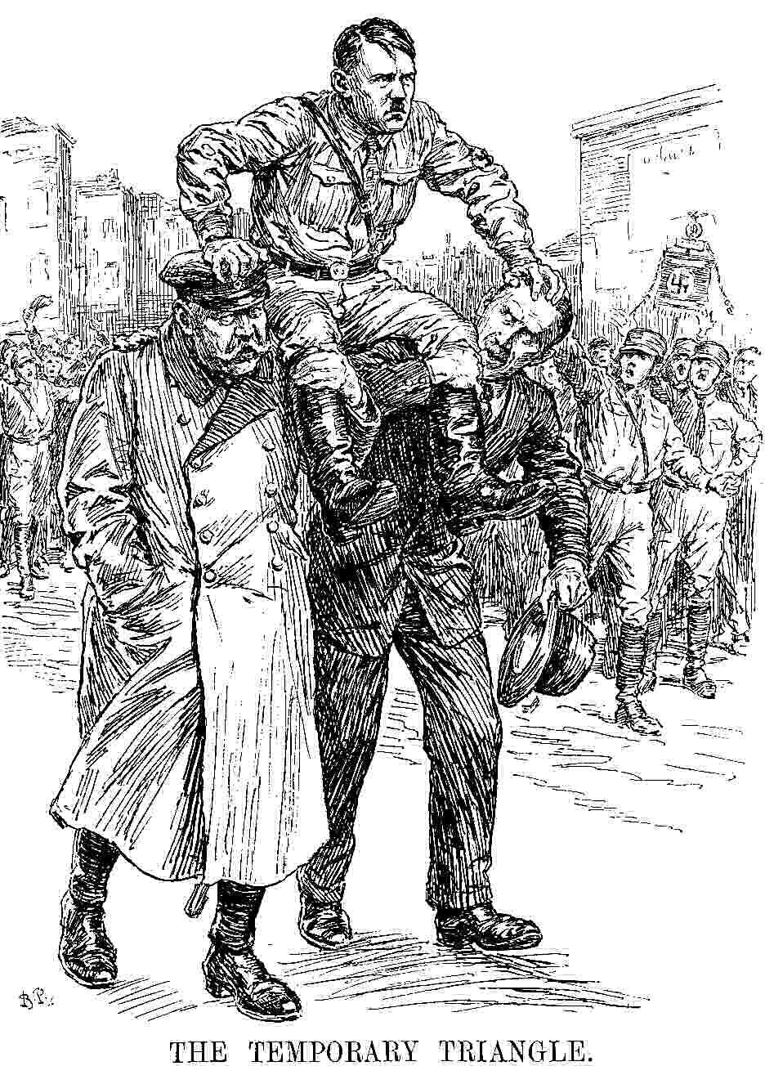
This drawing was printed in the British satirical magazine ‘Punch’ in 1933. It shows President Hindenburg and Vice-Chancellor von Papen holding up Chancellor Adolf Hitler.
What can you infer from this cartoon about Adolf Hitler’s position by 1933?
Using your knowledge from today’s lesson – try to support this interpretation.
Overall – would you say Adolf Hitler was in a strong position by January 1933?

