Slide 1
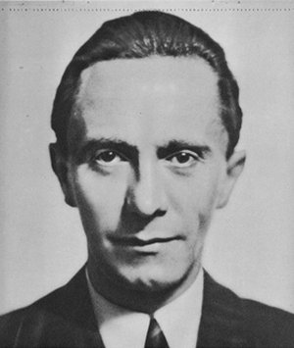
Did Hitler really reduce unemployment in Germany?
In this lesson, we will:
Describe the ways that Hitler’s government tried to tackle unemployment.
Assess to what extent the Nazis ‘hid’ unemployment.
Starter: Return to your lesson on how the Nazis used culture. As a class we will discuss how art and music were used by Goebbels and the Ministry of Propaganda.

Slide 2
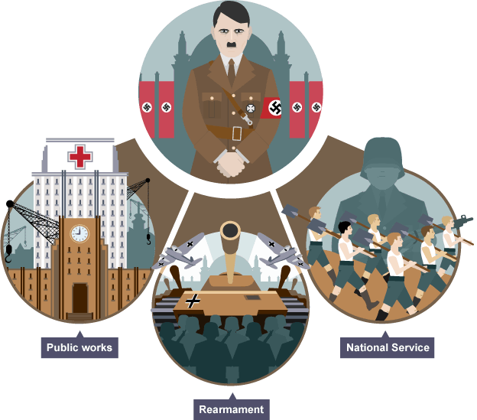

Slide 3
Learning Task One
https://www.bbc.com/bitesize/guides/zpq9p39/revision/1
Evidence of Nazi economic success | Evidence of Nazi economic failure

Slide 4
Learning Task Two
Year | % Unemployed
1932 | 44%
1933 | 36%
1934 | 21%
1935 | 16%
1936 | 12%
1937 | 7%
1938 | 3%
1939 | 1%
Collect your copy of the unemployment figures for Nazi Germany.
Draw a bar graph to show this data.
Explain what we can learn from this graph.
Using your own knowledge, explain why this is happening. (pp.123-125)
Explain why we cannot trust this data (p.125)
Overall – how would this have benefitted the Nazi party?
Topical thought
Who would have benefitted from these policies?
Who would have suffered?

Slide 5
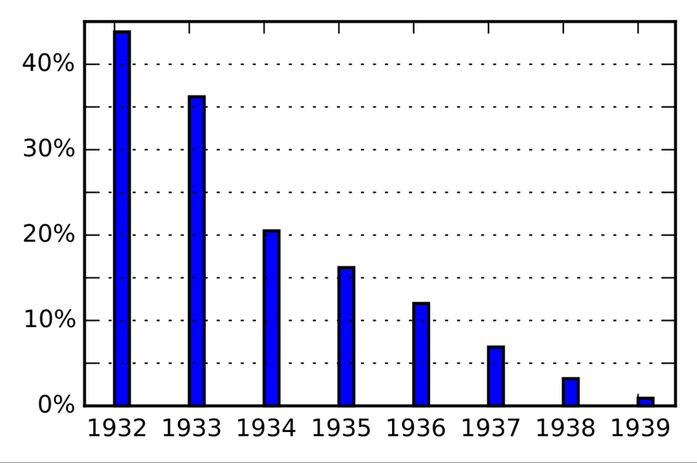

Slide 6
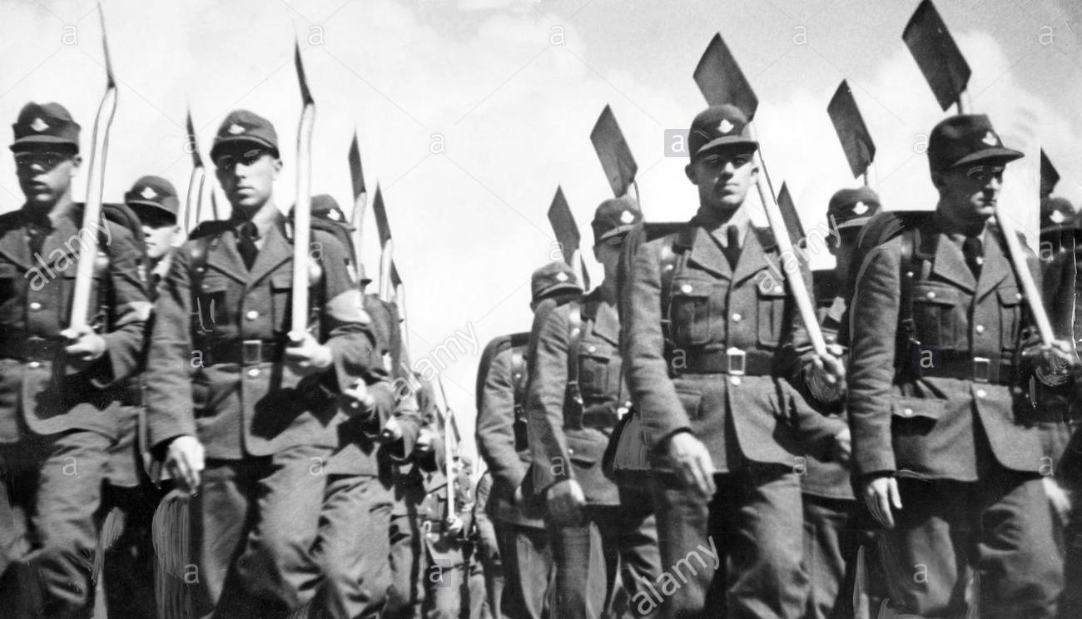
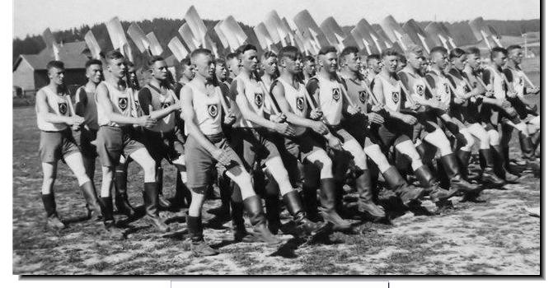
The ‘RAD’ project
Set up in 1933 – offered paid work for unemployed.
People were put to work repairing roads, planting trees and draining marshes.
After 1935 it was compulsory to serve 6 months.
Run like an army – uniforms, camps, drills and parades.
Pay was very low and working conditions poor.
422,000 were part of RAD in 1935.

Slide 7
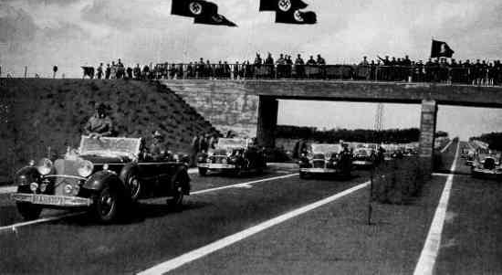
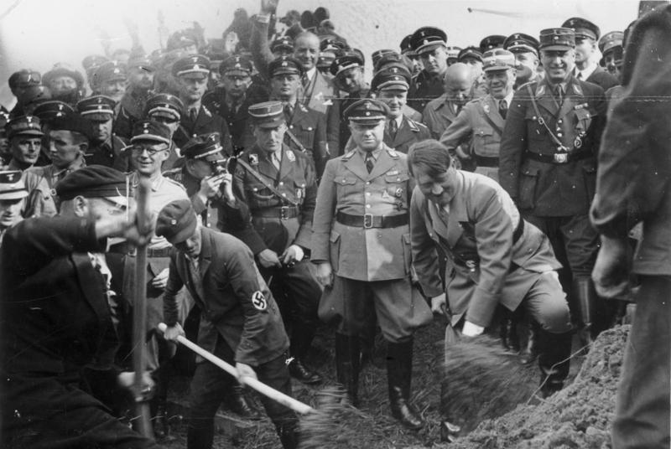
The Autobahn project
Set up in September 1933.
Planned to build over 7,000 miles of motorways and dual carriage roads.
First stretch was laid in May 1935.
By 1938 125,000 men had built 3,500km of road.
Helped employment and also Germany.
Cheaper transport helped industry and agriculture.

Slide 8
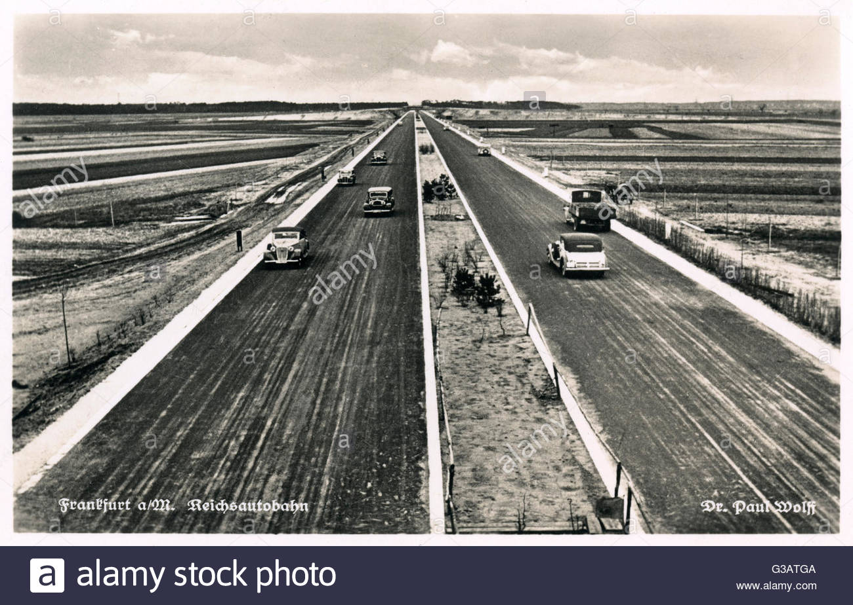

Slide 9
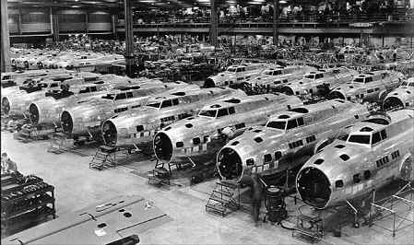
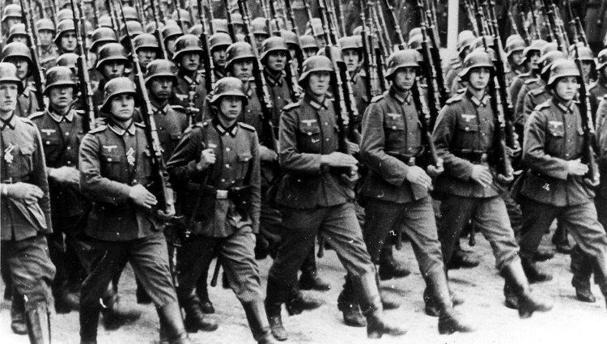
How did rearmament help Germany?
In 1935, conscription was introduced. By 1939 there 1.36 million soldiers.
Spending on armed forced increased from 3.5 billion to 26 billion.
Massive surge in people employed in arms production (tanks, aircraft, weapons etc.)
Aircraft employment increased from 4,000 to 389,000 by 1939.
This boosted the support for the Nazis from all sections of German society.

