Slide 1
Was the ‘wild west’ really so lawless?
In this lesson, we will:
Describe the case of Billy the Kid
Assess to what extent his case can be seen as an example of lawless in the west.
Starter: Valentines day special!
Who was King William I’s wife?
What did King William love as much as his own children?
Who was Oliver Loving?
Name two groups of people we’ve studied who could have more than one wife.
True or false – Plains Indians ate the heart of a buffalo.

Slide 2
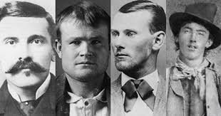
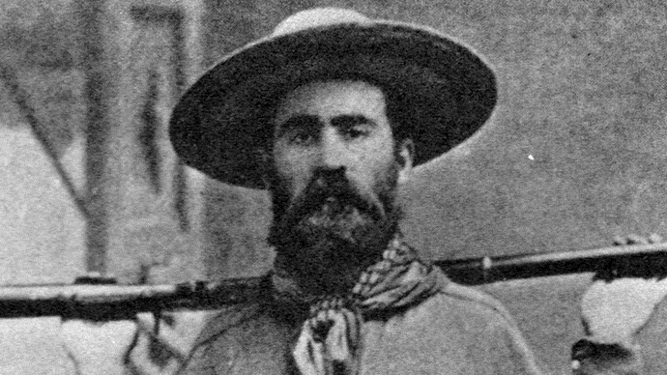
Why was there so many outlaws in the west?
Most people struggled to make a living, so crime was hard to resist.
Territories were so large that gangs found it easy to escape justice.
Due to the poor pay, governors and sheriffs often took bribes.
Traditional justice was often undermined by vigilante justice – people took the law into their own hands.

Slide 3
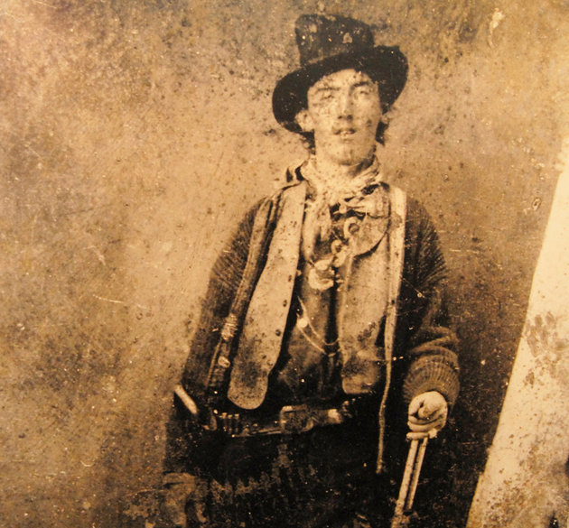
Who was Billy the Kid?
Born Henry McCarty and grew up in New Mexico.
Got involved with theft at 15 (cattle rustling and horse stealing).
Was involved in the Lincoln County War, resulting in the death of his friend Murphy.
In 1878 he vowed to kill everyone responsible for Murphy’s death.
Started calling himself ‘William Bonny’

Slide 4
Learning Task One
Read the article provided to you by your teacher.
Glue it into your book page.
With a colour, highlight all the crimes committed by Billy the Kid.
With another, highlight strategies used to capture him.

Slide 5
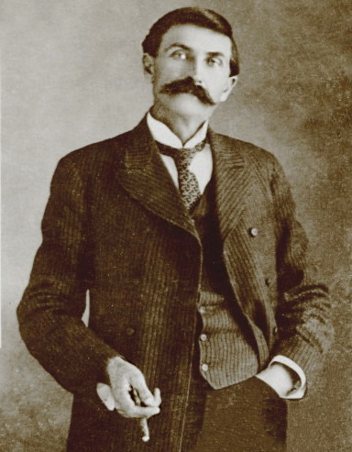
How was he caught?
In December 1880, a $500 bounty was set for his capture.
Sheriff Pat Garrett caught him on December 23rd and brought him to court.
In May 1881, Bonney was sentenced to hang.
Whilst in prison, he managed to escape by killing two men.
By July, Garret tracked him down to Fort Sumnter and shot him in the heart.

Slide 6
Learning Task Two
Green groups
Explain the importance of Billy the Kid for the problems of law and order (8 marks)
Draw and complete the table below for the story of Billy the Kid.
Evidence of the west being ‘lawless’ | Evidence of the west not being ‘lawless’
Orange groups
How could Billy the Kid be seen as a hero for the downtrodden?
How could the case of Billy the Kid be seen to show a weak justice system?
Blue groups
What does this case show us about the wild west?

