Slide 1
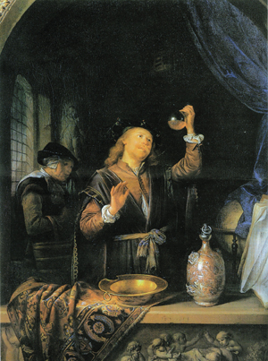
Why did ideas about medicine and disease begin to change between 1500 and 1700?
Starter: Explain one difference between a physician in the 1200s and 1600s.
By the end of this lesson we will:
Describe some new ideas during this time period.
Explain why new ideas were beginning to form during this period.

Slide 2
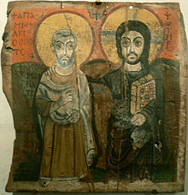
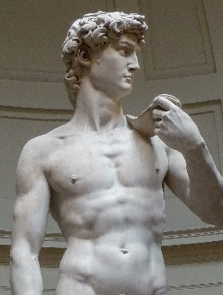
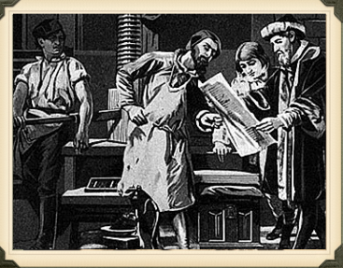
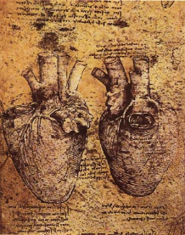
What does ‘Renaissance’ mean?
The Renaissance was time in which great changes in society began to take place. The word literally means “rebirth”
The Renaissance saw the beginning of scientific method - which involved conducting an experiment, collecting observations, then coming to a conclusion.
Artists began to study the body more carefully and some began to study/drawn anatomy.
The printing press allowed new ideas to spread quickly through Europe.
The discovery of America by Columbus meant that new foods and medicines were brought back from the New World.
As a result of this change in society, medical knowledge of human anatomy and disease began to improve!

Slide 3
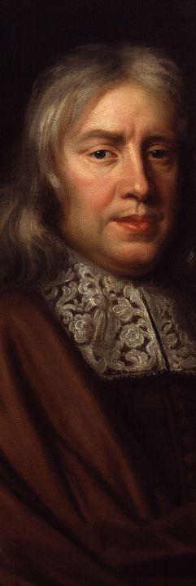
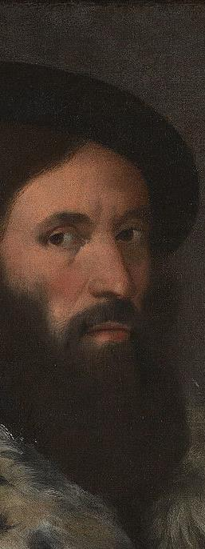

Slide 4
Checkpoint one: Can you describe some new ideas during this time period?
For each of the people below, write their name and write down one new idea/technique/discovery they contributed to medicine during the Renaissance:
Paracelsus
Girolamo Fracastoro
William Harvey
Jan Baptiste van Helmont
Robert Hooke
Thomas Sydenham
Antony van Leeuwenhoek
Stretch challenge
For each, write one sentence explaining how much of a change this was/why it was important.

Slide 5
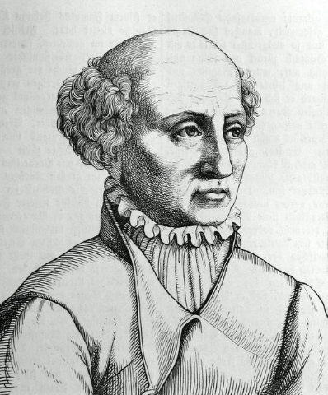
Disease was something separate from the body, which needed to be attacked.
Promoted the use of new chemical treatments, influenced by alchemy/iatochemistry
Very different from medieval, as rejects the idea of Four Humours which said disease was caused by something inside the body.

Slide 6
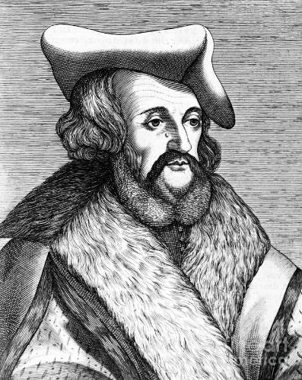
Writes and prints a book called ‘On Contagion’ in 1546. It suggests disease is caused by seeds in the air.
Slightly different to medieval beliefs as suggesting external factors, but similar to miasmic theory.

Slide 7
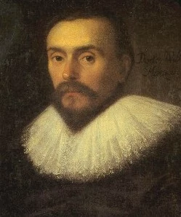
Writes a prints a book in 1628 which suggests blood is circulated around the body, rather than being made in the liver
Extremely important as first to prove Galen wrong.

Slide 8
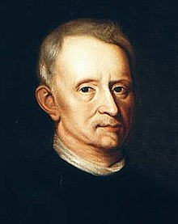
Developed a better understanding of the digestive system.
Said disease had nothing to do with eating the wrong things.
Said urine was not the best way to diagnose illness

Slide 9
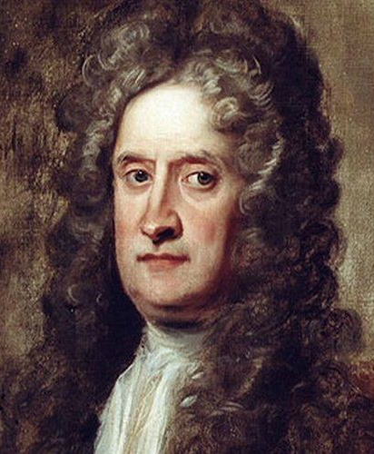
Publishes a book in 1665 called ‘Micrographia’ which showed detailed images underneath microscopes.
He copied the image onto paper and had it pubished (including drawing of a flea!)
Very important, as beginning to use technology to look closer at human anatomy.

Slide 10
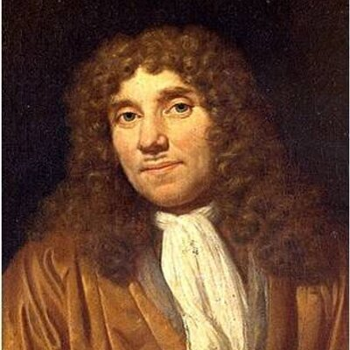
Uses microscopes to observe ‘animalcules’ in plague scraped from human teeth.
Publishes image in 1683
Very important as it is the first recorded evidence of bacteria.

Slide 11
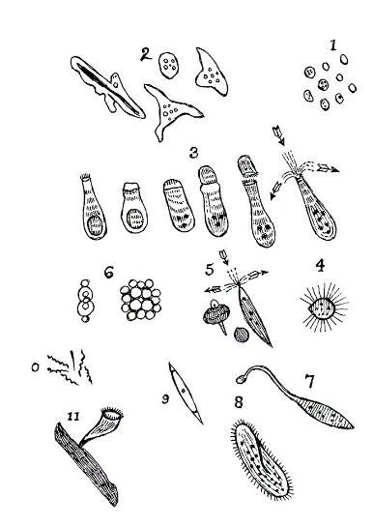
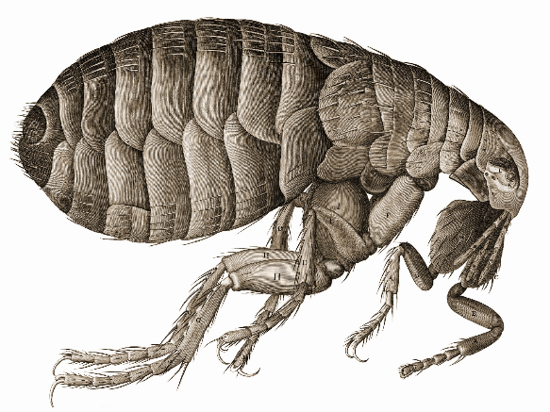
‘Animalcules’ or ‘Little Animals’ (1683) Antony van Leeuwenhoek
‘The Flea’ (1665), Robert Hooke

Slide 12
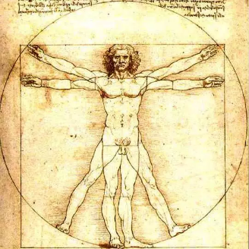
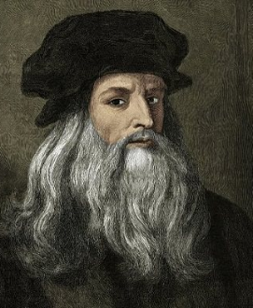
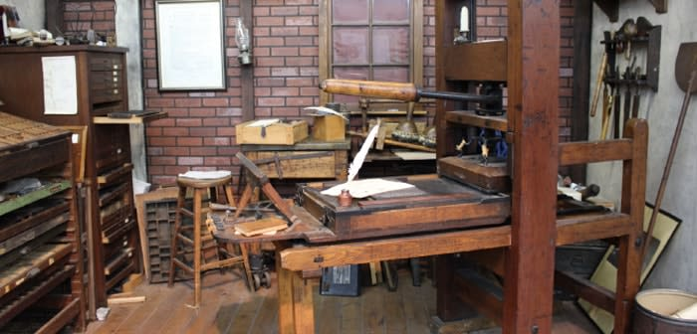
Why did things begin to change during the period?
One reason is because of the development of ‘Humanism’ which spread through Europe.
This was an idea that promoted learning and said that humans could make up their own mind when it came to discovering truth.
Humanists rejected the idea that God caused everything but they hadn’t came up with their own ideas yet.
These ideas began to spread and influence other people thanks to the invention of the printing press.
As new books are published, it encouraged more people to begin to experiment and investigate medicine. People began to be more critical of the Church!

Slide 13
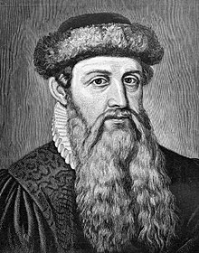
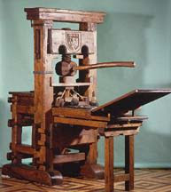
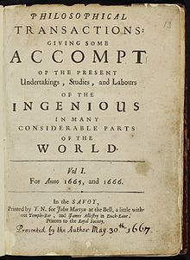
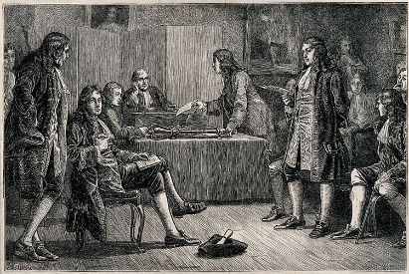
Leads to…
https://www.youtube.com/watch?v=8svE2AjQWYE

Slide 14
Checkpoint two: Can you explain why new ideas were beginning to form during this period?
On half a page of your book, draw a small timeline. It should start and end with:
Gutenberg creates printing press (1439)
Royal Society published first journal (1665)
In the middle, you should write a small narrative explaining how one event led to another!

Slide 15
Gutenberg creates printing press (1439)
It involves small wooden or metal letter blocks that can be moved to print text
The world becomes more connected as books allow new ideas to spread quickly around Europe and the world e.g. Fracastoro, Sydenham etc.
The Royal Society is established – they aim to explain the world in secular terms and allow scientist to share ideas and talk to each other. They encouraged argument and debate about scientific theory. King Charles II supported this.
Books no longer controlled by the Church, doctors and physicians who are experimenting can now printing their ideas.
As doctors and scientists begin to read the work of others, they begin to look for a way to group together.
The Society publishes their first scientific journal which consisted of letters, book reviews and experiments conducted by doctors and scientists. This was important as it made it easier for new ideas to spread and for young doctors and physicians to gain access to the latest ideas.

Slide 16
William Harvey publishes a book which shows that the heart pumps blood around the body, rather than Galen’s idea of the liver constantly making new blood. His ideas are based on dissections and observations. This was important, as he proved Galen was wrong.
The Royal Society is established – they aim to explain the world in secular terms and allow scientist to share ideas and talk to each other. They encouraged argument and debate about scientific theory. King Charles II supported this. This was important, as it allows a platform for ideas to be shared and starts to develop a critical view of medicine.
Fracastoro wrote a text called On Contagion, suggesting that disease was caused by seeds that spread in the air. This was important, as it begins to challenge Four Humours and moves towards the idea of ‘germs’
Antony van Leeuwenhoek developed a microscope and discovered what he calls “animalcules” – this was the first recorded observation of bacteria.
Printing press invtented in 1440 in Germany, by 1500 there were hundreds across Europe. Text no longer had to be done by hand, so the Church could not control the supply of books. Helps medicine develop as new ideas could now be published and spread. Physicians could not criticise Galen and thousands could read it.
Sydenham publishes Observationes Medicae which rejected the idea of the Four Humours and suggested illness was caused by external factors. Sydenham encouraged doctors to observe their patients’ symptoms, write them down and then find ways to cure each symptom. He rejected the idea that the personality of a human had anything to do with illness.
Medicine largely influenced by Hippocrates and Galen. The Four Humours and Theory of Opposites seen as the only legitimate theory for treating disease. Church controls all medical training.
The Society publishes their first scientific journal which consisted of letters, book reviews and experiments conducted by doctors and scientists. This was important as it made it easier for new ideas to spread and for young doctors and physicians to gain access to the latest ideas. Scientists began to build on others work e.g. when Leeuwenhoek’s theory of “animalcules” was published. Robert Hooke used his own microscope to confirm their existence.

