Slide 1
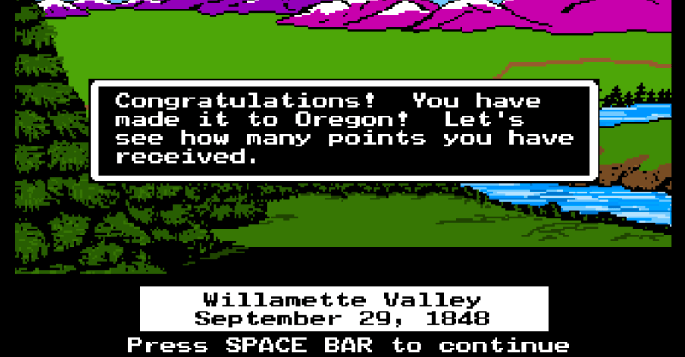
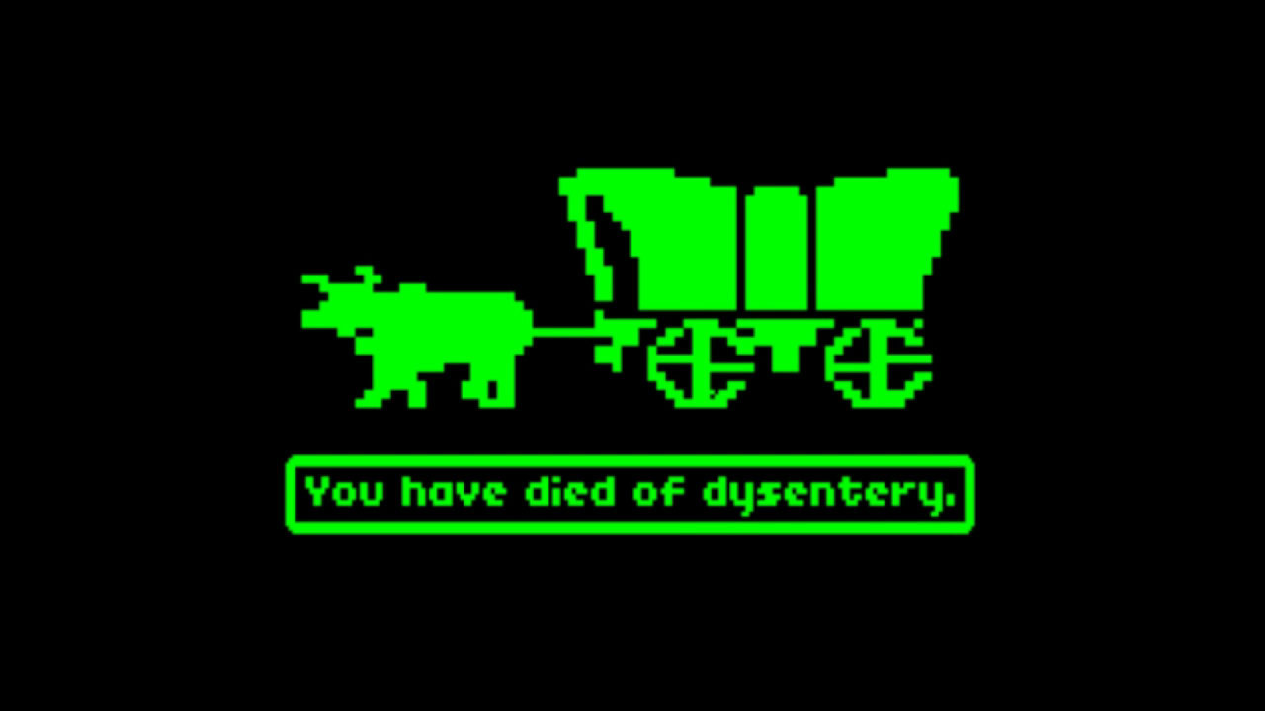
What dangers were there travelling west on the Oregon Trail?
In this lesson, we will:
Describe the dangers facing migrants on the journey west.
Explain solutions developed to overcome these problems.
Starter: True or false?
The Oregon Trail is over 2,000 miles long.
To reach the west coast before winter, migrants had to reach ‘Indepedence Rock’ by 4th July.
The biggest threat facing travellers was Indian attacked.
60% of all people who travelled along it, died.

Slide 2
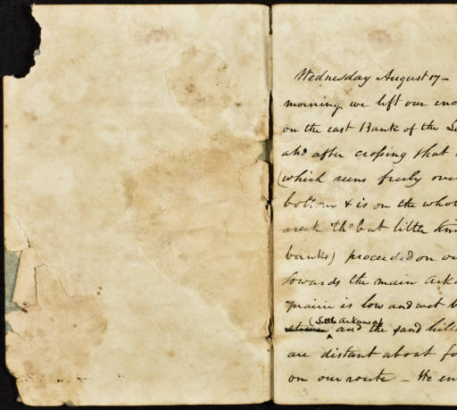
Learning Task One
Read through the primary sources given to you. Each was written by a migrant who travelled the Oregon Trail.
Using this, identify as many problems as possible facing migrants.
You must provide a quotation from the source to support it!

Slide 3
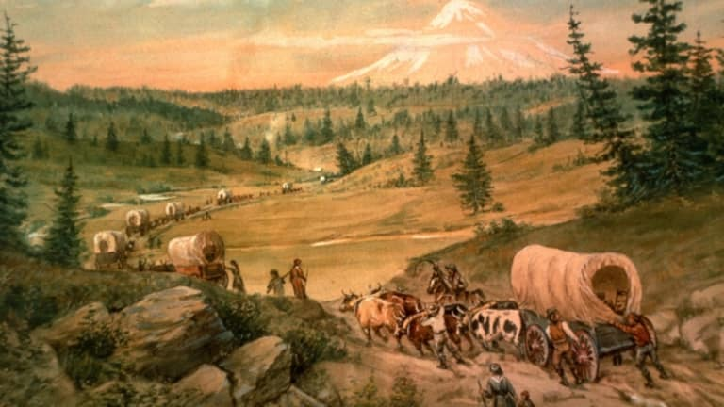
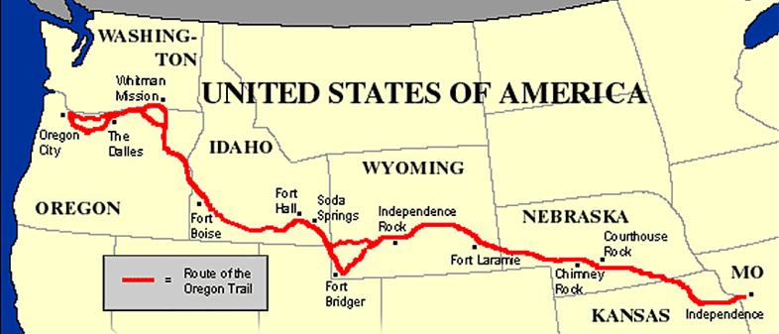
Some background on the Oregon Trail
It is 3,200km long.
Starts at the Missouri rover and ends in Oregon.
When heading to California, migrants had an extra 600km to travel after coming off the Oregon Trail.
Most migrants travelled in families – they were not professionals.
The wagon was used for supplies, the sick and the elderly. Most walked 15 miles per day.
More than 20,000 people died on the journey west.

Slide 4
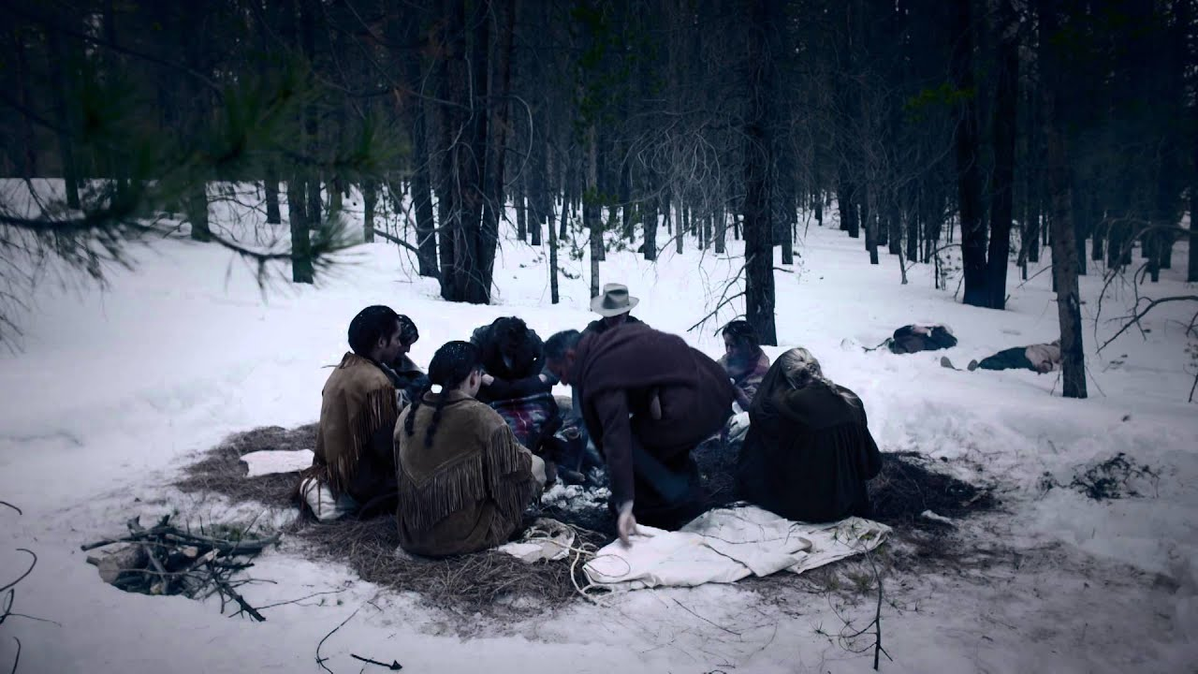
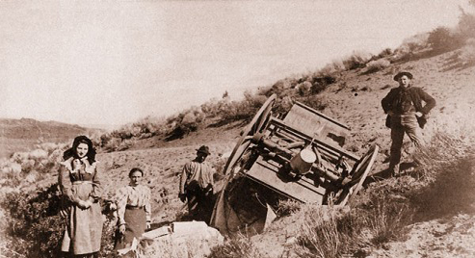
What dangers were there on the journey west?
The threat of winter could trap migrants in the Rocky Mountains. They would freeze to death.
Animals would run out of food as grass could be depleted.
Migrants could run out of food. Little to hunt.
They had a lot of supplies to carry with them.
Wagons could break an axel and migrants would be stranded.
Migrants could get injured by animals, firearms or slip on wet rocks.
Diseases could kill e.g. yellow fever, smallpox and cholera.

Slide 5
Learning Task Two
Green and Orange Groups
For each problem below, identify the solution:
Freezing to death in winter.
Running out of food.
Lots of heavy supplies to carry.
Wagons breaking down.
Injuries
Diseases (e.g. cholera)
Blue groups:
Match up the heads to the tails on the sheet provided. It will show the problems and solutions facing migrants.

Slide 6
Problems | Solution
The threat of winter could trap migrants in the mountains. They would then freeze to death. | They would leave in April, that way the fresh grass would have grown allowing food for their cattle and horses.
Animals pulling the wagons could run out of food and die due to grass being depleted. | They had to stick to the trail at all times and slow down during difficult terrain. They often brought with them a carpenter who could repair any damage.
Migrants had to carry a lot of supplies and belongings with them | Migrants had to bring food with them to survive on. The most common was salted pork which stayed fresh for months. Also dehydrated vegetables in ‘brick’ format could be rationed.
Food was very scarce on the journey. People could starve. | Very little people could do stop this. Someone with medical skills may be able to make the feel comfortable but medicine was very basic.
Wagons could break down and migrants would be stranded. | Wagons were used to carry belongings. They could be used in ‘trains’ sometimes up to 20 to carry lots of items.
Injuries were common e.g. animal attacks, firearms or slipping on wet rocks. | Migrants would set off early in the year, to make sure they made the journey before winter. The aim was to reach Independence Rock by 4th July.
Diseases could kill migrants e.g. yellow fever, smallpox and cholera. | People would come along with medical skills to perform basic first aid.

Slide 7
Problems | Solution
The threat of winter could trap migrants in the mountains. They would then freeze to death. | Migrants would set off early in the year, to make sure they made the journey before winter. The aim was to reach Independence Rock by 4th July.
Animals pulling the wagons could run out of food and die due to grass being depleted. | They would leave in April, that way the fresh grass would have grown allowing food for their cattle and horses.
Migrants had to carry a lot of supplies and belongings with them | Wagons were used to carry belongings. They could be used in ‘trains’ sometimes up to 20 to carry lots of items.
Food was very scarce on the journey. People could starve. | Migrants had to bring food with them to survive on. The most common was salted pork which stayed fresh for months. Also dehydrated vegetables in ‘brick’ format could be rationed.
Wagons could break down and migrants would be stranded. | They had to stick to the trail at all times and slow down during difficult terrain. They often brought with them a carpenter who could repair any damage.
Injuries were common e.g. animal attacks, firearms or slipping on wet rocks. | People would come along with medical skills.
Diseases could kill migrants e.g. yellow fever, smallpox and cholera. | Very little people could do stop this. Someone with medical skills may be able to make the feel comfortable but medicine was very basic.

Slide 8
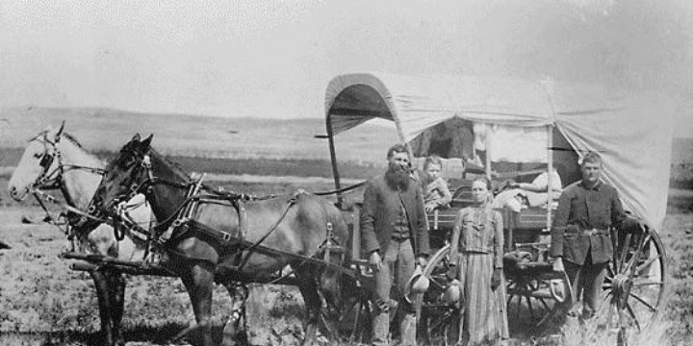

Slide 9
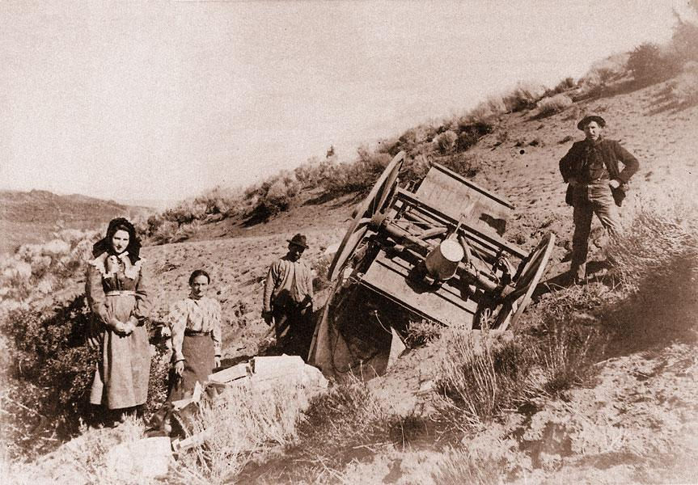

Slide 10
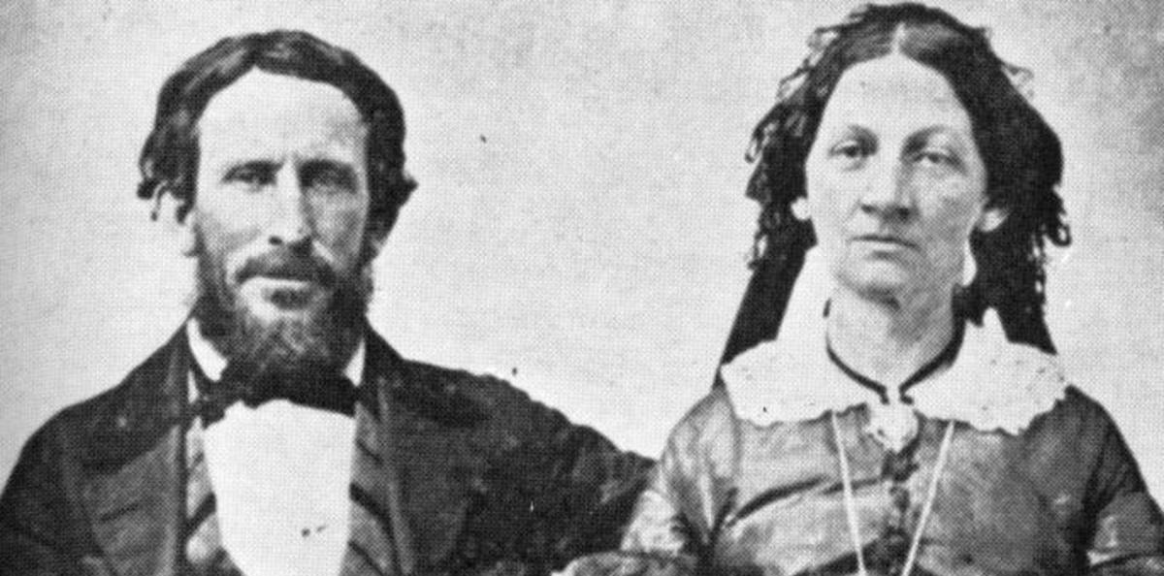
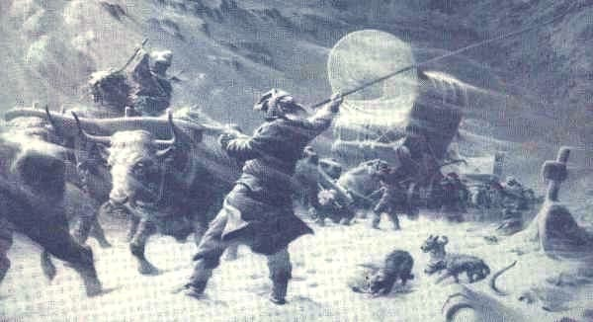
Why was the Donner Party migration a failure?
They were a group of 300 migrants in 60 wagons.
They set out in May 1846.
Two brothers and group of 80 decided to try a shortcut suggested by another guide.
The short cut was a disaster as the route was difficult to travel through (rocky, steep slopes etc.)
The party struggled to cross rivers, and travelled through large areas of desert.
By November, they reached the Sierra Nevada mountains. Snow storms trapped them for 3 months.
Only 40 survived by eating the corpses of those who died.

Slide 11
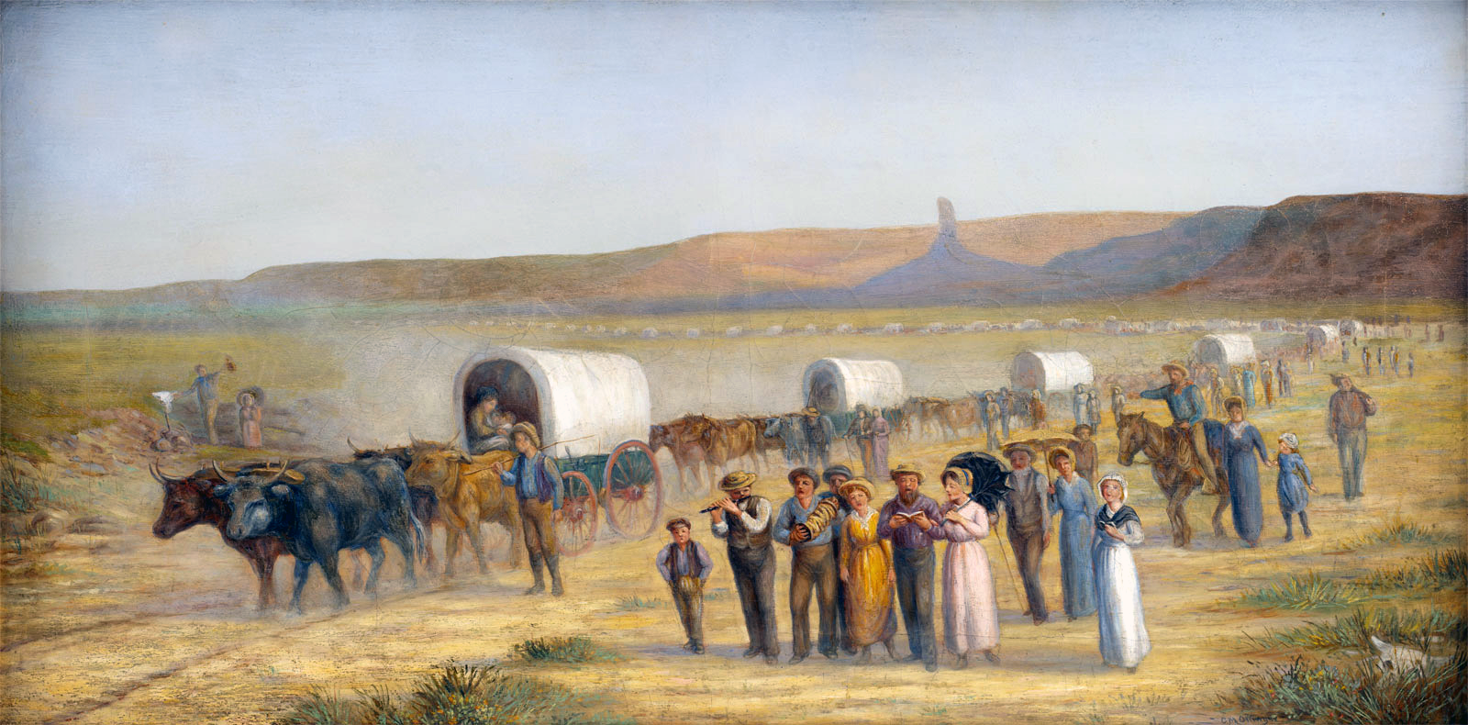
Why was the Mormon migration so successful?

