Slide 1
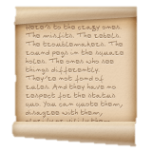
How much did treatments change between the Medieval and Renaissance periods?
Starter: Try to identify the two key events shown in emoji form below.
Challenge: Can you write a fact about them?
In this lesson, we will:
Identify key features of treatment in the 13th and 16th centuries
Compare both centuries and explain changes and continuity.
1.
2.

Slide 2
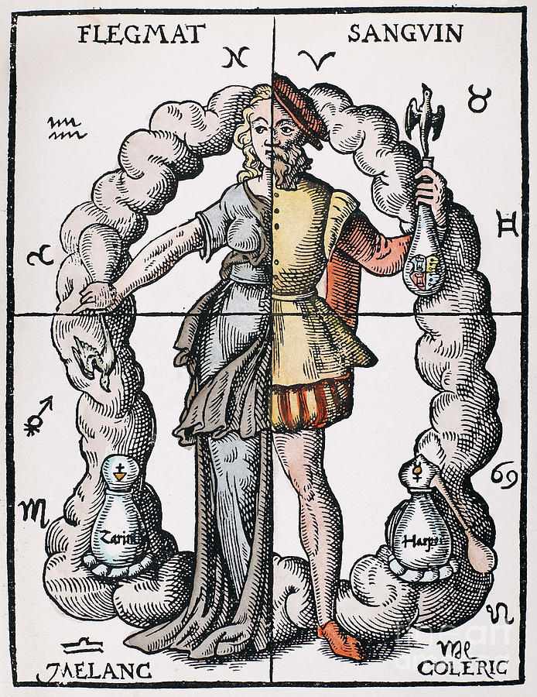
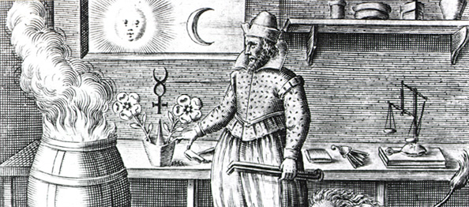
Change between 1250 and 1500
Between the Medieval and Renaissance periods ( 1250 – 1700), many strange medical treatments were used to combat illness and disease.
Over the space of this 500 year period, many things stayed the same e.g. the reliance on humoral treatments.
However, some things began to change – new herbs and treatments were introduced.
New surgeons were making new discoveries about the human body (e.g. Andreas Vesalius and William Harvey), however this had no impact on the way diseases were treated,
Overall, it can be argued that this 500 year period saw little change and things stayed the same.

Slide 3
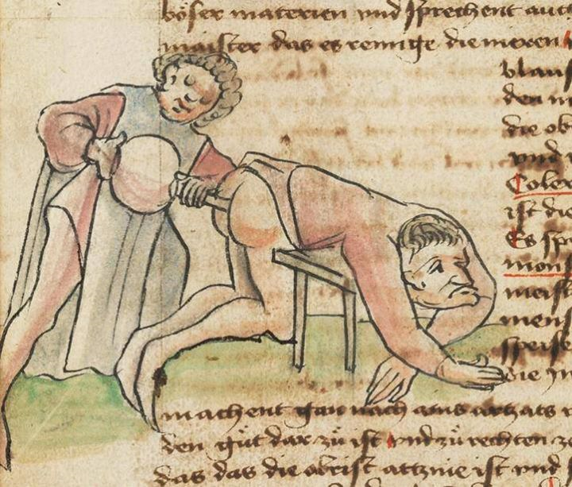
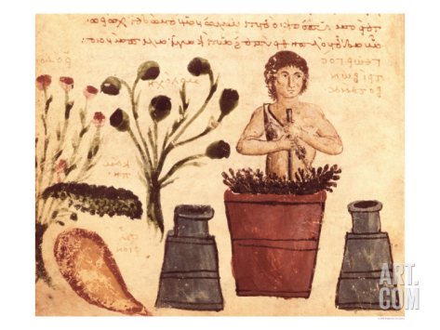
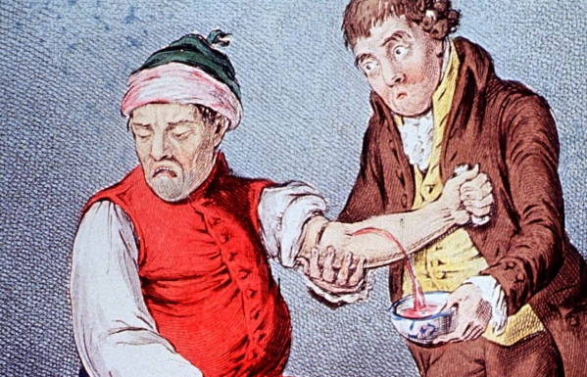
Treatments during Medieval period
Various remedies were used to drink, sniff or bathe in. E.g. aloe vera to help digestion. Others include mint, camomile, rose oil etc. Theriaca was very common – it was a spice mixture that had 70 ingredients including pepper, saffron and even opium.
Bloodletting (aka phlebotomy), was the most common way of treating an imbalance of blood. The idea was it would drain the badness from your body. It was so common that physicians hardly performed it - it would be performed by a lesser trained barber surgeon. Three ways included cutting a vein, leeches and cupping. Some people died from this procedure as they lost too much blood. Average = 1 pint.
Purging aimed to remove any leftover food from the stomach by making them sick using an emetic, or by encouraging a bowl movement with a purgative (laxative). Parsley, aniseed or even some poisons were used to encourage vomiting. Mallow leaves and linseed was used to encourage a bowl movement. Sometimes they would be administered using an enema (clyster).
https://www.youtube.com/watch?v=JONQpHJu34I

Slide 4
Learning Tasks
Read through the infosheet your teacher has given you.
Draw a table to show similarities and changes of the Medieval and Renaissance period.
Now, take the subheading “Paper 1, Question 3”
Using the information in your table, answer the two GCSE questions
a) Explain one way in which medical treatments were similar in the 13th and 16th centuries [4 marks]
“One way that medical treatments were the same was ______________. In the 13th century they ….., and in the 16 century they….”
b) Explain one way in which medical treatments were different in the 13th and 16th centuries [4 marks]
“One way that medical treatments were different was ______________. In the 13th century they ….., whereas in the 16 century they….”

Slide 5
Things that stayed the same (continuity) | Things that changed (change)
Humoral treatment used in both e.g. bleeding, purging (antimony used in 16th Century for this) Colours of Renaissance still linked to humours. Herbal treatments used in both centuries (theriaca used in medieval, ipecac and cinchona used in renaissance) | Introduction of iatrochemistry due to growth in alchemy e.g. mercury being used to treat syphilis. Transference began to be used – inanimate objects like vegetables were thought to have the ability to drain the disease from the body. Colour linked to humours e.g. red wine used to treat ‘red diseases’. Plants and herbs from New World being used e.g. coffee, tobacco, cinnamon etc.

