Slide 1
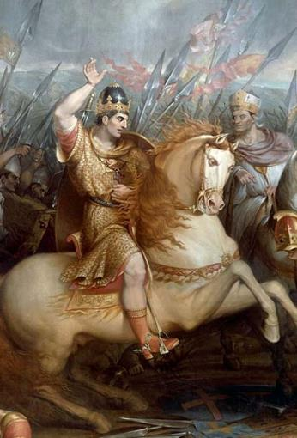
How did William control his kingdom between 1066 and 1070?
In this lesson, we will:
Explain policies introduced by King William to govern England.
Assess the impact of these policies
Starter task: Each group will be given a source. Around it, scribble down what you think it is. How would it help William control England?
Write it around the picture! You have 10 minutes.

Slide 2
Learning Task One
Your teacher will now put you into new groups.
Taking it turns, tell the people of your group about the source you looked at.
Everyone should bullet point in the ‘What we’ve inferred without the teacher’ column of your worksheet!

Slide 3
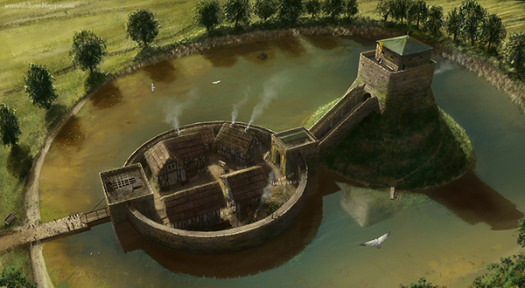

Slide 4
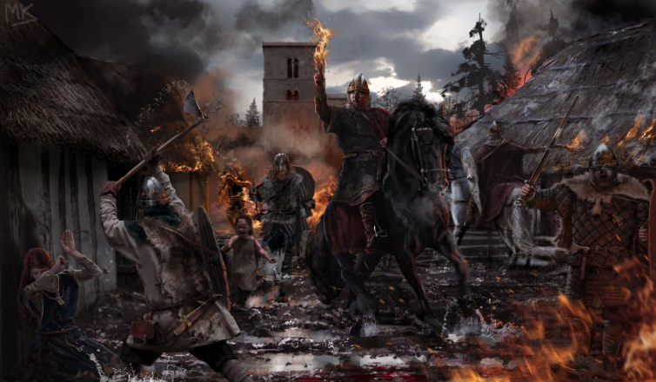

Slide 5
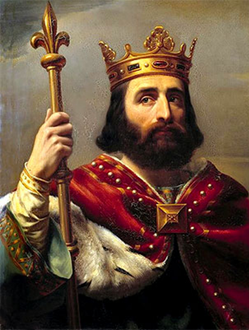

Slide 6
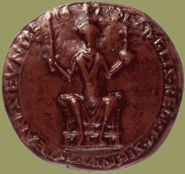
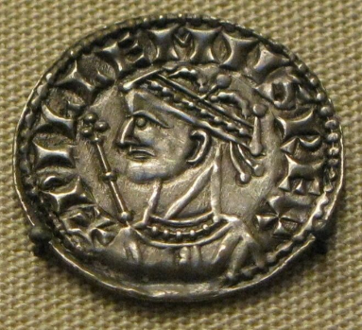

Slide 7
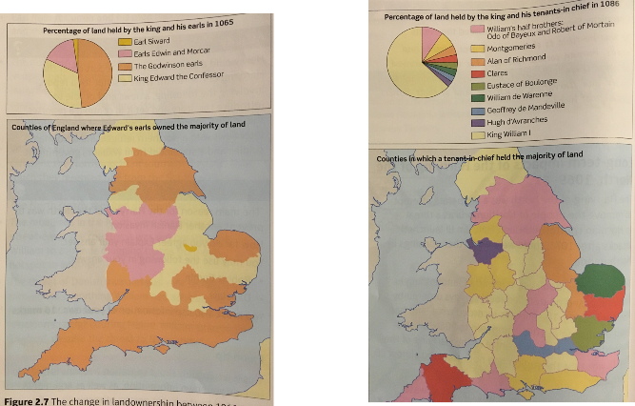

Slide 8
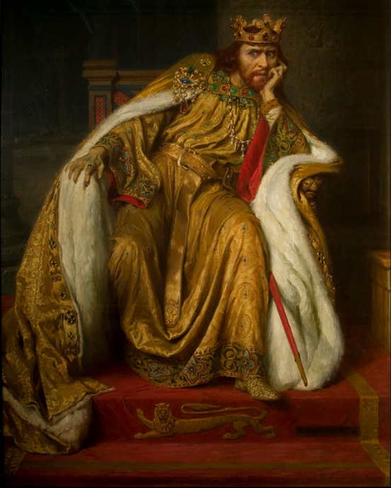
Problems facing King William I
Rebellion – many of the Anglo-Saxon peasants did not like their new lords. His Normans were in danger if they wished to rule. He also faced the threat of Vikings, Scottish or even Edgar Aethling.
Challenges – Edward had allowed the earldoms to grow massively. Families like the Godwins had grown in such strength that they could challenge the king.
His image – many in England feared William but still did not see him as the legitimate king. He had to get them to want him to be their king.

Slide 9
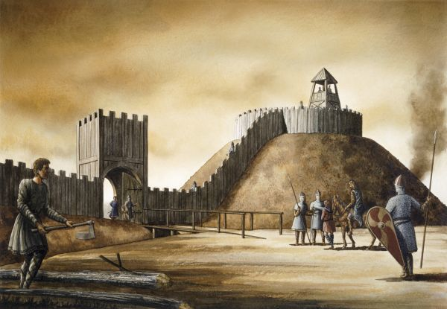
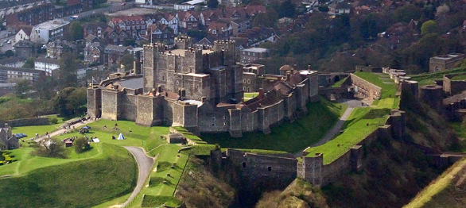
How did William deal with rebellions?
Motte and bailey castles were used by William to enforce his rule on the Anglo-Saxons.
Over 500 of them were built under his reign. The first move he made in England when he landed in 1066 was build a castle at Pevensey.
Motte & bailey castles were designed in England to ensure William could establish control.
By building them in key locations across England, he could use them to crush any rebellions through military strength.
An example of them being used effectively was during Edwin and Morcar’s rebellion in 1067.
William also used ‘harrying’ as a tactic in 1069. This caused the deaths of over 100,000 people and effectively stopped all rebellion in the North.

Slide 10
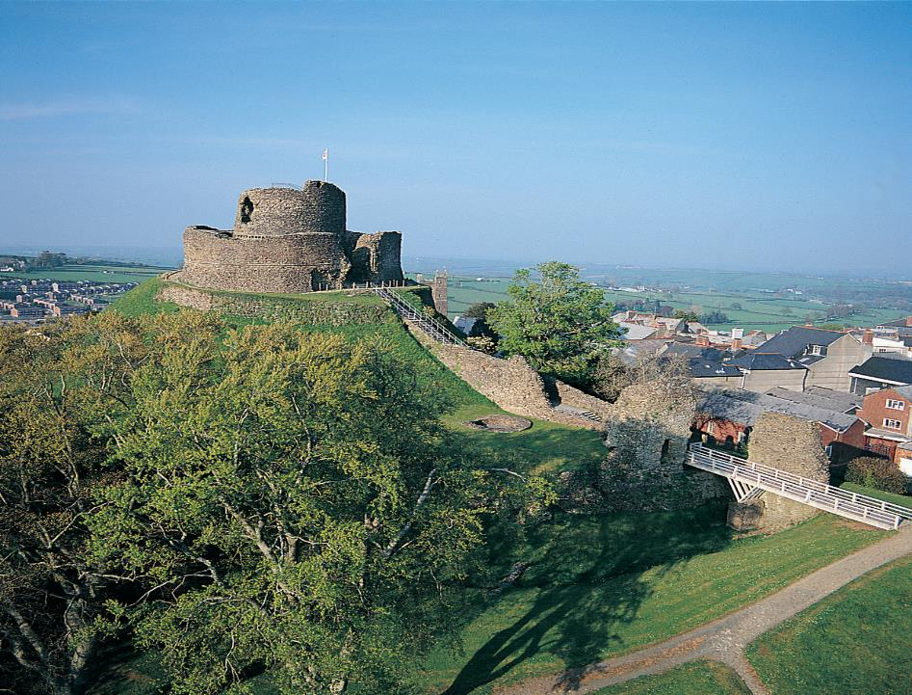
Launceston Castle ,Cornwall

Slide 12
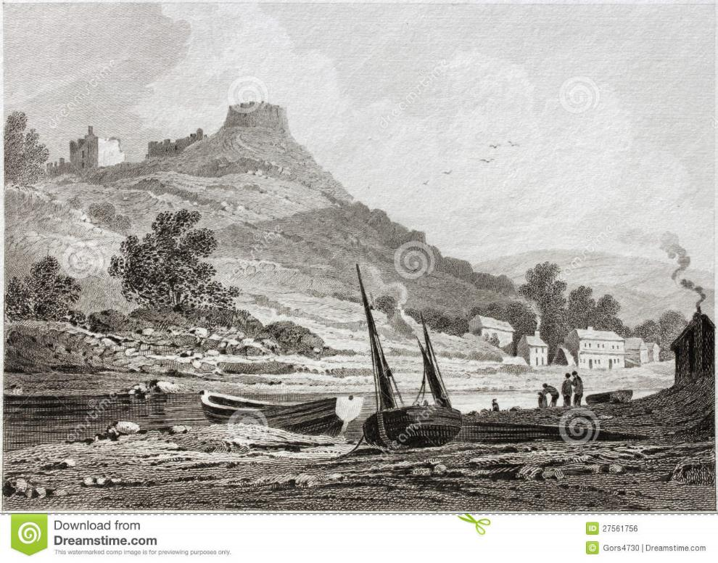
Trematon castle, Cornwall

Slide 14
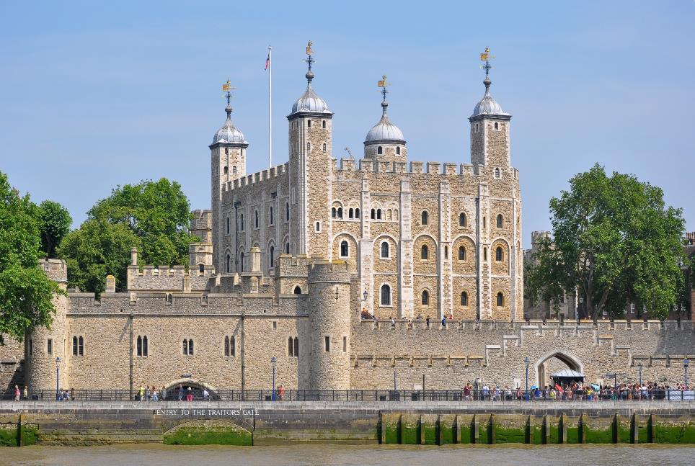

Slide 15
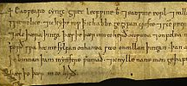
How did William stop people from challenging him?
Earldoms were largely reduced (the first were Northumbria and Mercia). This prevented any family from gaining so much territory that they could challenge the king (like the Godwins had done)
Most of the Anglo-Saxon nobility were slowly replaced by Normans whom William could trust.
Most land was taken from Anglo-Saxons and granted to Norman lords (by 1087, only 2 Saxons held land)
Introduced the idea of ‘forfeit’ – which meant that if anyone acted against William he would take their land from them.
If an Anglo-Saxon wanted to get their land back from William, they had to pay him money. When a Norman died, the land went back to the king. Their heir would have to pay a tax to William to inherit the land.

Slide 17
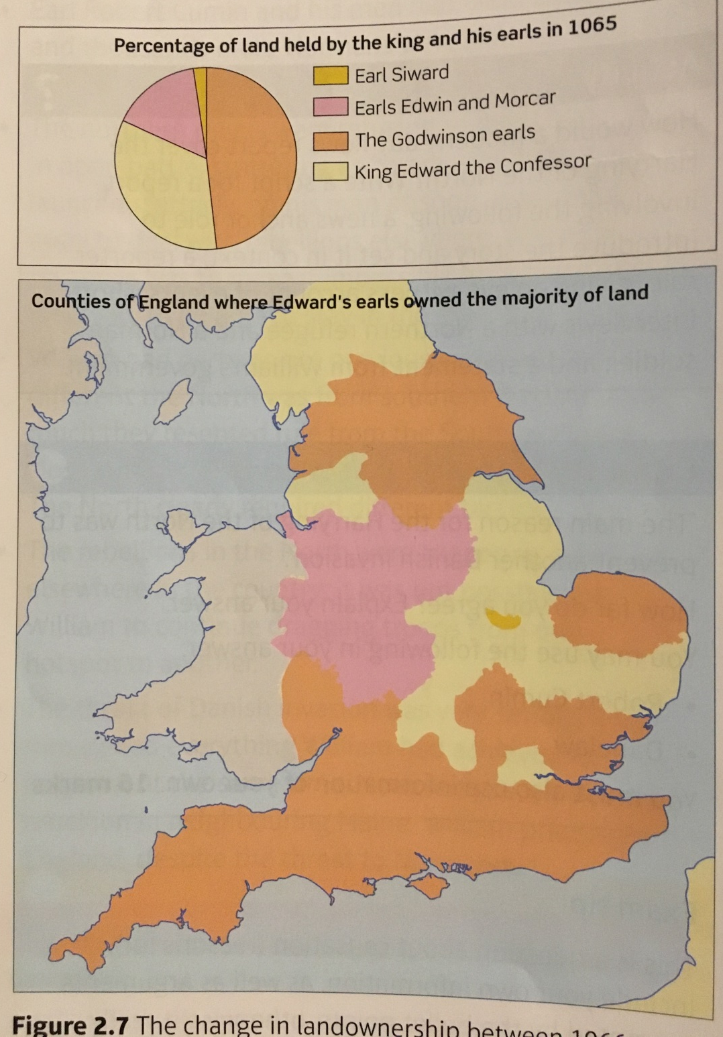
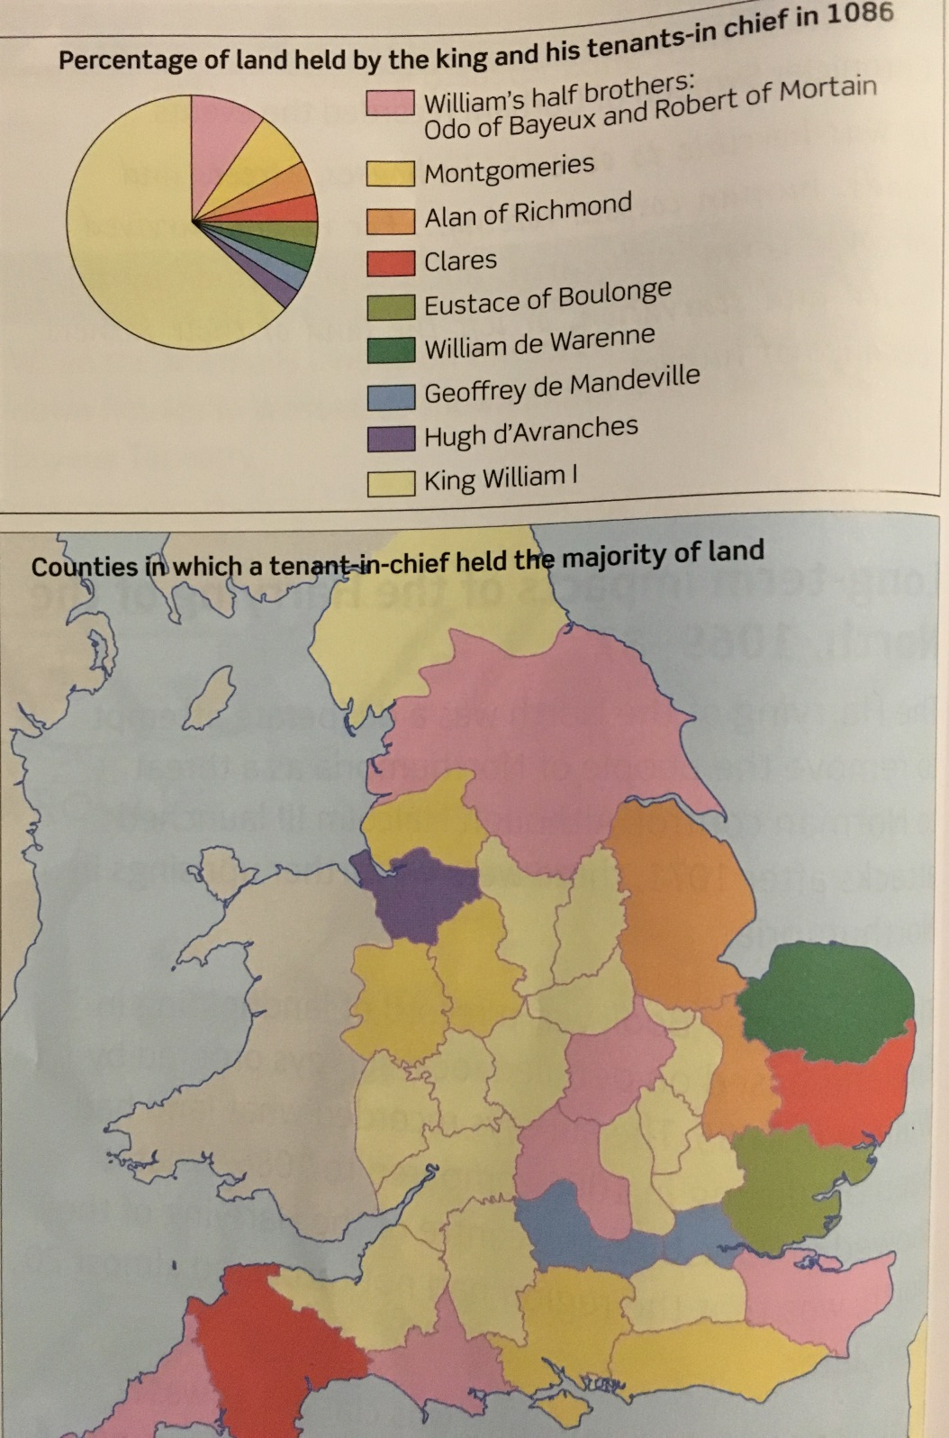

Slide 18
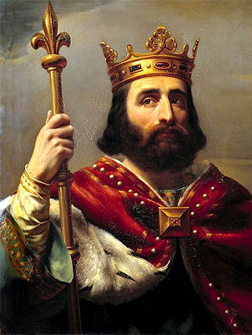
How did William convince his subjects to see him as a legitimate king?
Relied heavily on royal ceremonies to show that he was the legal king.
At his coronation he was anointed with sacred oil which meant he was appointing by God.
Decided he would be seen with his crown jewels three times a year at a meeting with his Witan.
He would meet Christmas, New Years Day and Easter at Winchester, Westminster and Gloucester.
All coins were minted with William’s image on it.
The Royal Seal attached to all official writs (documents) had William’s seal.

Slide 19
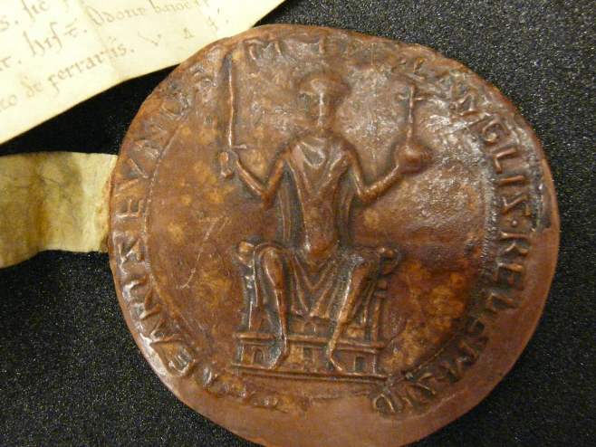
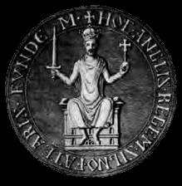
Royal Seal of King William I, c.1070

Slide 20
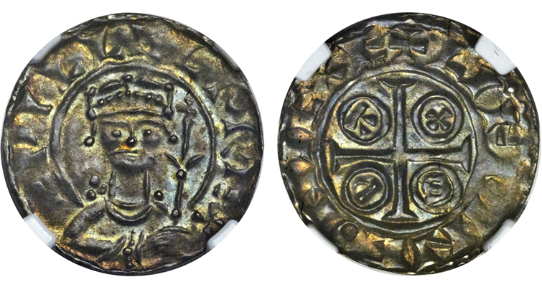
English silver penny, c.1070

Slide 21
Learning Task Two
Now using the information your teacher has went through with you, as well as the BBC video, complete the second column of your worksheet!

Slide 22
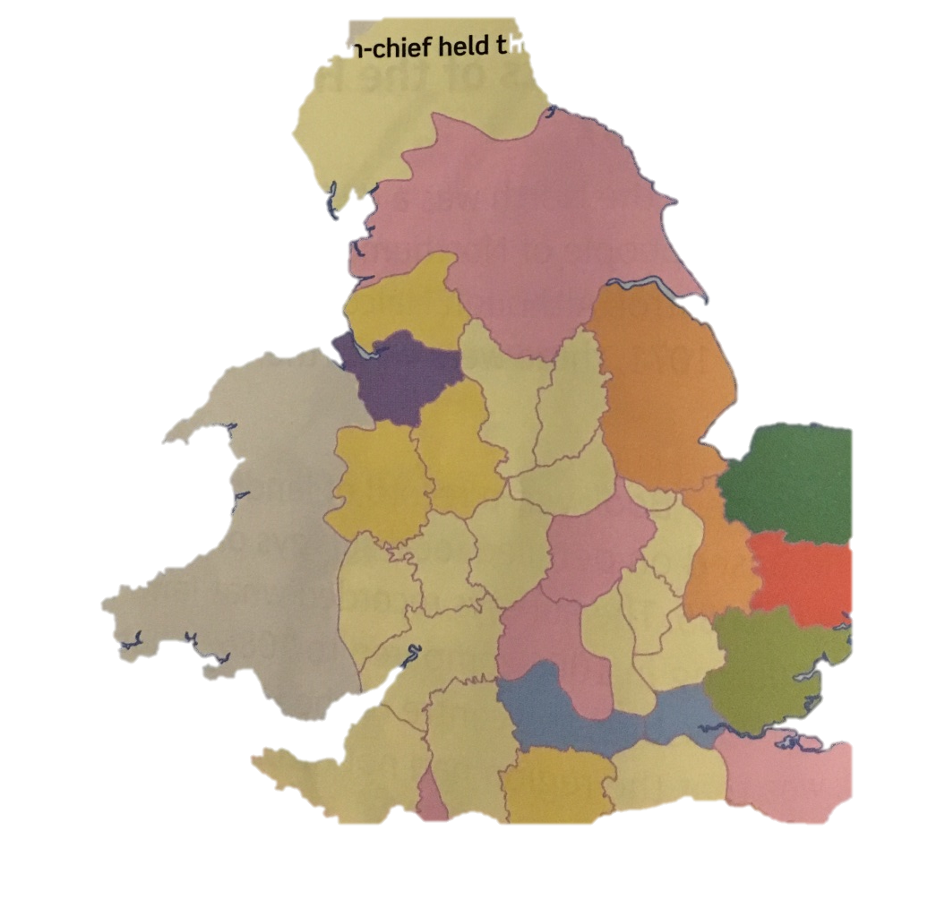
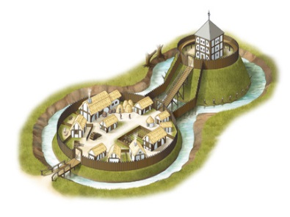
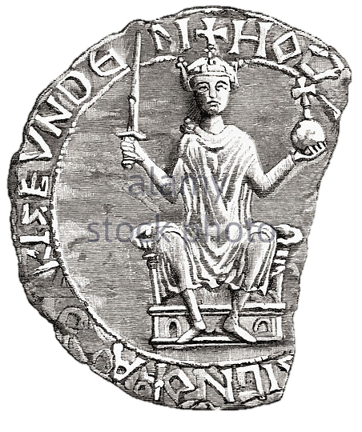
Rebellion
Challenges from nobles
William brought the idea of castles from Normandy. Over 500 of them were built under his reign. The first move he made in England when he landed in 1066 was build a castle at Pevensey. Motte & bailey castles were designed in England to ensure William could establish control.
Helped him keep control as they were built in strategic locations to maximise control (near rivers, near major towns or near the Welsh border. As they were filled with soldiers, it allowed him to intimidate the locals. If a rebellion happened, an army could be raised quickly. They helped crush rebellions in areas like Exeter, Warwick, Nottingham and York. They were also a symbol of Norman rule – they reminded the peasants that the Normans were here to stay.
William replaced most of the Saxon nobility with Normans. By 1087 only 2 Anglo-Saxons still held land (Less than 5% of the land was held by Anglo-Saxons).
He destroyed the earldoms – separating them into smaller areas of land and creating lots of new earldoms. This prevented any family from gaining so much territory that they could challenge the king (like the Godwins had done)
Introduced the idea of ‘forfeit’ – which meant that if anyone acted against William he would take their land from them.
If an Anglo-Saxon wanted to get their land back from William, they had to pay him money. When a Norman died, the land went back to the king. Their heir would have to pay a tax to William to inherit the land.
This helped him secure England as with less Saxons in power, it reduced the chances of rebellions against him. This was further reduced by prevening any Norman family from gaining too much land (divide and conquer). The crown gained more money from taxes to inherit land.
People not accepting him as king
Maintained his reputation as a fearsome warrior by consistently showing military strength e.g. how he deal with rebellions by Harrying the north.
He got support from the Church, so it looked as if God was on his side and wanted him to be king.
He would be seen wearing his crown three times a year and three key locations Winchester, Westminster and Gloucester. He also wore it in the ruins of York on Christmas Day 1069 as a symbolic show of his power.
All coins had his face on them, as did his royal seal which were attached to all documents.
He often travelled across his kingdom, meeting powerful families so the people could see him and his authority.
He constantly took land and granted land which showed everyone how powerful he was.
He made everyone who held land taken an oath to him.
This helped him secure England as his show of military strength scared many of the Saxon peasants into submission. With the Church on his side, he could excommunicate anyone who acted against him. By travelling around the kingdom wearing his crown, and having his face on all seals, he was projecting an image that he was the rightful king so many would support him. (In fact many Saxons actually fought for William during rebellions).

