Slide 1
Plains Indians: Religion and beliefs

Slide 2
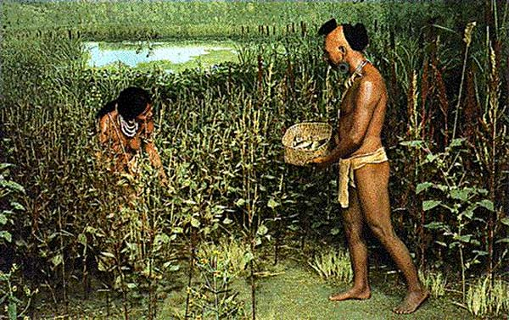
Indians and the Land
Land was sacred – the “mother” of the Plains Indians. Without it, the buffalo nor the tribes could survive without it.
Throughout Indian land, there were various sights which held spiritual significance e.g. Black Hills of South Dakota for the Lakota Sioux.
Alongside the buffalo, many tribes farmed, hunted, fished and gathered wild plants.
Farm land belonged to all members of the tribe.
When food was scarce, conflicts could occur as tribes pushed into hunting grounds used by others.
Mining was seen to be disrespectful to the land – they had no desire for coal, silver, gold etc.
The Adena Indians used tools made of stone, animal bone, and tortoise shell to grow crops of squash, pumpkins, gourds, sunflowers and maize. The primary agricultural product of the Ohio Indians, shortly after the introduction of agriculture to Knox County, was maize!

Slide 3
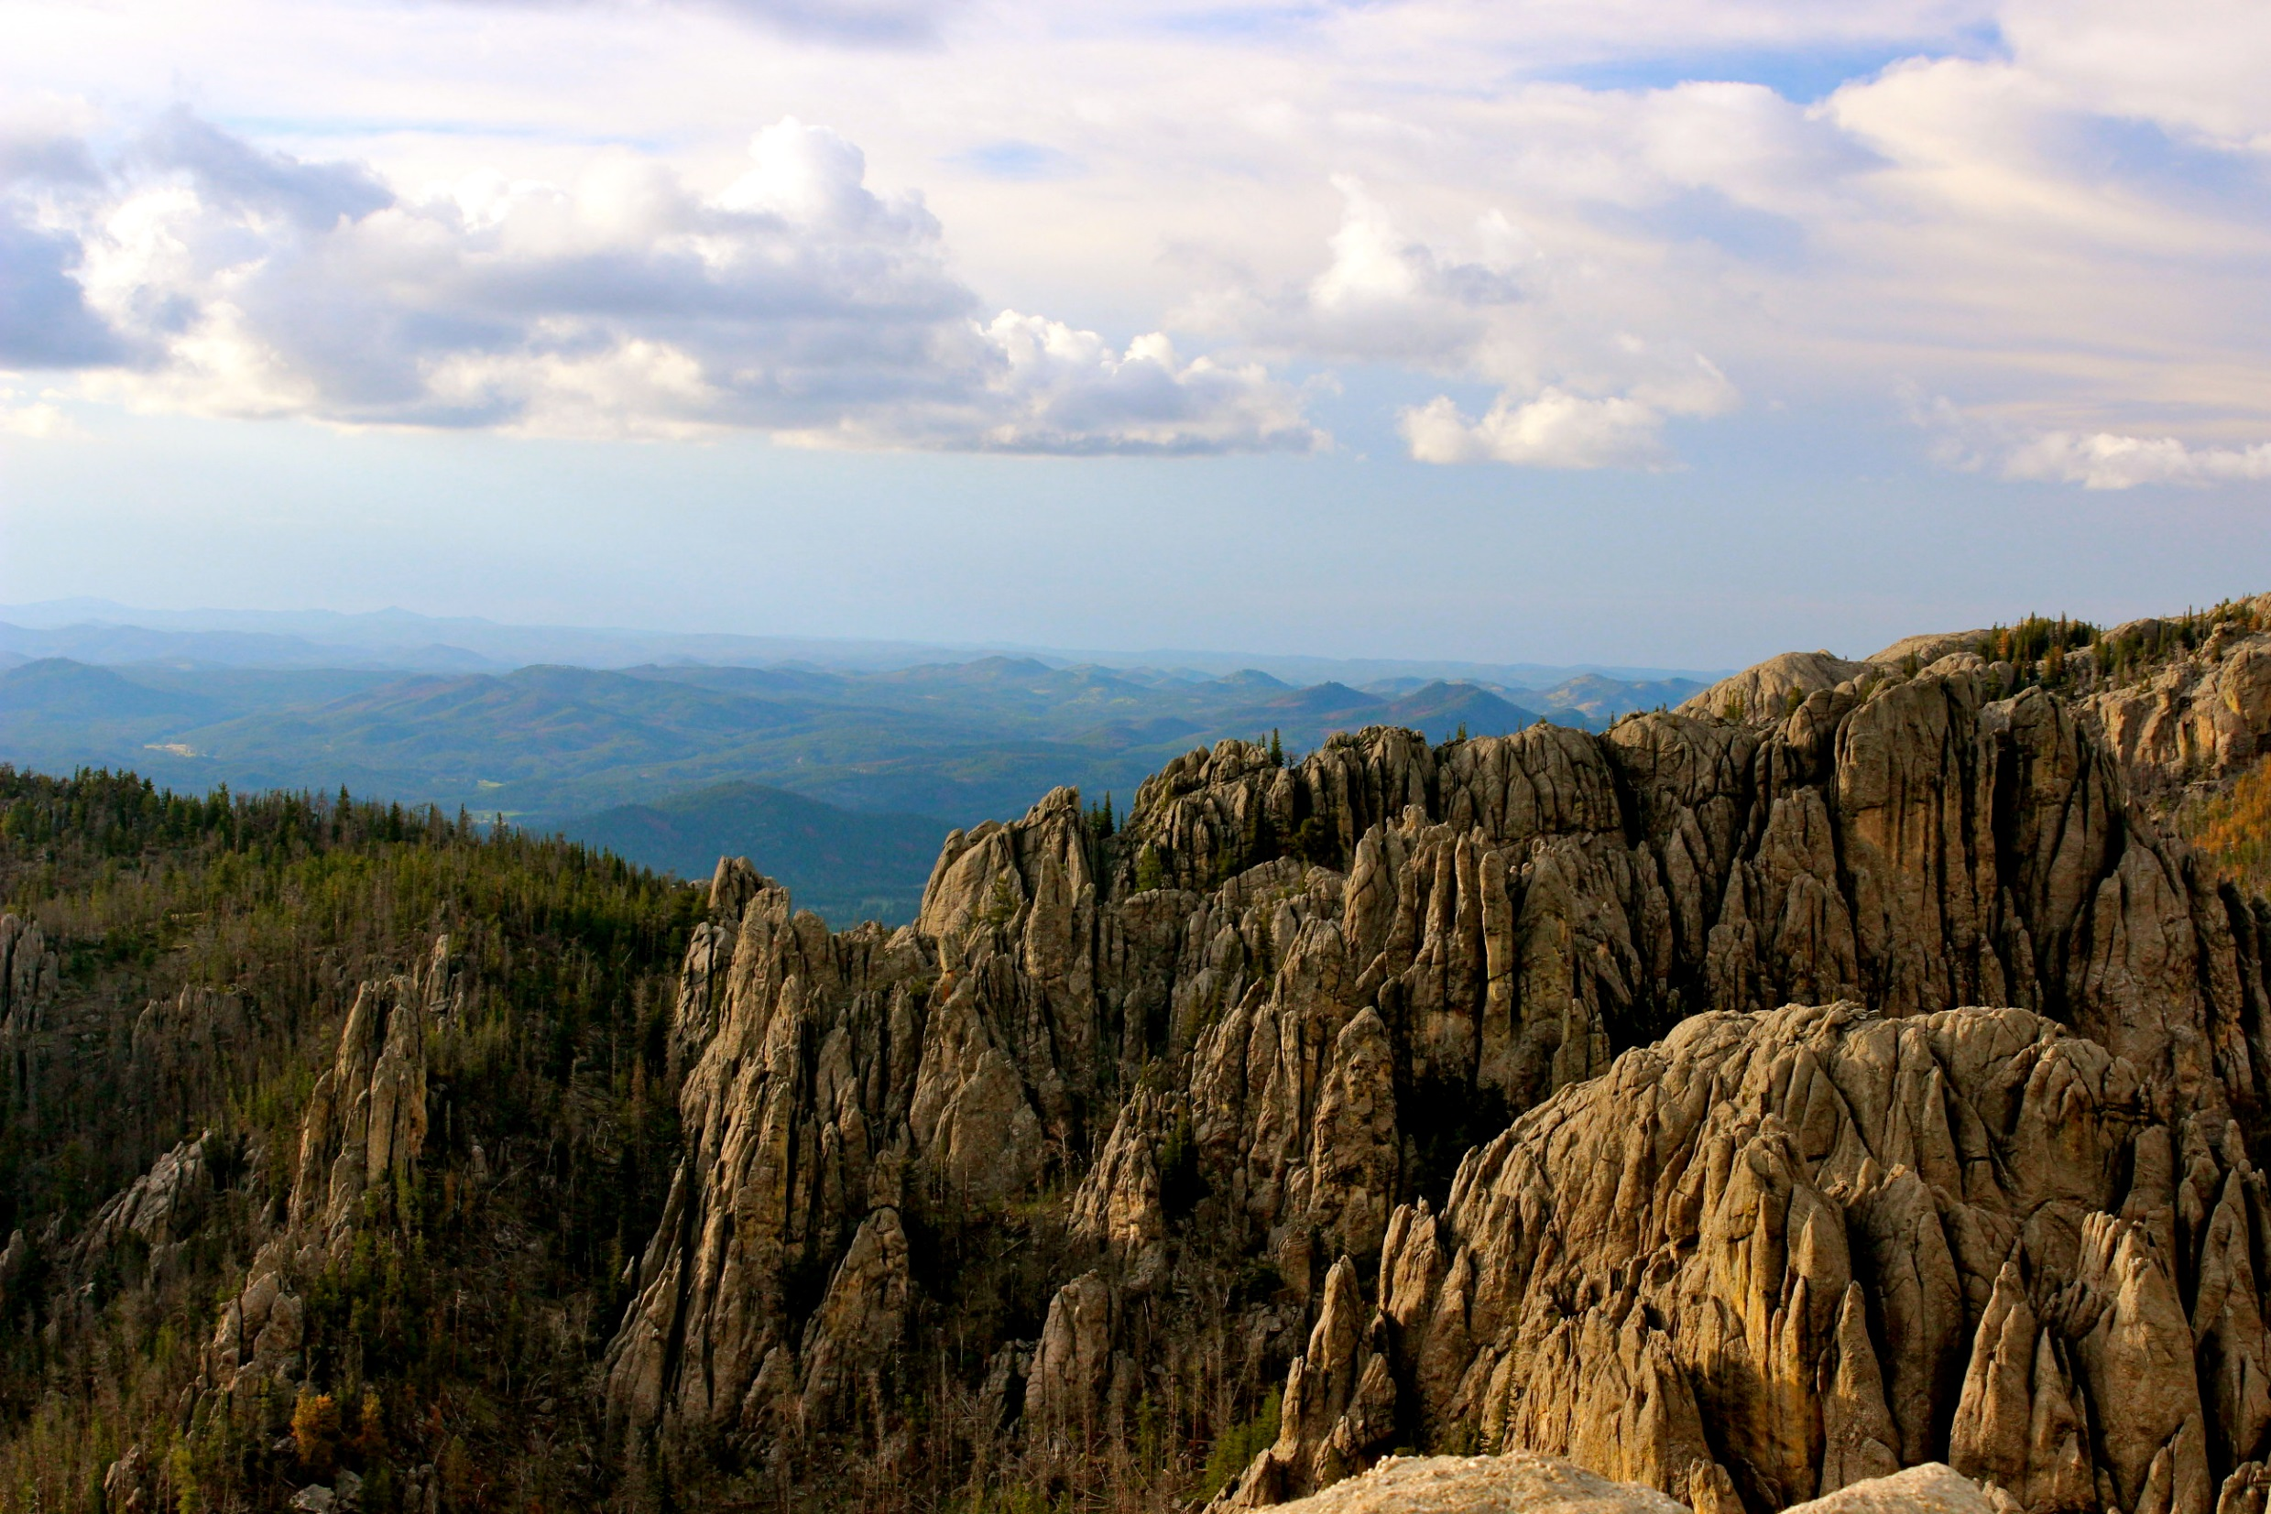
For thousands of years, hot mineral springs were used by indigenous people for healing purposes. Grizzly bears, black bears, wolves, and buffalo roamed and lived in these sacred mountains.
Their were caves in the hills where Natives buried their dead.
Lakota Sioux claimed that their tribe had been born there.

Slide 4
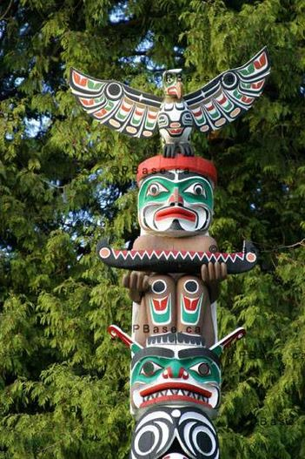
Spirit Animals
Indians believe that they could contact the spirit world through vision quests guided by animals or “totems”.
A totem was an animal that was assigned to a certain tribe or sub-tribe (e.g. eagle, wolf, hawks, bears, foxes)
These totems could charge up items to bring Indians luck in battle or hunts.
Fun fact – totem poles are carved out of giant cedar trees by Native tribes. It similar to a book you can read, but instead of using words it uses symbols of spirit animals. It is a way of passing down stories!

Slide 5
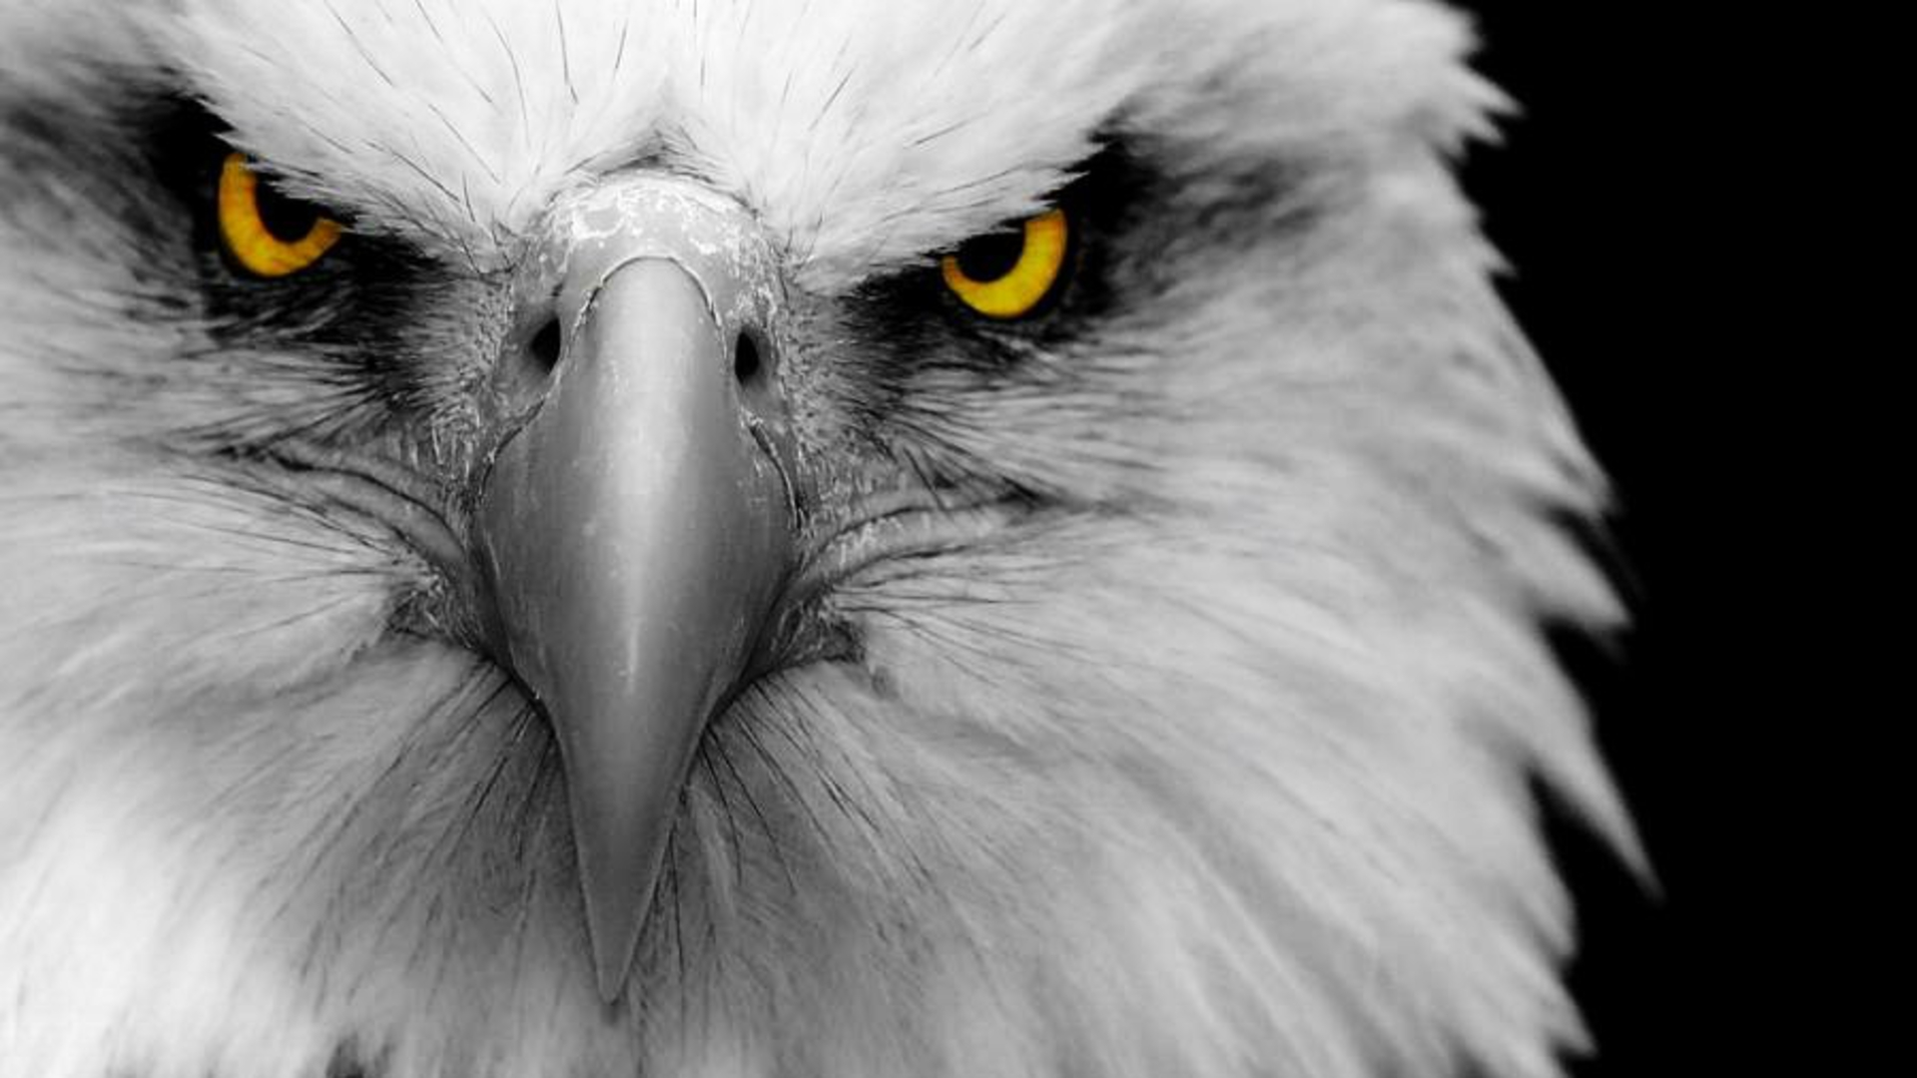
To most tribes, eagle is referred as thunderbird in stories. It was believed that when eagles open and close their eyes, they cause lightning. They also saw the eagle as God's messenger.
In religious ceremonies, Eagle feathers were rewarded to those who acted of bravery.

Slide 6
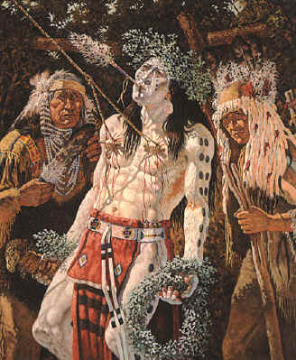
The Sun Dance
It is aimed at asking the sun for strength and to help their tribe thrive!
The performer would have their face painted and others would blow through the eagle bone and play the drums to call on the Thunderbird (the god).
Their skin would be pierced, and they would be attached to a tree for 4 days.
https://www.youtube.com/watch?v=qpOnuQnRI7M

Slide 7
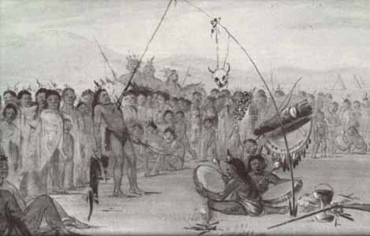

Slide 8
Tasks
Define these two Native American concepts:
Sun Dance
Counting Coup
For each of the below statements, explain what the consequence would be on Native Americans:
White settlers fence off land that the tribes use for hunting and then begin to plough it for crops.
White people start to mine for gold in the Black Hills area of South Dakota.
The US government force all Indian teenagers to attend a school in a white city to learn about Christianity.
The white man begins to build a railroad through native territory, shooting any buffalo that gets in their way.
Grade 9,8,7, 6 challenge
Explain the consequence of each consequence!
e.g. “The consequence of white fencing off land to plough would be Natives would scare the buffalo away, prevent Indians from using it and would cause tension. The consequence of this would be the Indians would find it difficult to survive as they wouldn’t have easy access to the buffalo for supplies. It may also result in some raiding and attacks on white settlers by Native American warrior brotherhoods because they would be angry.

Slide 9
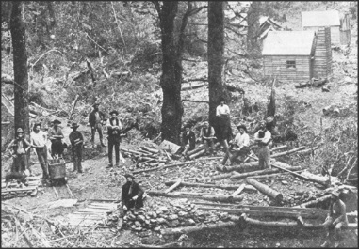
Gold prospectors, Black Hills

Slide 10
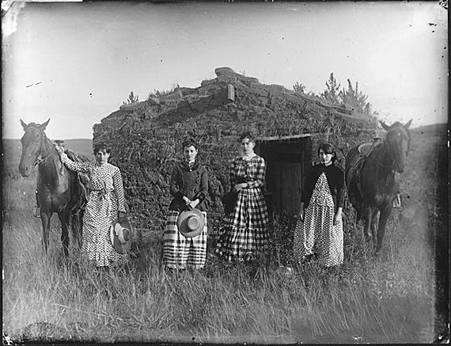
Homesteaders, Great Plains

Slide 11
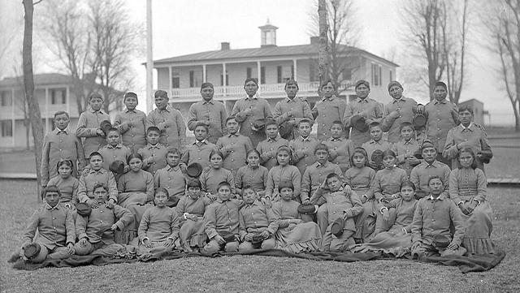
Carlisle Indian School

Slide 12
Define these two Native American concepts:
Sun Dance – a sacred ritual which includes dancing, drum music and fasting before participating in a ceremonial piercing of skin. A single member of the tribe would have his chest pierced with buffalo skin or eagle claws and would be attached to a tree. They would then continue this without food or water for several days.
Counting Coup – the bravest style of fighting a young warrior could achieve. A warrior would attempt to hit or touch an an enemy and get away without being injured or killed. A man’s rank as a warrior depended on his total score in coups and his ability to lead successful raids.
For each of the below statements, explain what the consequence would be on Native Americans:
White settlers fence off land that the tribes use for hunting and then begin to plough it for crops.
White people start to mine for gold in the Black Hills area of South Dakota.
The US government force all Indian teenagers to attend a school in a white city to learn about Christianity.
The white man begins to build a railroad through native territory, shooting any buffalo that gets in their way.
The consequence of white fencing off land to plough would be Natives would scare the buffalo away, prevent Indians from using it and would cause tension.
Whites would begin to cut down trees to build houses, therefore populating the area. They will use the rivers for washing, cleaning etc. spreading disease to the Indians.
Natives would begin to become more “white” – rejecting their own culture. This would prevent their culture from being passed down.
The railroads would scare away buffalo, making it harder for tribes to hunt them. They would have to compete with whites for supplies.

