Slide 1
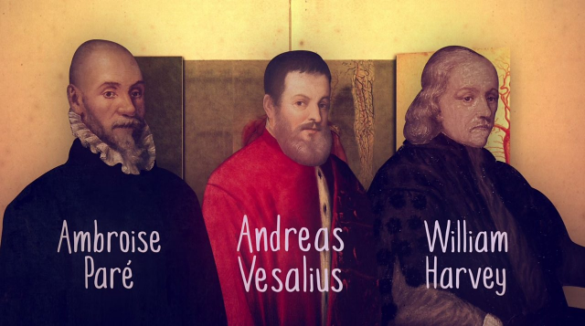
How did Fleming, Florey and Chain contribute to the first ‘magic bullet’?
In this lesson, we will:
Describe the contributions of Fleming, Florey and Chain
Explain how penicillin became mass produced by the 1950s.
Starter: For each of pioneers in Renaissance surgery, explain their contributions!
Andreas Vesalius
William Harvey

Slide 2
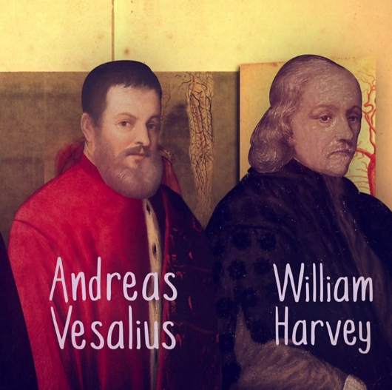
1536
He discovered the spermatic vessels. He also realized that the famous doctor Galen could be wrong, when he discovered that he was wrong about two bones in the jaw, and about how muscles were attached to the bone.
1537
He became professor of medicine at Padua University. He said that medical students should perform dissections for themselves, stating that:"... our true book of the human body is man himself.“
1543
He published 'Fabric of the Human Body' (with high-quality annotated illustrations).
Trained at Cambridge and Padua universities, and became doctor to James I and Charles I of England. Influenced by Vesalius.
1616
He calculated that it was impossible for the blood to be burned up in the muscles (as Galen had claimed).
1628
He published 'Anatomical Account of the Motion of the Heart and Blood', which scientifically proved the principle of the circulation of the blood. This book marked the end of Galen's influence on anatomy.

Slide 3
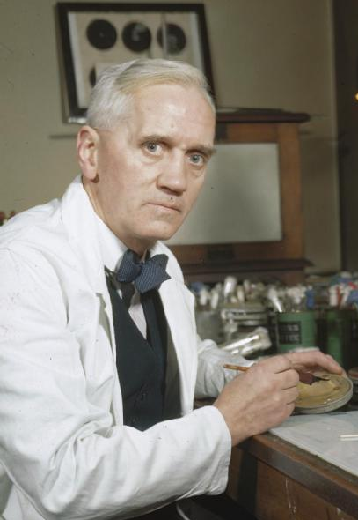
Alexander Fleming served in the First World War with the RAMC.
In 1918, he returned to St Mary’s Hospital in London.
In 1928, he became a Professor of Bacteriology at the University of London.
During World War I, Fleming witnessed the death of many soldiers from sepsis resulting from infected wounds. Antiseptics, which were used at the time to treat infected wounds, often worsened the injuries
During the 1920s, Fleming researched substances that might be effective at combatting infection.
In 1928 he discovered that mould had grown inside one of his petri dishes which appeared to be killing the bacteria inside.
This mould was identified as ‘penicillin’. Fleming published his work in 1929, but did not pursue it further.

Slide 4
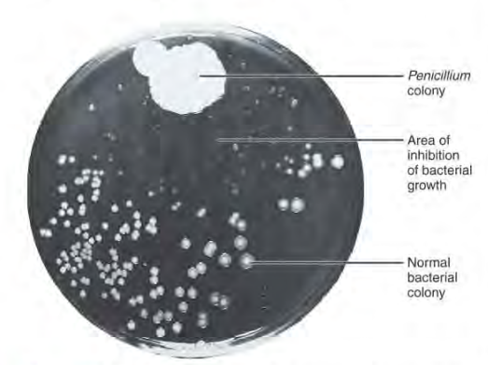
“When I woke up just after dawn on September 28, 1928, I certainly didn't plan to revolutionise all medicine by discovering the world's first antibiotic, or bacteria killer. But I suppose that was exactly what I did.”
— Alexander Fleming

Slide 5
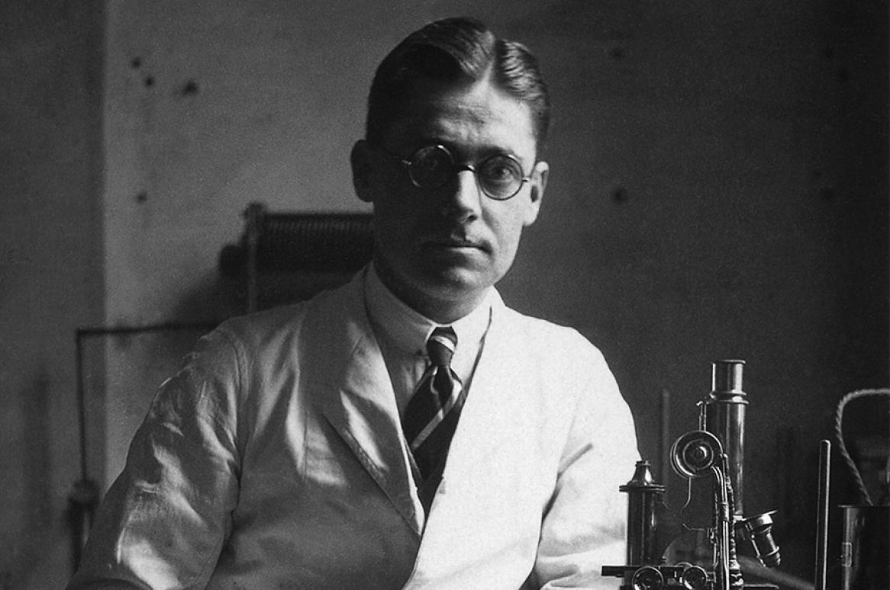
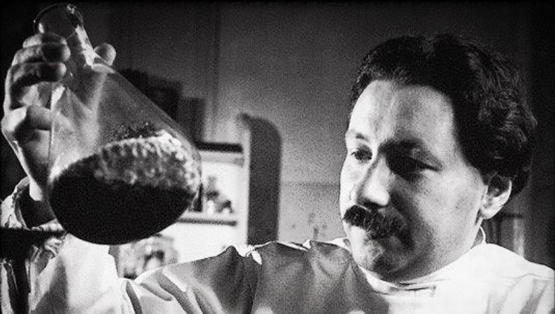
Howard Florey was an Australian pathologist working at Oxford medical school. Ernst Chain was a German refugee from Nazi Germany and biochemist.
Both men were researching antibiotics and were looking for neglected work that could be investigated further.
They decided to test Fleming’s work further. Chain grew the mould in his laboratory and used extracts of it for testing.
In 1940 they tested it successfully on mice but found it hard to produce a large amount of it.
They set about growing as much as possible using milk churns, bed pans and bath tubs. By 1941 they tested it on a local policeman dying of blood poisoning.
They had too small amounts, and although it showed signs of working the small dosage led to the patient dying.

Slide 7
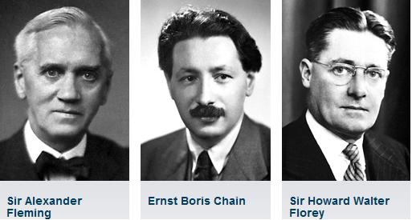
On your profile sheet for each figure:
Identify who they were and how they contributed to the development of penicillin.
Target 9 – 8
Consider Fleming’s quote: “I certainly didn't plan to revolutionise all medicine by discovering the world's first antibiotic, or bacteria killer”
Do you agree with what he is saying?
Target 7-4
Evidence that Fleming should get credit for penicillin
Evidence that Fleming should not get credit for penicillin
Target 3-1
Who is most responsible for the development of penicillin? Be prepared to share your answer with evidence to back it up!

Slide 8
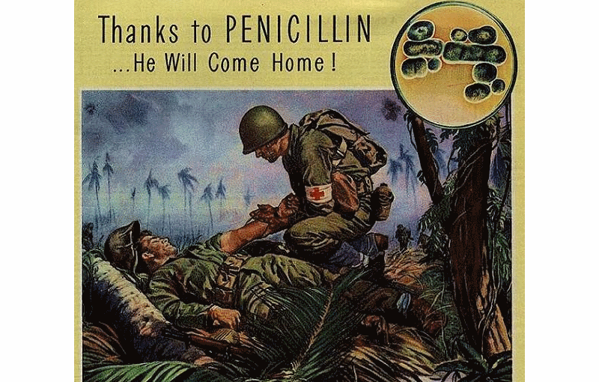
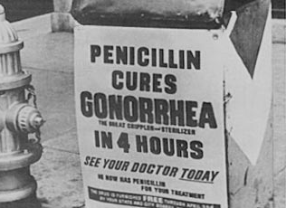
At first, Florey approached British pharmaceutical companies for assistance in the mass production of penicillin. However all companies were too busy producing materials for the war effort against Nazi Germany.
In July 1941 he visited the United States (who at that point were neutral) and convinced some companies to begin penicillin production. It was very slow process using beer vats – after one year they had enough to treat ten people.
The US government were very impressed with the benefits of the drug, so agreed to fund the research over 21 companies for five years as they saw the potential for American soldiers.
By 1943, the British government began funding the venture as well to reduce infection rates in the British army.
By D-Day (1944), there was enough penicillin to treat all Allied casualties. 15% of soldiers were saves by this drug.

Slide 10
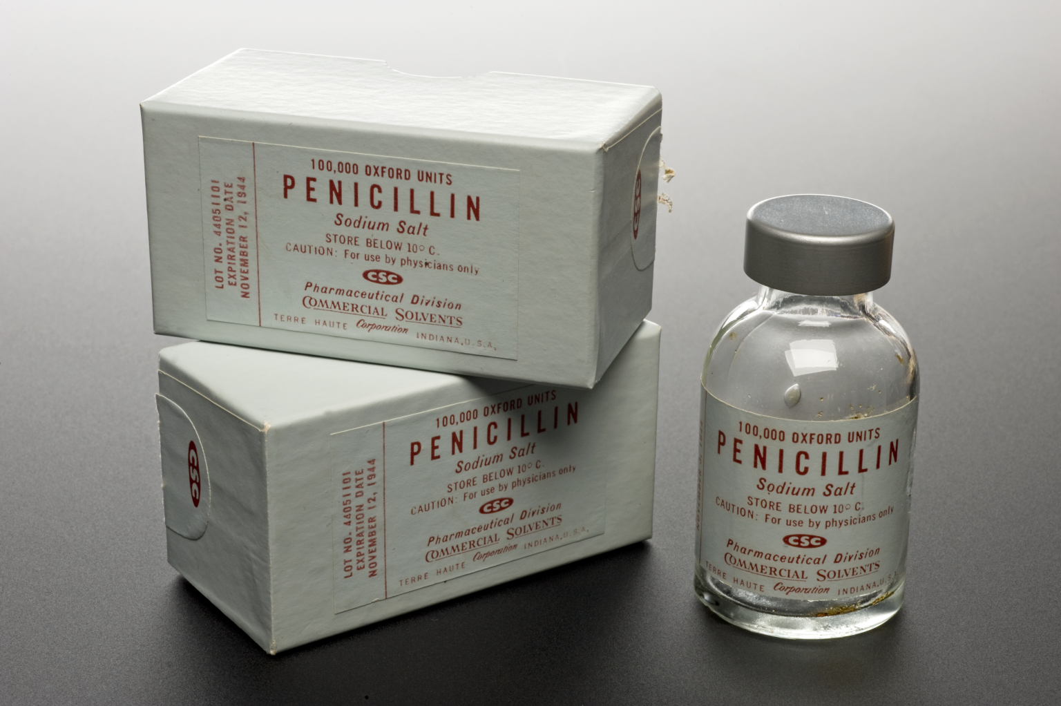
Factors that allowed penicillin to be mass produced
Consequence:
Consequence:
Consequence:

