Slide 1
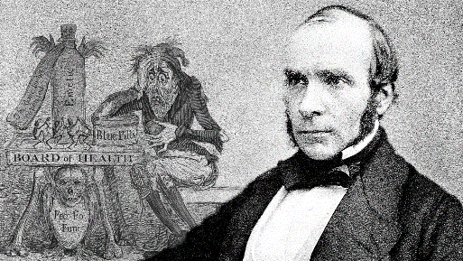
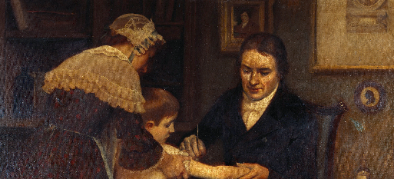
How did ideas about the cause of disease change in the 20th Century?
Starter: Your teacher will ask you a series of questions about John Snow and Edward Jenner. On your mini whiteboard, write your answers!
In this lesson we will:
Describe the key events which led to the mapping of the human genome.
Assess how different our knowledge of lifestyle choices and disease was by the end of the 20th Century.

Slide 2
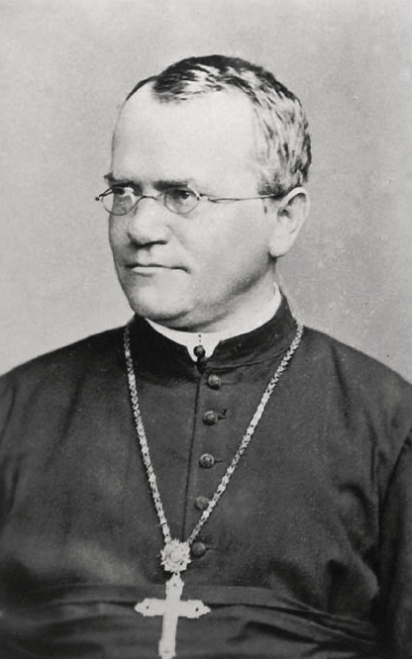
Early research into genetics
By 1900, it was clear to scientists that microbes did not cause all illness and disease. E.g. babies being born with conditions that developed in the womb.
The cause of this remained a mystery to doctors for the first half of the 20th Century. There was still a piece of the puzzle missing – how did children inherit traits from their parents?
Early scientists, such as Mendel, theorised that genes come in pairs and one is inherited from each parent (known as the fundamental laws of inheritance). But could not prove it due to lack of technology.
By 1951, scientists were confident that characterises were passed down from parents to children. They believed that a substance in human cells must pass this information on from person to person. This substance must also pass on hereditary diseases.
However it would not be until 1953 that the missing piece was discovered: DNA.

Slide 3
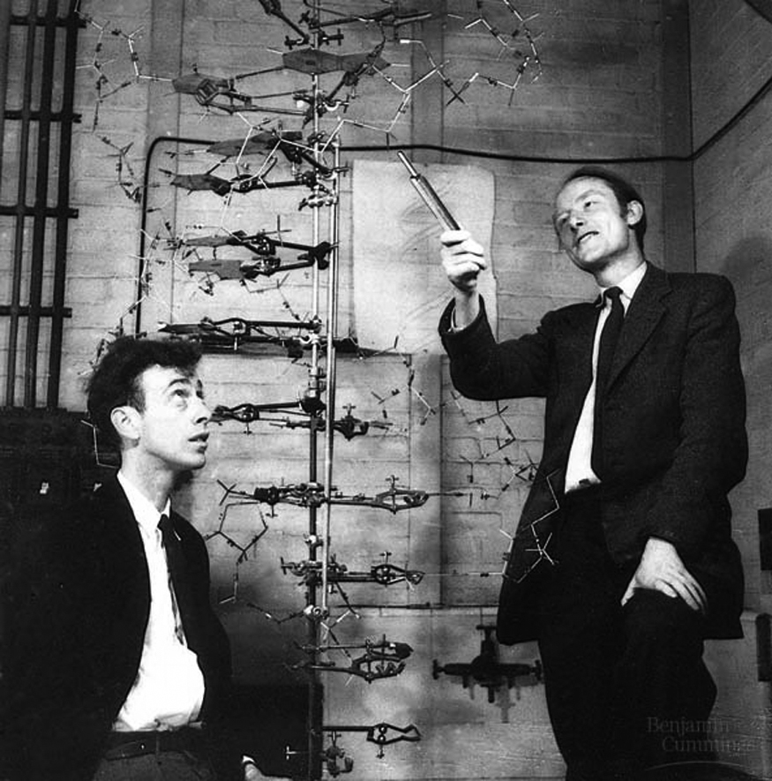
The work of Watson and Crick
James Watson was an American biologist and Francis Crick was an English physicist. In 1953, they both shared an office at Cambridge University. Both men shared an interest in finding out more about human biology.
They saw an early x-ray taken by Rosalind Franklin in 1951 which showed DNA and built a model of it. Franklin made some slight changes, as did Maurice Wilkins. Together they managed to build an accurate model of DNA
They discovered that it was shaped as a double helix which could ‘unzip’ itself to make copies.
Watson and Crick published their paper in 1953 – understanding the shape of DNA meant that they could now begin to look at its structure and identify which parts caused hereditary diseases.

Slide 4
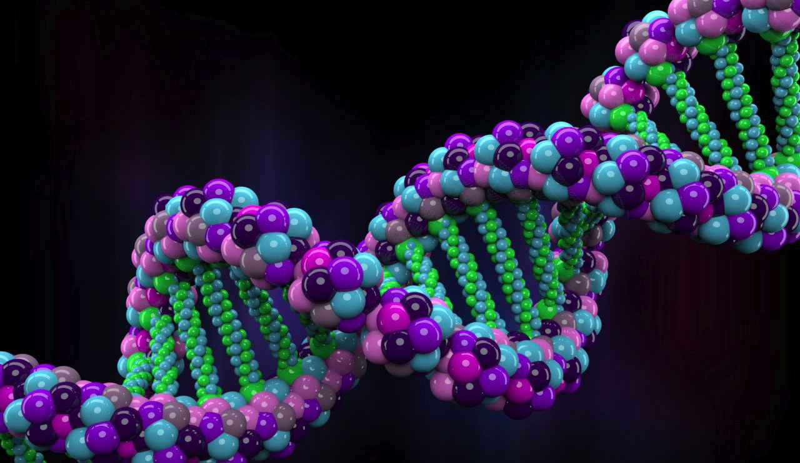
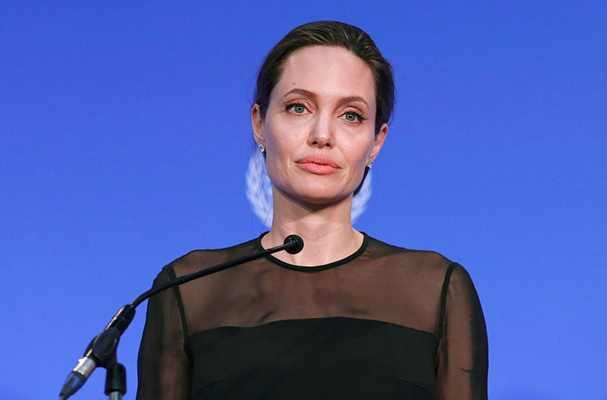
The mapping of the human genome
A genome is the complete set of DNA that contains all the information needed to build an organism. In humans, this is more than 3 billion DNA pairs and is unique to each person.
The Human Genome Project was set up in 1990 and was led by Watson himself. For 10 years, 18 teams of scientists all over the world worked together to decode and map the human genome. The first draft was completed in 2000.
By using this map of the human genome, it was possible for doctors to look for mistakes in the DNA of people suffering from hereditary diseases.
E.g. scientists are now able to identify a gene that is sometimes present in woman who suffer from breast cancer.
https://www.youtube.com/watch?v=MvuYATh7Y74

Slide 5
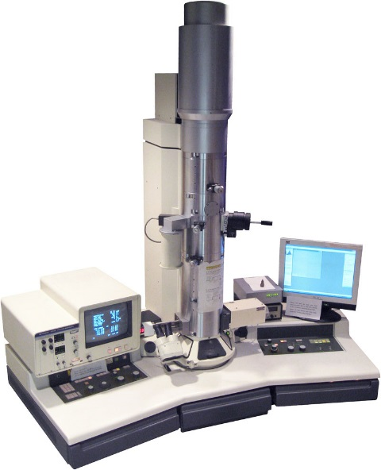
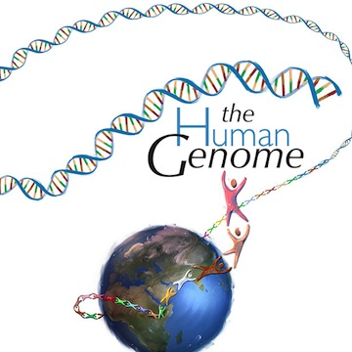
Learning Task One
TECHNOLOGY | SCIENCE
All targets
1. Read the information on pp.101-104. Create a timeline in your book of the key events in the discovery of genetics.
2. For each factor below, explain how it helped the development of genetics:
Science
Technology

Slide 6
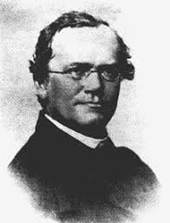
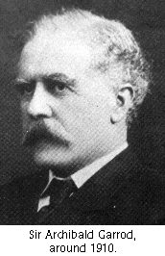
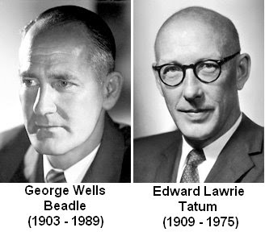
1900
-German scientist Mendel says genes come in pairs. One is from each parent. Known as “Fundamental laws of inheritance”
1902
-Archbald Garrod says that heridatry diseases are cause by missing information in the body.
1941
George Beadle and Edward Tatum prove Garrod’s theory.

Slide 7
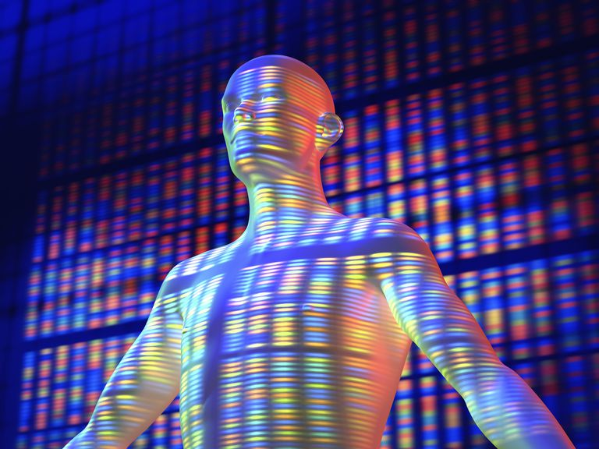
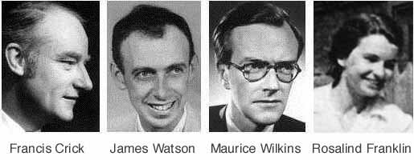
1951
-Rosalind Franklin and Maurice Wilkins use x-rays to photograph DNA.
1953
- James Watson and Francis Crick build the first model of DNA.
1990
-The Human Genome Project is set up to decode and map the human genome.

Slide 8
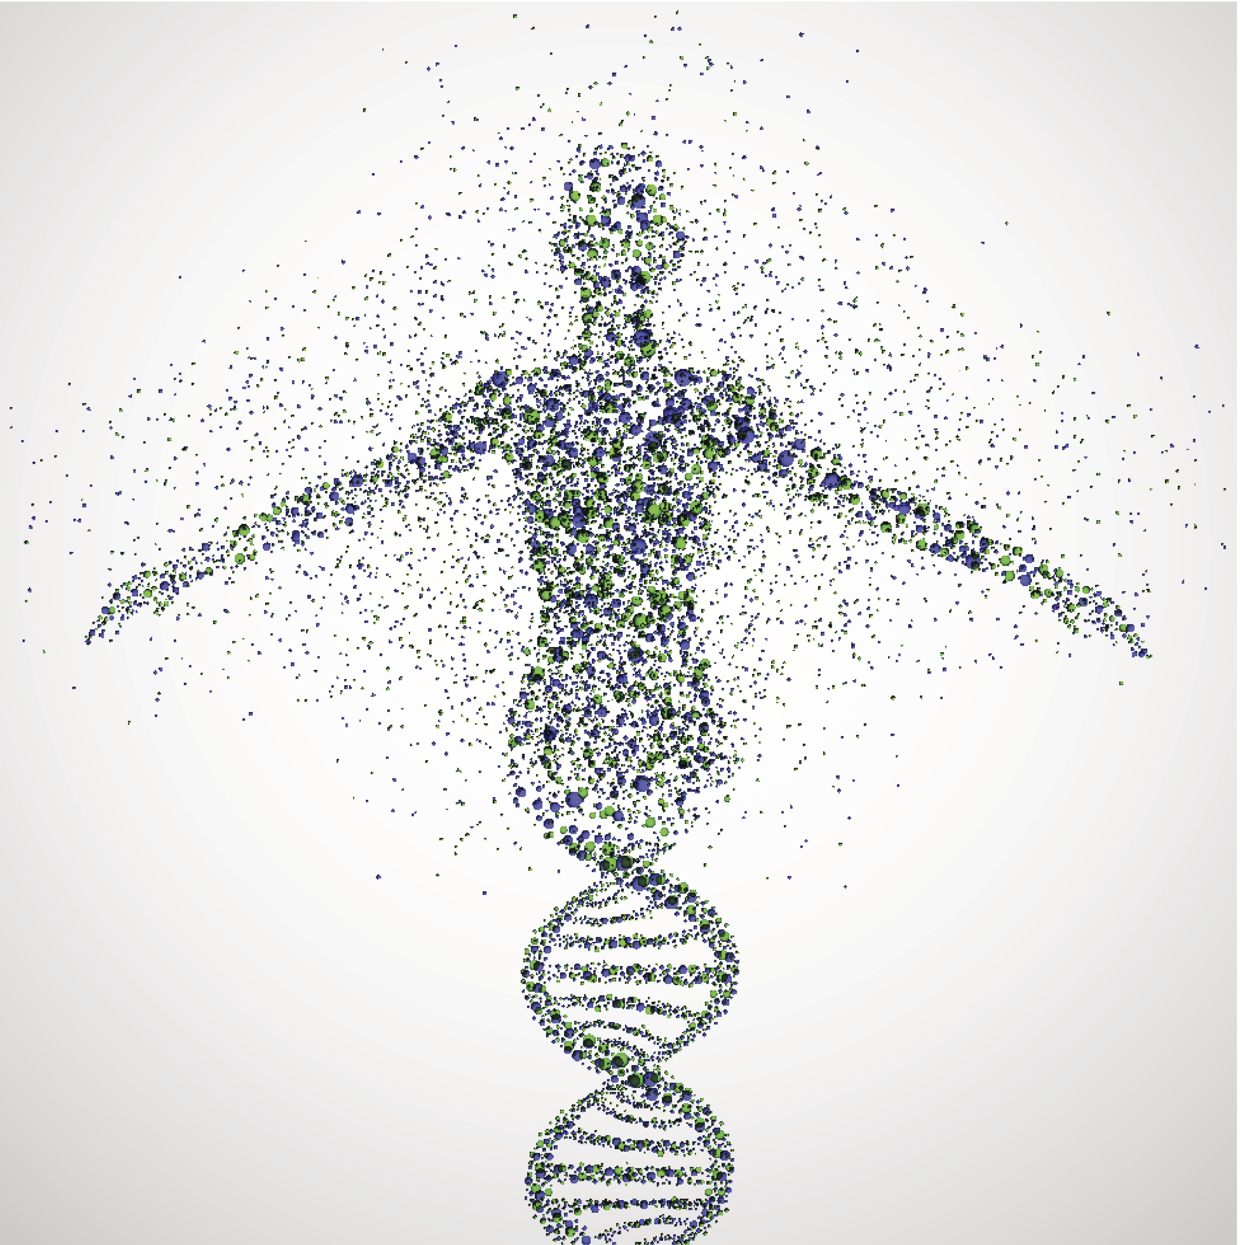
2000
- The human genome is successfully mapped. Scientists can now look for mistakes in human DNA.
2013
- Angelina Jolie gets a double mastectomy after it is discovered she has a fault in her DNA that could cause breast cancer.

Slide 9
Checkpoint: Can you describe the key events that led to the human genome being mapped?
Why is Rosalind Franklin important?
What did Watson and Crick do in 1953?
What is a genome?
What was the Human Genome Project?
By mapping the human genome, what can scientists now do?

Slide 10
Learning Task Two
Use the information on pp.104-105, as well as general knowledge to complete the following tasks.
Targets 7-4
For each of the below, explain the health problems and how it was different/similar from previous periods.
Targets 3-2
For each of the following, explain the health problems:
Smoking
Poor diet
Excessive alcohol use
Drug taking
Unprotected sex
Tanning (using sun beds)

Slide 11
Lifestyle | Effects | Difference from before
Smoking | Causes many problems like high blood pressure, cancer (lung, throat and mouth), heart disease, tooth decay. It is more dangerous to second hand smoke. Children exposed to cigarette smoke are more likely to develop asthma. | In the 1920s it became very popular and was associated with being young and free. Women smoked during this period to rebel. Cigarettes were often advertised on radio, in public and eventually on TV.
Poor diet | Doctors now recommend plenty of fresh fruits and vegetables and everything in moderation. Too much sugar can cause the body to develop Type 2 diabetes. Too much fat can lead to heart disease. Not getting the correct nutrients or not eating enough can cause problems | People have always linked diet to disease due to belief in Four Humours. During plague outbreaks, fresh fruit and veg was always recommended.
Alcohol | Drinking too much alcohol by binging or alcoholism can lead to liver disease and kidney problems
Drug taking | Diseases such as aids can be spread through drug taking, as well as addition and overdose. | Drug use has always been common, particularly in the 19th century with the use of opiates. Laws have become more strict and drugs more regulated.
Unprotected sex | STIs are very common amongst those who have regular unprotected sex. | Different from previous decades where diseases like syphilis were never linked to sex. In the 1960s and 1970s, unprotected sex was common amongst the youth with little knowledge of the impacts.
Tanning | Exposure to UV light on tanning beds can cause skin cancers. | Completely different as was not a problem prior to the 21st century.

Slide 12
Checkpoint:
What are Mendel’s ‘Fundamental Laws of Inheritance’?
How are beliefs about smoking different in the 20th Century?
How were beliefs about diet different in the 20th Century?

