Slide 1
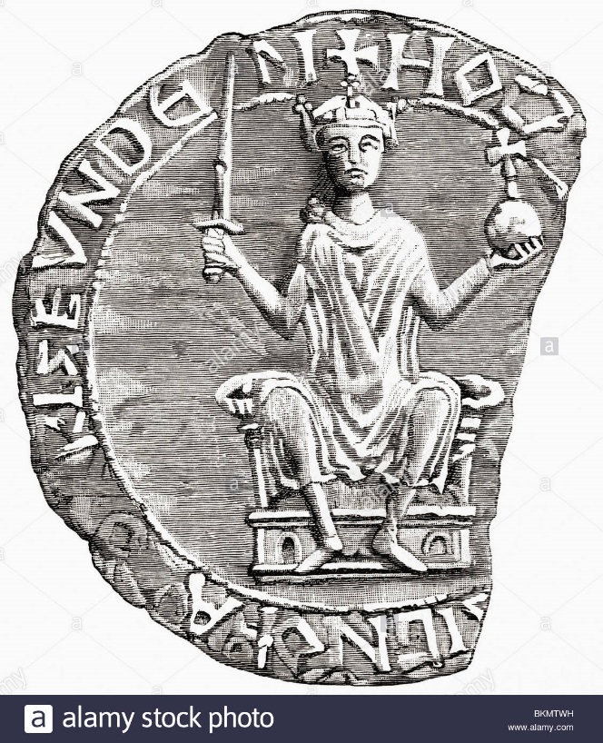
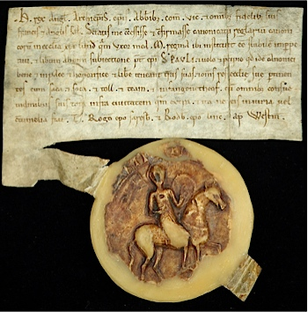
How did William use Forest Laws and Domesday to strengthen the crown?
Seal – used by William on all official documents. Acted like a signature. It shows him holding an orb, sword and crown – the three symbols of being a king.
Writ – an official document issued by the king. They were used to spread the king’s laws and messages.

Slide 2
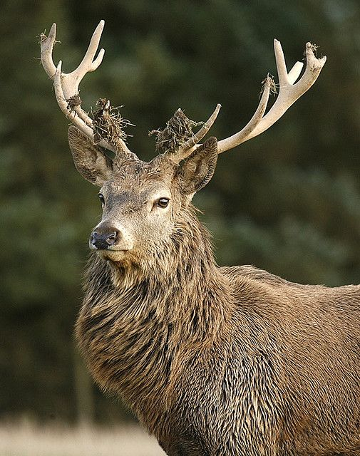
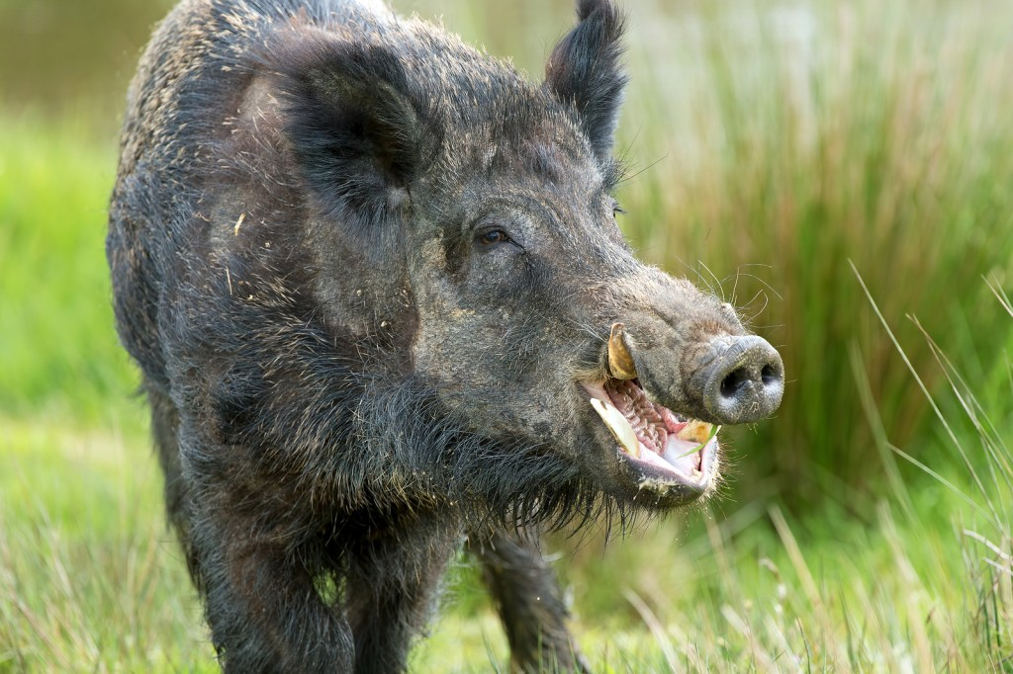
“The King preserved the harts and boars And loved the stags as much As if he were their father.” Anglo-Saxon Chronicle

Slide 3
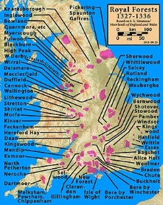
William’s ‘Forest Laws’
Before the Conquest the kings of England enjoyed the right to hunt freely on their own lands, but in this they did not differ significantly from any other landowner
18% of the land was royal demesne in 1086 – more than double that of Edward)
William had the opportunity to extend his hunting ground.
He effectively stole land from land owners for himself. Whole regions were conversed to “forests” – families were evicted.

Slide 4
 | Positive Effects | Negative Effects
Ordinary people who live in the forest
King William I of England

Slide 5
 | Positive Effects | Negative Effects
Ordinary people who live in the forest | Nothing! | As it was an offence to carry hunting weapons into forests it prevented families from eating. Prevented clearing woods and building in the forests so people had less of a choice where they could live Families were evicted from their homes if it was on royal forest land.
King William I of England | Gave him more land to hunt boar and stag. Protected his land from destruction so animals could would be healthier. Allowed him to control more land which enforced his rule of England. Strict laws for poaching reinforced his images as a strict leader. Would get richer through the fines imposed on breaking Forest Laws. | As he was basically taking land off Saxons, it justified Norman land grabs which would anger his subjects, could lead to rebellion.

Slide 6
The Domesday Book
Although being King for almost 20 years, William knew very little of the economic potential for his kingdom.
He feared that if there was a future invasion, how much money could he raise?
On Christmas Day 1085, William ordered a mass survey to be completed of England.
He wanted to know who held what land, what taxes they owed the king and whether they could pay anymore.
Crops, livestock, housing was taken account of – no one escaped William!
http://historyofliverpool.com/liverpool-domesday-book/

Slide 7
What can we learn from Domesday?
Total value of land in Domesday is about £73,000 a year.
Land had went up in value since 1066. Thaxted in Essex was worth £30 in 1066 and £60 in 1086.
Harrying of North had damaged land so badly that balue decreased by ¼ (described as waste in the book)
35% of land was used for crops, 25% for cattle, 15% was forest, 25% was “other”

Slide 8
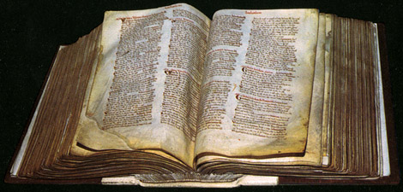
Watch and Learn
https://www.youtube.com/watch?v=om_BIzXaVwU

Slide 9
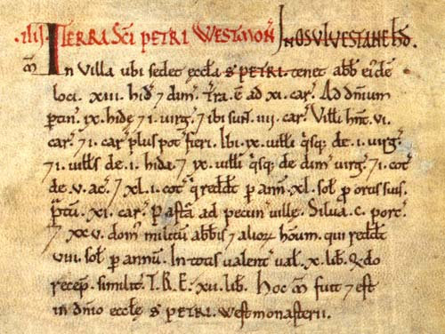

Slide 10
Learning Tasks
Create a flow diagram to show for the Domesday Book:
Why did it happen?
What was it?
What was the significance of it?
Target 4, 5, 6:
Complete tasks S1 and S2 on P.83
Go through your book and ensure all work is completed, titles underlined, handouts glued in etc.
Target 7,8,9
Complete tasks C1 and C2 on P.83
Go through your book and ensure all work is completed, titles underlined, handouts glued in etc.

Slide 11
Why?
What?
In 1085 William ordered a mass survey of his kingdom. He sent inspectors to all areas of his kingdom to report on landholdings, taxation even down to how many animals people owned. Completed by August 1086, it contained records for 13,418 settlements across the English kingdom.
William wanted to know the economic potential of his kingdom – was everyone paying their fair share of tax? Could it be increased?
William was worried of potential invasion threats from Vikings. He always had to bring in knights from Normandy for extra support. He wanted to see how many extra soldiers each tenant-in-chief could provide.
William was sick and tired of dealing with land disputes. He wanted to know exactly who owned what. He could this survey to deal with land disputes justly and fairly.
Significance?
After the survey was completely, there were several heavy geld taxes in 1086 – William must have become aware that some people were not paying as much as they could. It allowed William to gain a better understanding of his kingdom. He now knew exactly how many men he could raise in times of an invasion.

