Slide 1
How significant were Pasteur and Koch to the understanding of disease?
Starter: Complete the true or false task on medieval and renaissance medicine. If it is false – write the correct answer! Make sure you glue this into your book.
In this lesson we will:
Describe what both Pasteur and Koch contributed to medical understanding
Assess to what extent they transformed medicine in the 19th Century.

Slide 2
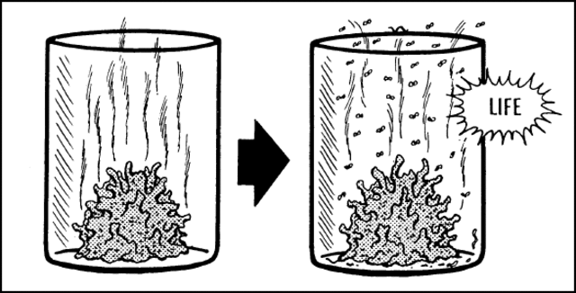
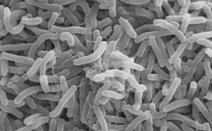
What did people believe caused disease by 1700?
Due to industrialisation and the health problems caused by this there was growing importance places on identifying the causes of disease.
The Four Humours had been rejected by the 18th Century and miasmic theory was starting to become less popular.
A new theory that had developed by 1700 was spontaneous generation. Due to new technology scientists could see microbes on decaying matter but believed it was a product of decay rather than the cause of it. They believed it was then spread by miasma.
It would not be until the 19th Century that scientist would begin to make solid links between these microbes and disease.
Two men would play their part – Louis Pasteur and Robert Koch
http://www.dailymotion.com/video/x11pe80

Slide 3
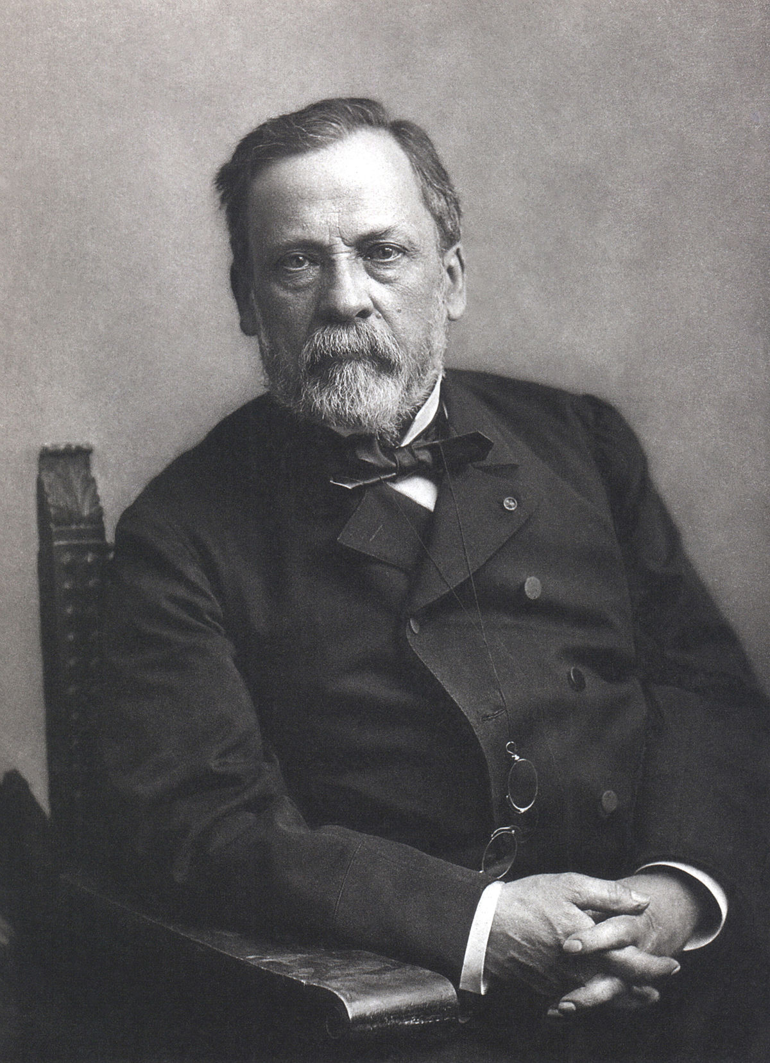
What did Louis Pasteur do?
Pasteur believed that it was microbes being carried on dust particles in the air that caused beer and wine to go sour.
To prove this, he designed an experiment using a ‘swan neck’ beaker. With this he proved that it is the air that carries microbes. He published his ‘Germ Theory’ in 1861.
His theory stated the following:
Microbes live in the air
Microbes cause decay
Microbes can be killed by heat

Slide 4
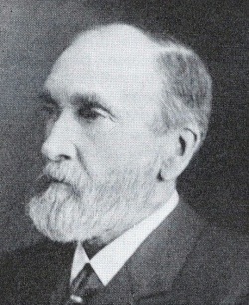
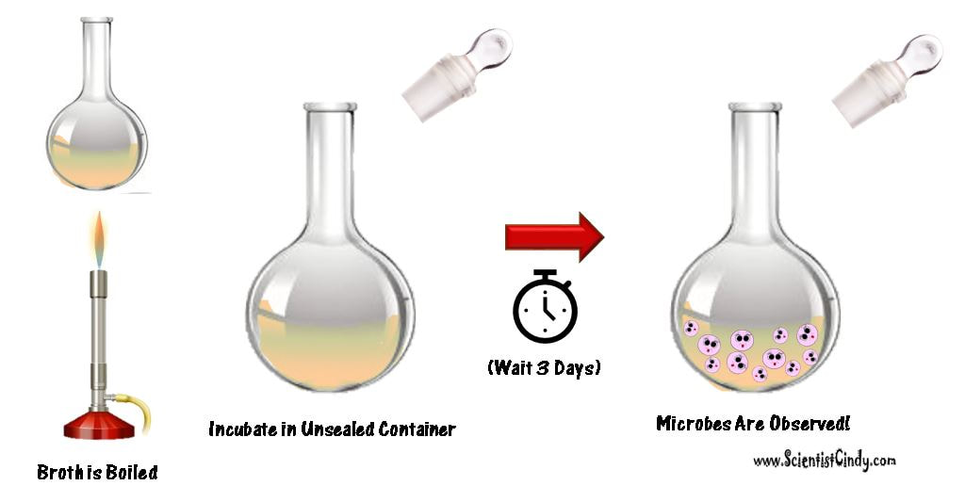
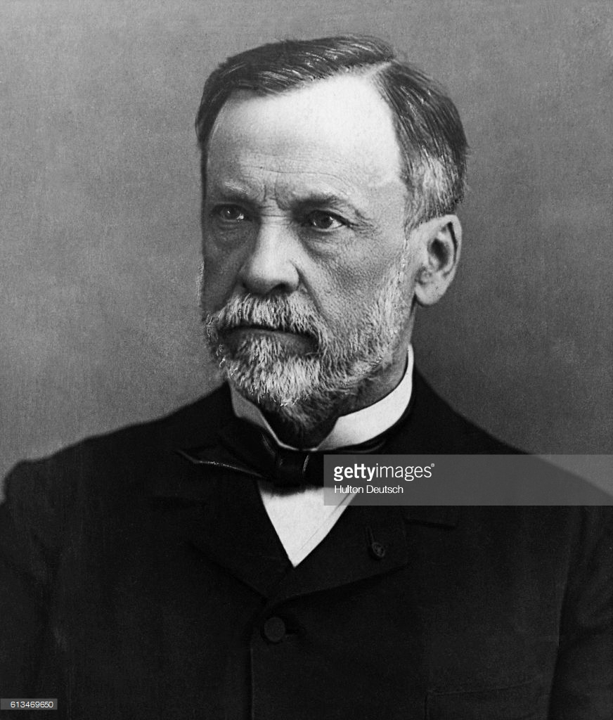
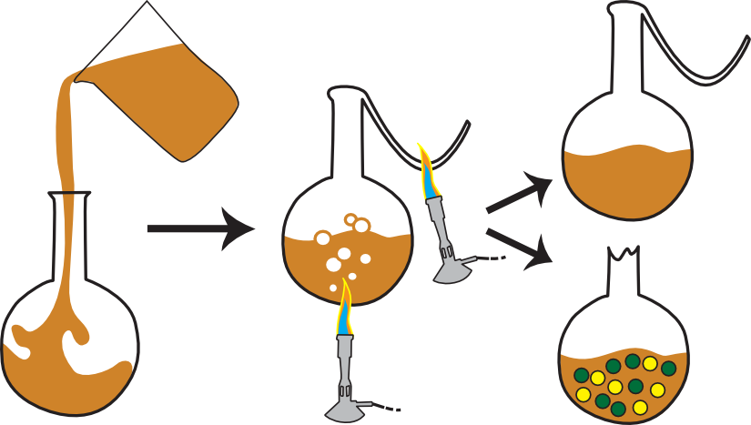
Dr Henry Bastian used this experiment to prove that germs “spontaneously” developed in matter.
Dr Louis Pasteur used his ‘swan neck’ experiment to prove that germs come from the air.

Slide 5
Learning Task One
On your worksheet, complete the tasks on the Swan Neck Experiment and the three principles of Germ theory.
When finished, go through and highlight/underline key words

Slide 6
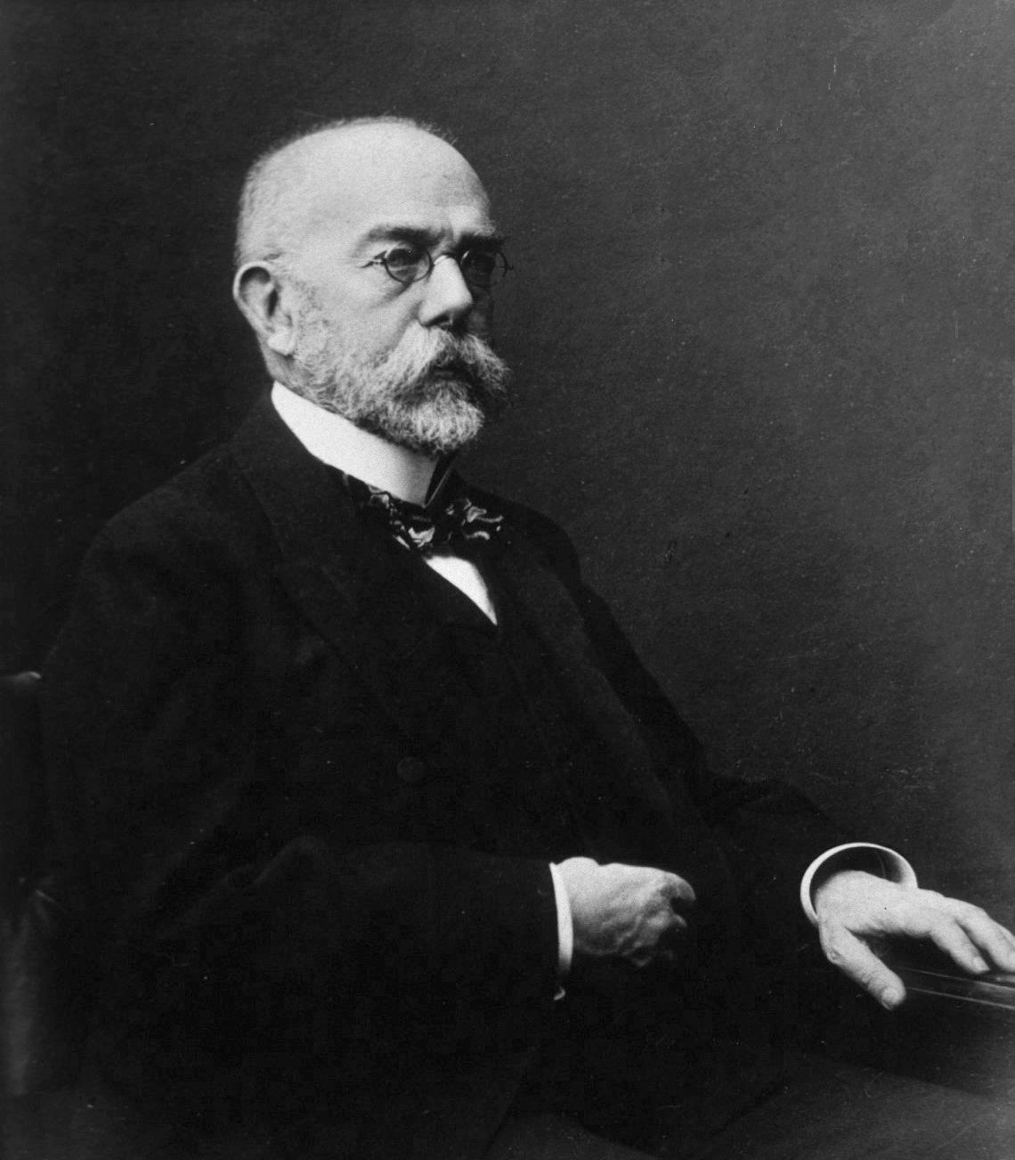
What impact did Robert Koch have?
German scientist Robert Koch built upon Pasteur’s theory and was the first to identify that different germs cause different diseases.
He discovered the bacteria that caused tuberculosis in 1882 and even developed new types of photographic lenses to take a picture of them and a special dye to stain microbes to make them easier to see under a microscope.
In 1883 using his 4 stage technique Koch discovered the germ cause of cholera. He followed this in 1884 by proving that this germ lived in drinking water in India. This supported what Dr John Snow had said back in 1854.
Koch published his methods that could be used to identify disease-causing microbes.

Slide 7
Learning Task Two
As a class, read through the information on p.71
Watch the below clip from the BBC.
You now have 5 minutes to write down 4 things Koch contributed to germ theory!

Slide 8
Checkpoint: Can you describe the contributions of Robert Koch and Louis Pasteur?
Your teacher will show you a picture. On your mini whiteboard, write down whether it relates to Koch, Pasteur or both!

Slide 9
It was in India where Robert Koch discovered the germ that causes cholera living in water!

Slide 10
It was coloured dyes that Robert Koch used to stain cultures to make them easy to spot under a microscrope

Slide 11
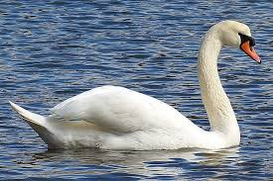
Louis Pasteur used a ‘swan neck’ beaker to disprove the idea of spontaneous generation in 1861.

Slide 12
Pasteur’s germ theory had a big influence on Dr Joseph Lister who linked it to infection after surgery.

Slide 13
Pasteur was French and it was the challenge set by the French Academy of Science in 1860 that led to him publishing his Germ Theory in 1861.

Slide 14
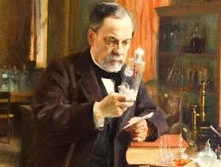
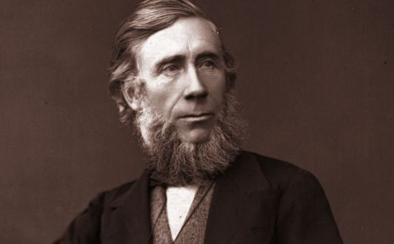
What impact did Pasteur have?
In Britain, Pasteur’s work was largely ignored! Most people continued to believe Dr Henry Bastian and spontaneous generation.
Some scientists built on Pasteur’s work e.g. Dr Joseph Lister applied Pasteur’s germ theory to infection wounds in surgery (antiseptic)
Dr John Tyndall applied germ theory to disease – in 1870 he gave a lecture which linked Pasteur’s work to Lister’s work.
However, most people doubted their work and continued to doubt germs caused disease or infection.

Slide 15
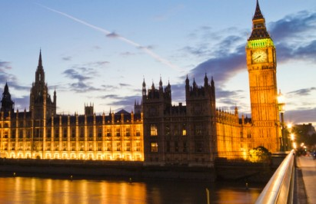
What impact did Koch have?
By identifying microbes which caused specific disease, Koch convinced many to believe in germ theory!
Scientists and doctors began to look for other germs using Koch’s work (e.g. 1883, diphtheria was found)
Governments refused to believe Koch’s work – in 1884 after he discovered the germ cause of cholera in water, the British government continued to promote the miasmic theory.
He paved the way for scientists and doctors to begin to look for new germs and vaccines to prevent them.

Slide 16
Learning Task Two
Targets 9 – 7
Use specific terminology
Provide 6 pieces of evidence to both support and counter the statement
Link to previous periods of medicine to show change or continuity.
Write the following statement down on a piece of paper.
“Individuals alone changed medical ideas in the 19th Century”
Below it, provide details to support it and counter it.
See the right for specifics on target criteria.
Targets 6 – 4
Try to use some key words
Provide 4 - 5 pieces of evidence to both support and counter the statement
Targets 3 – 1
Provide 3 pieces of evidence to both support and counter the statement

Slide 17
Checkpoint: Can you assess to what extent they transformed medicine in the 19th Century
Who is more important – Koch or Pasteur?
Justify your answer in one/two sentences

