Slide 1
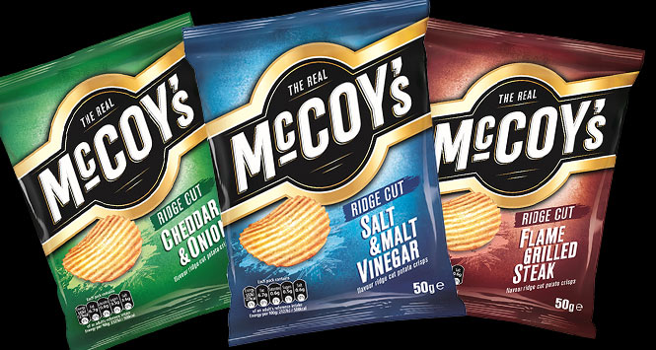
Why did open range cattle Ranching decline after 1870?
In this lesson, we will:
Explain why open range cattle ranching declined.
Starter: What do all these images have in common?
Challenge: For each, expand with subject knowledge!

Slide 2
Falling beef prices in the 1880’s
The success of cattle-ranching on the Great Plains
The Great Die Up 1866 - 67
Why did Cattle Ranching start to decline?
Other?
Introduction of Barbed Wire
The Wind Pump
Activity 4: Copy this diagram into your book (3 min)

Slide 3
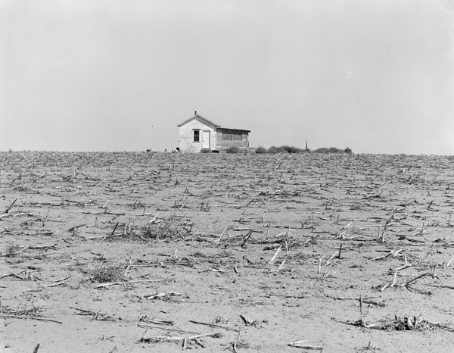
The success of cattle-ranching on the Plains
The success of cattle-ranching on the Plains led to more ranchers settling on the Plains. This increased the number of cattle and put pressure on the grass stocks leading to overgrazing.
A US Farm on the Great Plains / Mid West in the 1930s. Over grazing can lead to the top soil turning into sand and blowing away, as the grass which holds the soil together can’t reproduce fast enough.

Slide 4
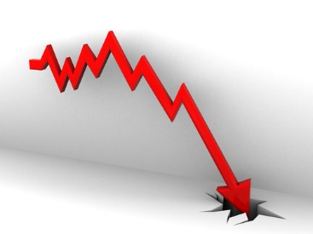
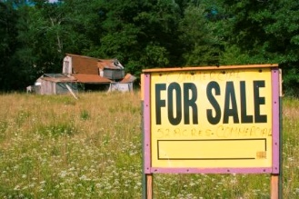
Falling beef prices in the 1880’s
Beef prices started failing in the 1880’s as it lost its popularity to other meats such as lamb.
Rather than sell their cattle at a low price, some ranchers kept them on the Plains. This increased pressure on the grass stocks even more. Some ranchers actually sold up.
Beef prices

Slide 5
The Great Die Up 1886-7
In spring 1886 there was a drought, followed by a scorching hot summer, reaching a temperature of up to 43°C.
This was followed by a winter storm in January 1887, in which the temperature dropped to -43°C.
Half the cattle on the plains died in a single year. As a result many cattle-men went bankrupt.

Slide 6
Introduction of Barbed Wire
More and more Homesteaders were coming onto the plains, and fencing off their farms with barbed wire, patented in 1874.
This prevented cattle from ranging on the open range.
The remaining cattlemen decided they had to do the same as it kept other cattle away from their grass, and cut labour costs – less cowboys were needed as animals were less likely to stray from the ranch.

Slide 7
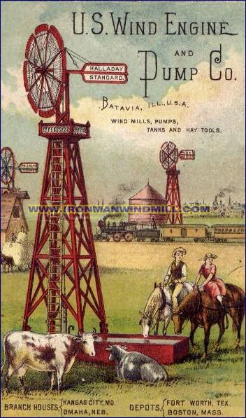
The development of the wind pump
The development of the wind pump allowed more land to be used for both cattle ranching and farming.
They pumped water from deep underground and removed the need to have a river or stream running through the ranch
This invention encouraged smaller cattle ranchers to set up as well as mark out their boundaries with barbed wire.
The extra cattle put increased pressure on the grass stocks and helped to lower the market value of beef even further forcing even more ranches to go bankrupt.
=
Beef prices

Slide 8
Falling beef prices in the 1880’s
The success of cattle-ranching on the Great Plains
The Great Die Up 1866 - 67
Why did Cattle Ranching start to decline?
Other?
Introduction of Barbed Wire
The Wind Pump
Now for each, explain how it led to cattle ranching declining!

Slide 9
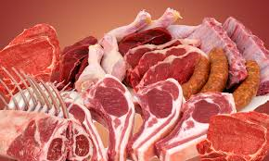
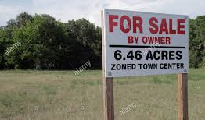
What impact did the end of open ranging have?
Cattle barons were largely put of business, as they lost a lot of land.
Meat quality actually improved, due to selective breeding and better diet.
The life of cowboys became much less exciting.
Cow towns like Abilene became much less important

