Slide 1
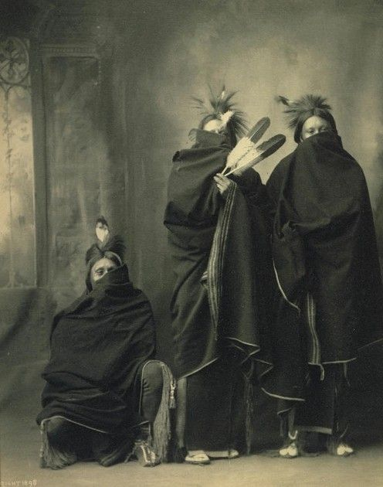
Starter: What is the story behind this image?
Many tribes believed that photograph would steal their soul – these young Cherokee Indians are covering their faces to avoid this happening!

Slide 2
Native Americans: Culture and Society

Slide 3
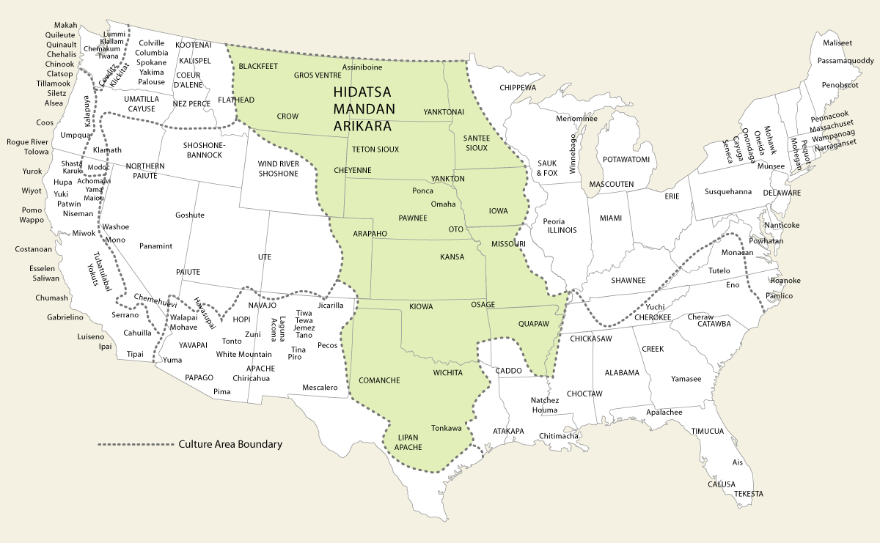

Slide 4
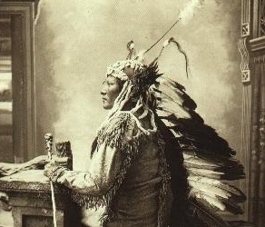
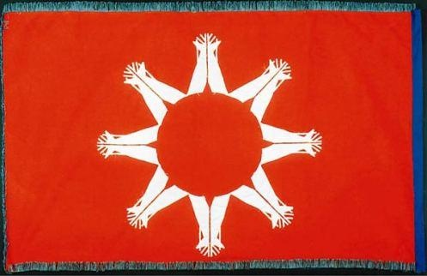
Lakota
Oglala
Sicangu
Hunkpapa
Miniconjous
Blackfeet
Itazipacola
Sioux Nation
Nakota
Yankton
Upper Yankton
Lower Yankton
Mdeakantonwon
Wahpeton
Wahpekute
Sisseton
Dakota

Slide 5
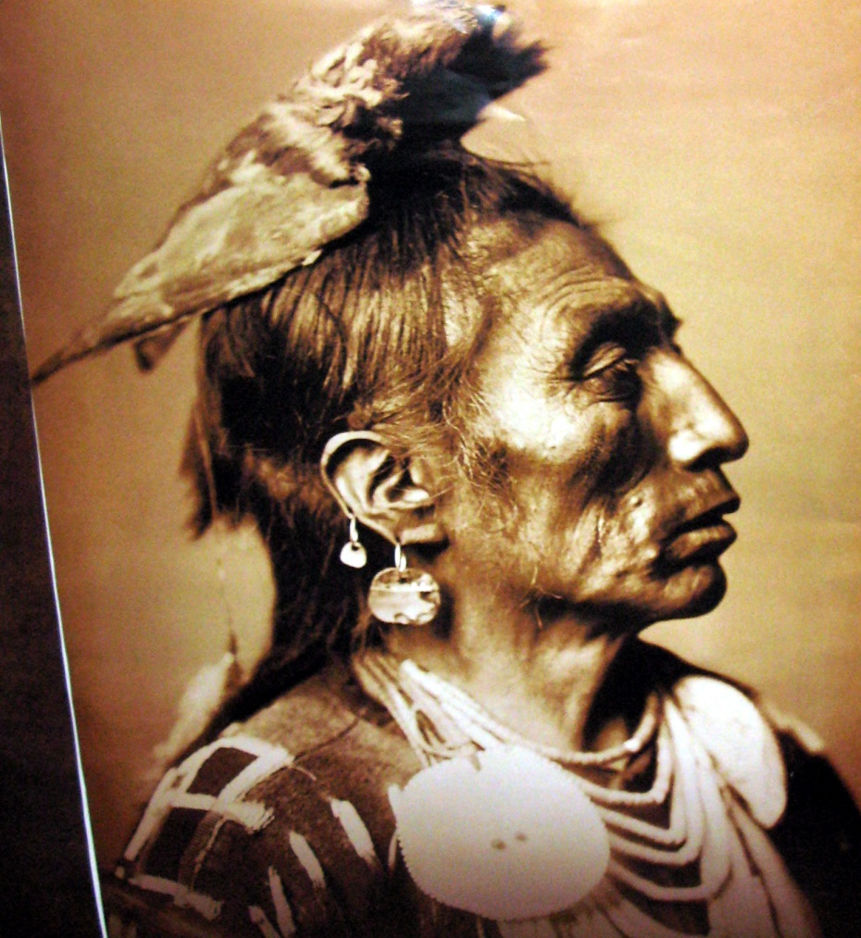
Nomadic movement
Tribes were nomadic – they never stayed in the once place and moved around the Great Plains 6-8 times per year.
The reasons behind this were:
The Great Plains would not support their way of life in any one place for long, they had to follow buffalo migration.
They believed the Great Spirit wanted them to live in a life on continual movment.

Slide 6
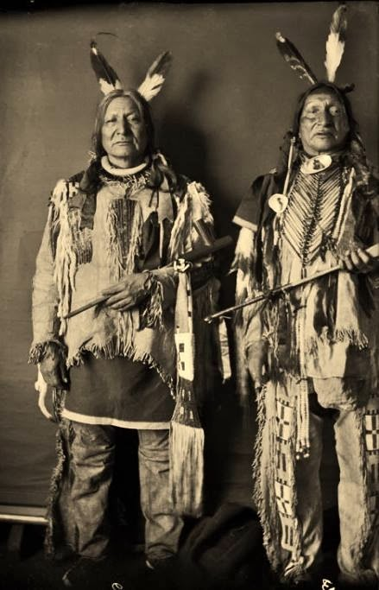
The Native Family
Due to the need to care for women and children, marriage was easy.
At 17, a youth paid a dowry of horses and took his bride (ages 12-15)
Family was a large part of Native American culture, and everyone had great respect for their elders.
Elder tribesmen were seen to very wise and full of experience that could be passed on to Youngers.
The younger members of the tribe were strictly disciplined not only in war, but also in values.
Practices polygamy (men had more then one wife)

Slide 7
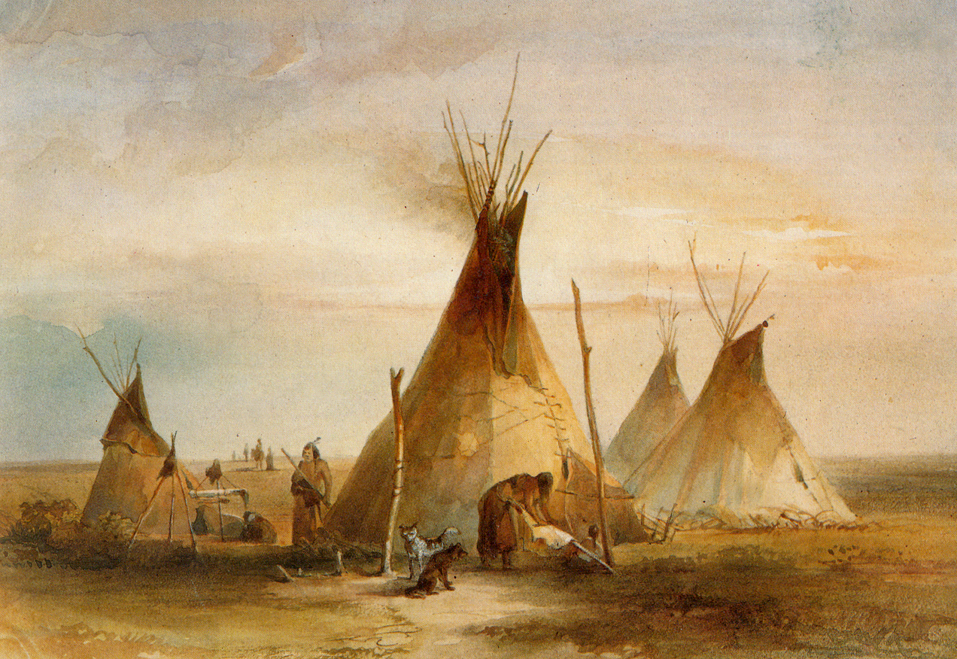
Housing
Native Americans lived in small tents called tipis – these always made using the skin from the buffalo.
Tipis were warm in the winter and cool in the summer so they were perfect for the harsh conditions of living in the Great Plains.
The shape of them is designed so be perfect at protecting the Native Americans against the winds. The reason that they are round is because Native Americans believe “the power of the world works in circles”.
Tipis worked well for the Plains Indians because they were easy to dismantle and transport when following the buffalo.

Slide 8
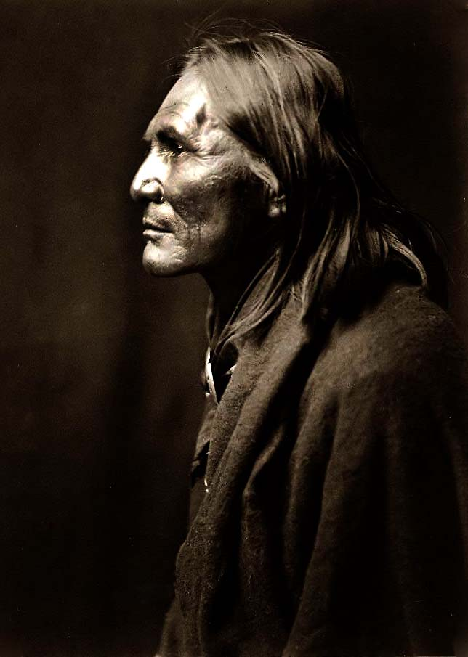
Tasks
Create a spider diagram to detail notes on the following areas:
Chiefs
Warrior brotherhoods
Role of women
Use of the buffalo
Use of horses
Tipis
For each area, perhaps using a different coloured pen, explain how it would help tribes survive on the Great Plains.

Slide 9
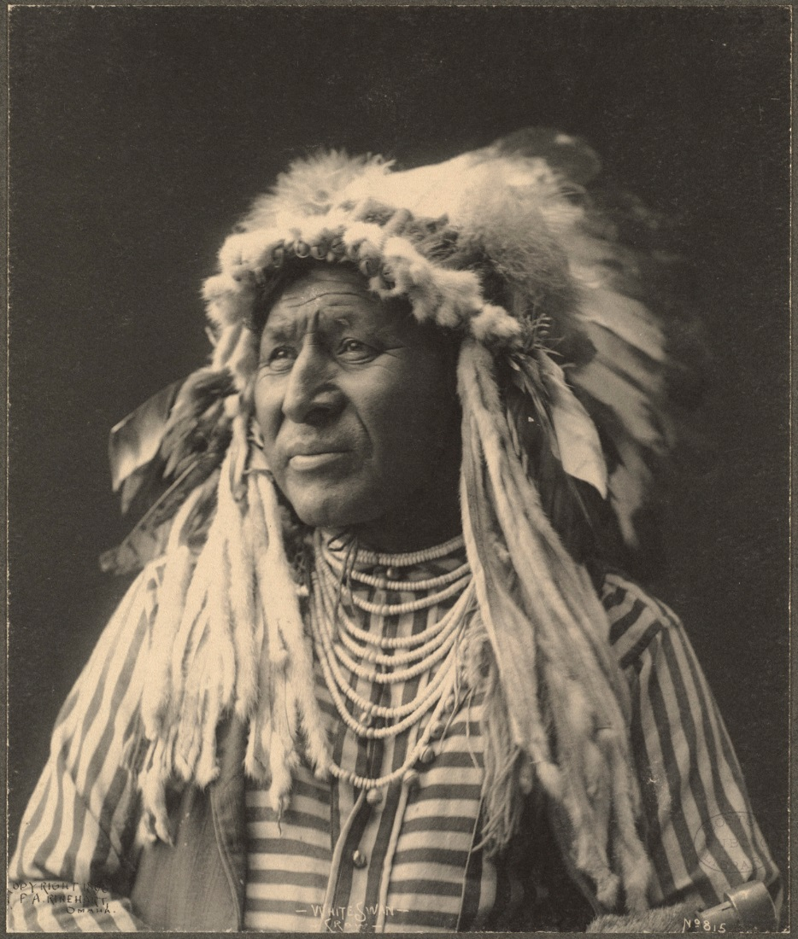
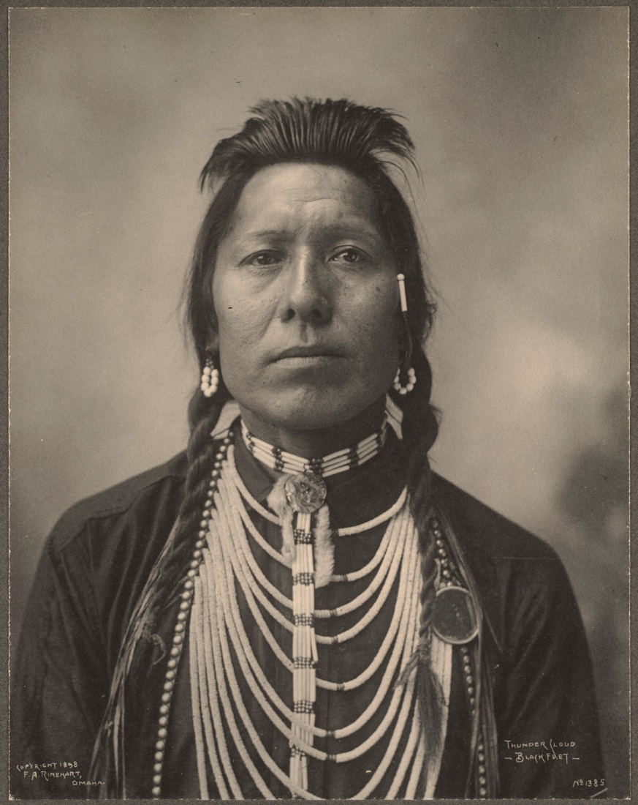

Slide 10
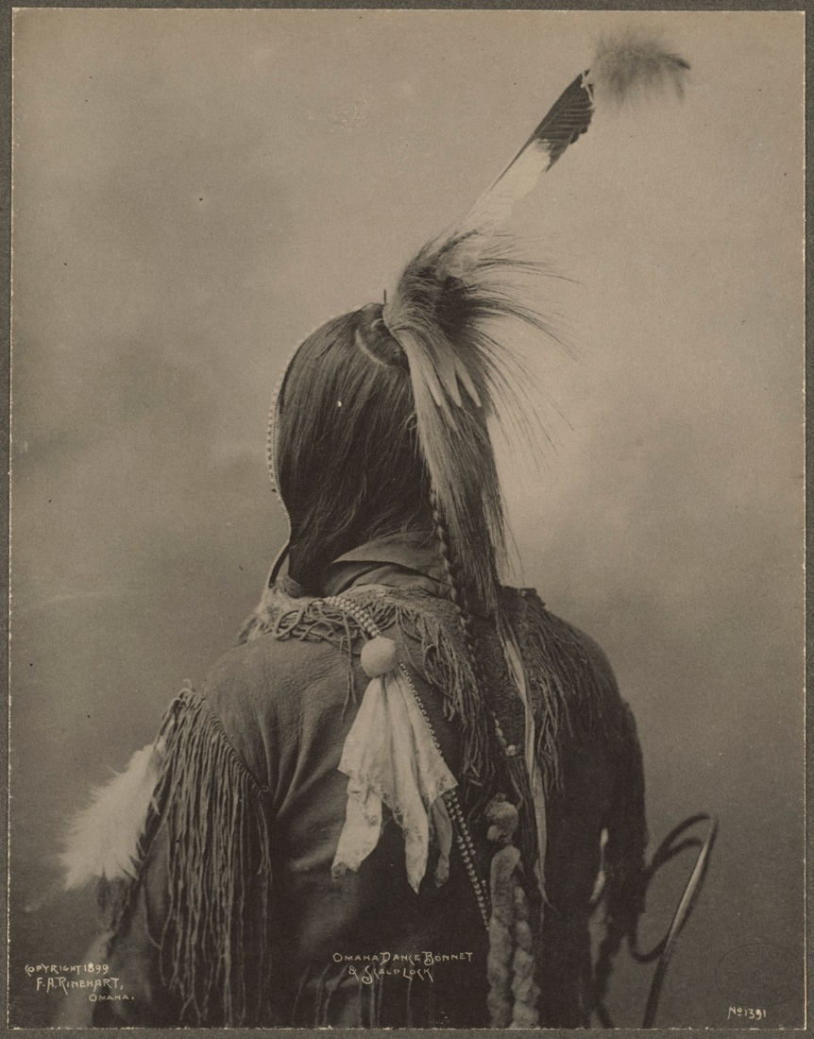
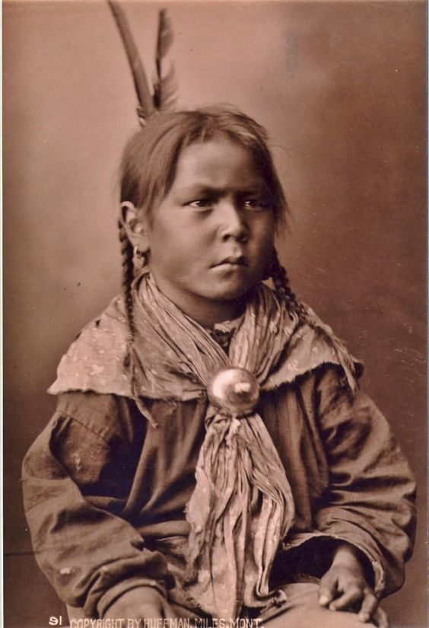

Slide 11
Chiefs
Use of horses
Role of women
Leaders of the tribe, always men. Tribe could have many chiefs e.g. War, Spiritual, negotiator etc. Europeans found this system strange because:
No system for choosing a chief – valued because of wisdom, never chief for life.
Everyone could give their opinion in the council. No decision was made until everyone agreed to it.
Chiefs had no power to command their people. Bands made their own decisions.
Essential to Indians as they needed them to hunt and travel. Wealth was determined by how many horses you had. They would often raid other tribes or white settles for horses. 1870s - Hunkpapa (2,900), Comanche (8,000).
Men could have more than one wife (polygamy). Responsible for feeding and clothing their families. They also were responsible for processing hides and meat, turning them into products that could be traded. They were valued highly.
This would help them survive as it meant the tribe always had the equipment and supplies needed to survive e.g. clothing, hides etc.
This would help them survive as it meant they could catch the buffalo for food and supplies. It also gave them an advantage during battles. Finally it meant they could follow the buffalo herds and move around the Plains.
Use of buffalo
How did the Native Americans survive on the Great Plains?
Buffalo were seen as spiritual animal due to how it helped them survive. They would kill only enough to feed the tribe during a hunt. All parts of the animal were used except the heart, which was left on the plains to give new life to the herd. The raw hide made bags, shields, whereas the tanned hide made the tipis. Dung was used for fuel, horns for arrow heads and the fur for blankets and saddle covers.
This would help them survive as it meant they had leadership and someone to represent them during negotiations with Europeans.
Warrior Brotherhoods
This would help them survive as it meant the tribe always had the equipment and supplies needed to survive. Shelter and blankets to keep warm. Fires to cook food and stay warm. Weaponry to fight and hunt.
Tribes had several; men joined after proving bravery and skill in fighting. Examples include White Horse Riders, the Strong Hearts, the Crow Owners. They would teach young men to fight, about the beliefs and values of the tribe. They also led the buffalo hunts.
Tipis
These always made using the skin from the buffalo. Tipis were warm in the winter and cool in the summer so they were perfect for the harsh conditions of living in the Great Plains. The shape of them is designed so be perfect at protecting the Native Americans against the winds.
This would help them survive because they were easy to dismantle and transport when following the buffalo. They would keep them protected on the harshness of the Great Plains
This would help them survive as it meant they had warriors with the skills to defend the tribe against enemies. It also meant that young members of the tribe respected their values, which would keep them unified and strong. As they led the buffalo hunt it meant all members of the tribe would be able to eat and have access to supplies needed to survive.

