Slide 1
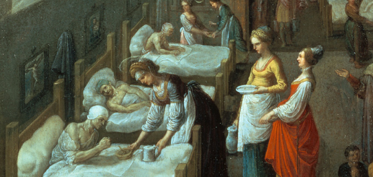
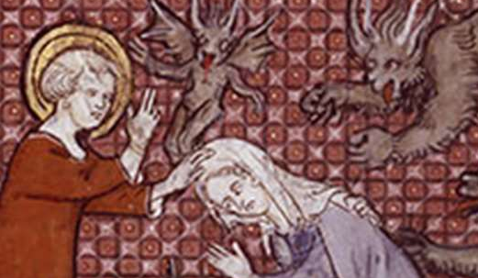
What did people in the medieval period believe about illness?
In this lesson, we will:
Describe medieval beliefs about illness, including the Four Humours and the occult.
Explain why classical thinking dominated medicine during the Middle Ages.
Starter: Remember back to Y9 history; what were the Four Humours?
Challenge: Can you explain how this theory worked?

Slide 2
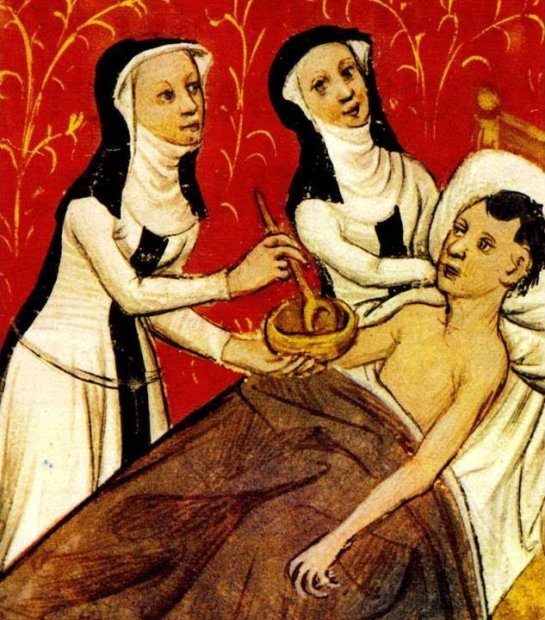
Religious explanations for disease
In Medieval England, people were very religious – every month they would pay some money to the Church to help care for the sick (a tithe)
Church used religion to answer people’s questions on illness.
It was taught that those who committed a sin could be punished by God through disease (e.g. leprosy)
God could also use disease to test someone’s faith (e.g. Job in the Bible)
If someone recovered, the Church would declare that a miracle had happened – they used it to prove God existed.

Slide 3
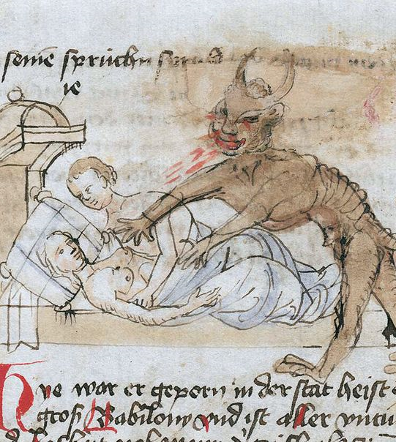
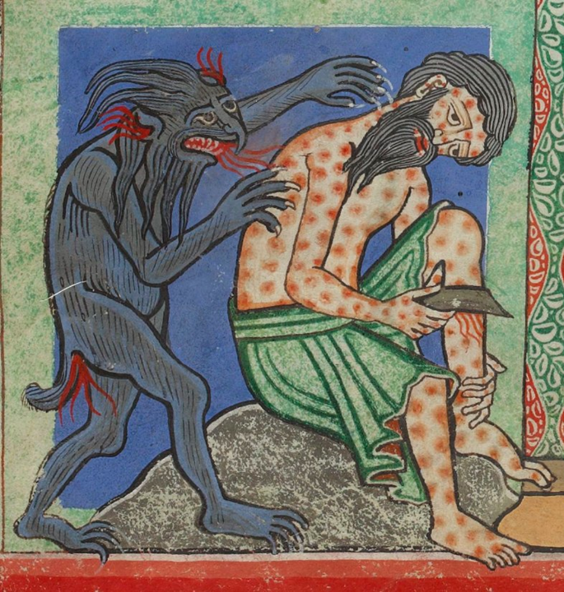

Slide 4
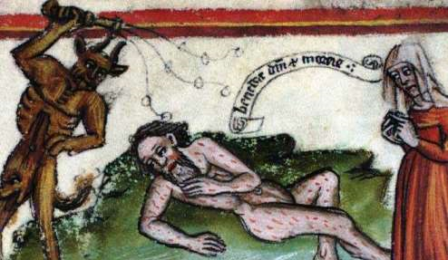

Slide 5
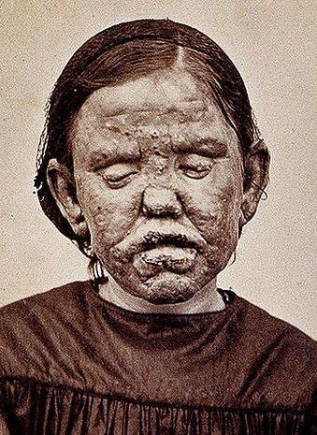
Disease case study: leprosy
Leprosy is an example of a disease that the Bible says was punishment from God.
Symptoms include a painful skin disease, followed by paralysis and then death. Fingers and toes often dropped off, hair would fall out and the skin would cover in ulcers.
They were often banished to isolated communities, far away from the public. It was believed their breath was contagious.
Those who did stay had to wear a cloak and ring a bell to inform people they were close.

Slide 6
Learning Task: One
On your worksheet, for each emoji identify the cause of illness and an explanation about it. Use the information pp.13-15!
 | Cause of illness | Explanation

Slide 7
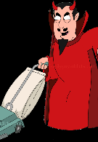
 | Cause of illness | Explanation
 | God | Church used religion to answer the questions people had about disease. They taught that those who were sinful would be punished by God – one punishment could be leprosy. When people recovered, the Church declared that a miracle had happened thanks to prayer. God could send disease to cleanse the soul of sin. If you became ill. God could be trying to purify your soul or test your faith.
 | Devil/evil spirits | The Devil was often held responsible for sending diseases to people. The bible told the story of Job – who was infected by Satan to test whether or not he was really faithful to God.
 | Astrology | The alignment of planets and stars was also considered by physicians to diagnose illness. They would look at star charts, looking at when they were born, when they fell ill etc. The Church didn’t support this, as it was close to predicting the future. Some even believed the plague was caused by bad alignment of planets.

Slide 8
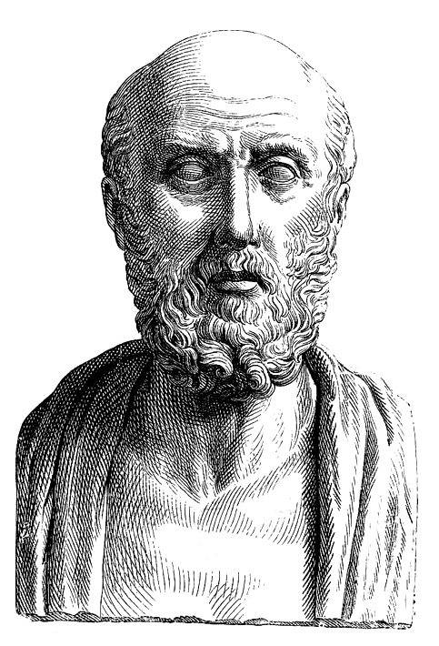
Hippocrates and the Four Humours
In Ancient Greece, the very wealthy were propped up by the poor, slaves and merchants. Meaning they had a lot of free time on their hands to think and observing the natural world.
One of these was Hippocrates – his first idea was clinical observation, diagnosis, prognosis. Important because it showed that diseases had a natural cause.
He also noted that when people got sick, they had one of four fluids coming out of their body. He came to believe that illness was caused by an inbalance of these humours (Greek word for fluid).
These were – blood, phlegm, black bile (diarrhoea) and yellow bile (vomit).

Slide 9
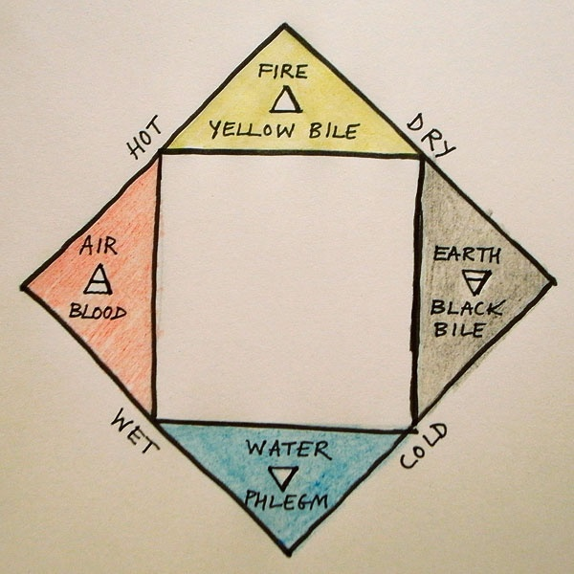
Summer
Spring
Autumn
Winter

Slide 10
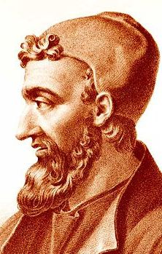
How did Galen build on these ideas?
300 years after Hippocrates, a Roman Physician known as Galen developed Hippocratic medicine further.
He had been a physician at gladiator training and was the personal physician for Roman Emperor Severus.
He had lots of time to experiment (dissecting the corpses of criminals and monkeys), ponder philosophy and write.
He came up with the Theory of Opposites – a way of balancing the humours.
After the collapse of the Roman Empire, the Christian Church accepted and promoted Galen’s ideas because it promoted the idea of God.
He famously argued: "human body perfect must be designed by god"

Slide 11
Start of Medieval period
End of medieval period
460BC – 370BC
129AD – 210AD
400AD
1400AD
Hippocrates’s ideas were still being used 1,800 years later. In fact they were already 800 years old by the time the Middle Ages began.
(That would be like you being treated with the same methods as the year 210AD)

Slide 12
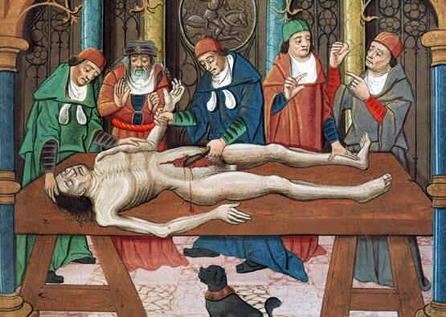
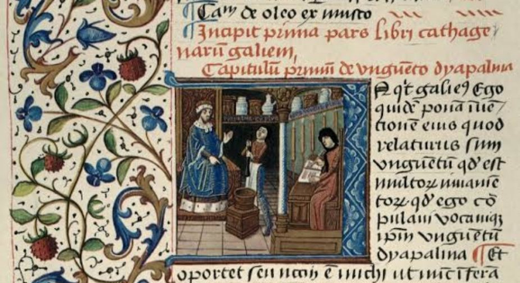
The Role of the Church
Books were produced by Christian monasteries and all libraries were controlled by the Church. Medical training was also run by the church so they controlled all circulation of medical ideas.
The Church made dissections mostly illegal during this period (the body had to be buried whole to enter heaven).
Vivisections were allowed on criminals however the physician had to sit far away and read the works of Galen whilst a lesser trained Barber Surgeon performed the examination.
This meant Galen’s ideas were maintained – anything that went against it was explained as being because they were a criminal and imperfect.

Slide 13
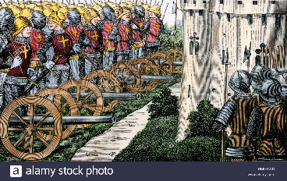
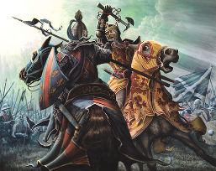
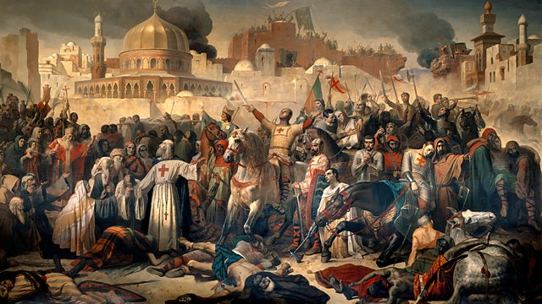
There was also lack of knowledge!
There was a general lack of scientific understanding, so new knowledge was very limited.
The huge amount of conflict in the world at this time disrupted communication and learning (e.g. Scottish Wars of Independence, the Crusades, the Hundred Years War etc)
Rather than explore new ideas, physicians and students generally tended to make new discoveries fit within old theories (this explains why Guy de Chaulliac , although performing a high amount of dissections still continued to use Galen’s ideas)

Slide 14
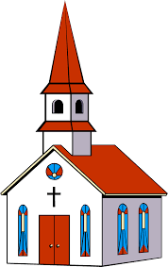
Learning Task: Two
Draw these small emoji's below.
For each, identify what they mean.
With this, answer the following exam question:
“Explain why the classic texts were still used in medicine between 1250 and 1500.” [12 marks]

Slide 15
Dissections were banned because the Church taught the body had to be buried while to enter heaven. This meant surgeons could not test to see if Galen’s ideas were true or not.
Sometimes dissections were carried out on known criminals (known as vivisection). However, the physician would stand far away and would read from Galen’s book whilst barber surgeons cut the body. This meant anything in the body that disagreed with Galen was explained by saying the criminals were imperfect.

Slide 16
The Church supported Galen’s ideas because they said that the body was designed by God and that the soul existed. This meant no one would challenge Galen’s ideas, as it may anger the Church and God.
The Church controlled all libraries, and all books were written by the Church. This meant only Galen’s ideas were printed, so no one could access new ideas.
The Church controlled all university training, so everyone was being taught Galen’s ideas.

Slide 17
People would only go to doctors who had read widely, which meant people were only being treated by Galen’s ideas.
Because the Church supported these ideas, people only read Galen’s work.

